Slide 1
DART 230/430
Integrity

Slide 2
How to succeed in digital arts (or in life itself)
Rule #1: Hands on the keyboard for coding exercises. This means you can work together (“Is that a colon or a semi-colon?) but nothing gets copied electronically.
Rule #2: Tests on paper are there to see what you can carry in your brain. Anyone can look it up in Wikipedia or the W3schools.
Rule #3: Use ordered lists.

Slide 3
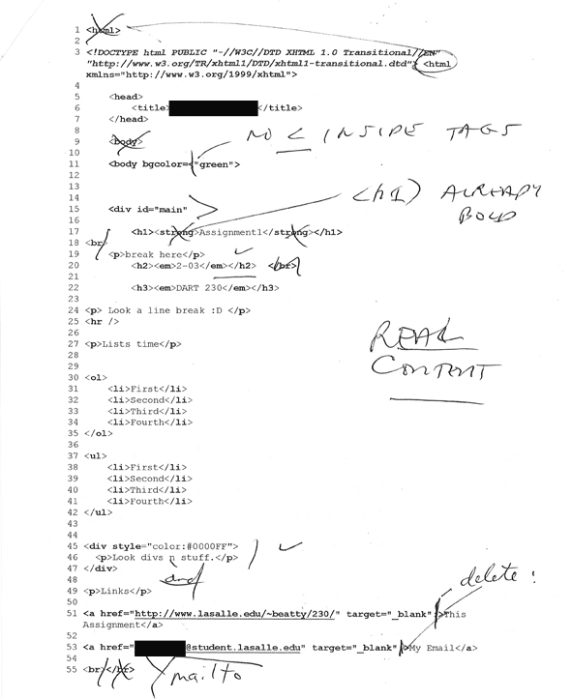
Code #1
Notice my comments

Slide 4
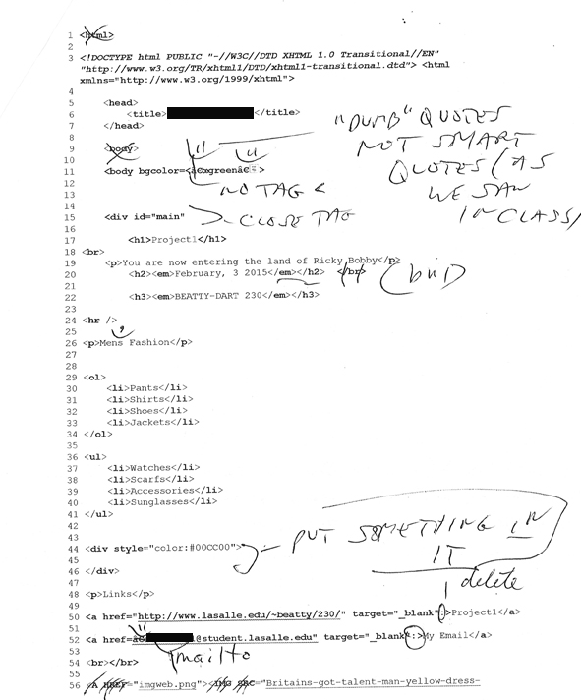
Code #2
Notice my comments

Slide 5
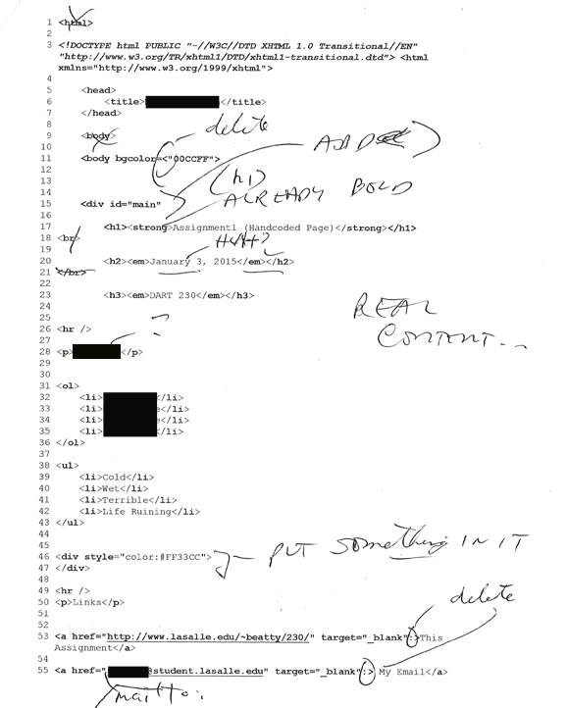
Code #3
Notice my comments

Slide 6
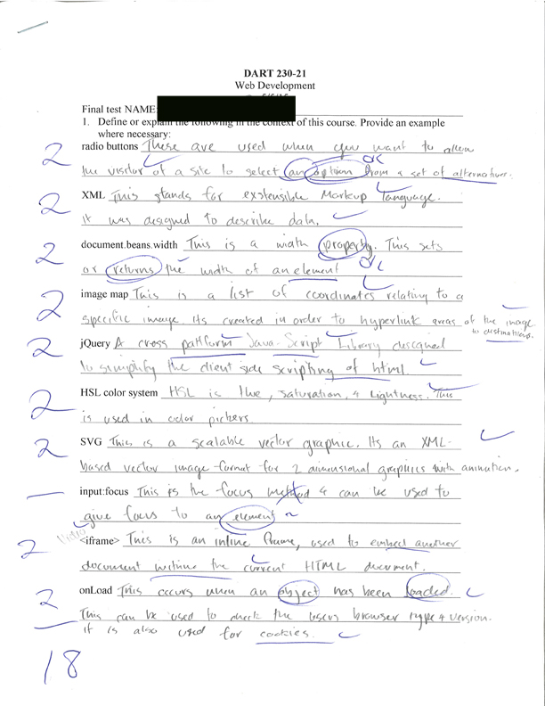
Test #1
Notice the language, e.g. For jQuery.

Slide 7
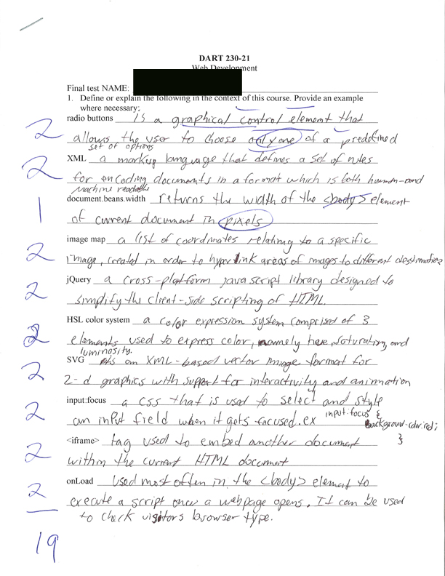
Test #2
Notice the language

Slide 8
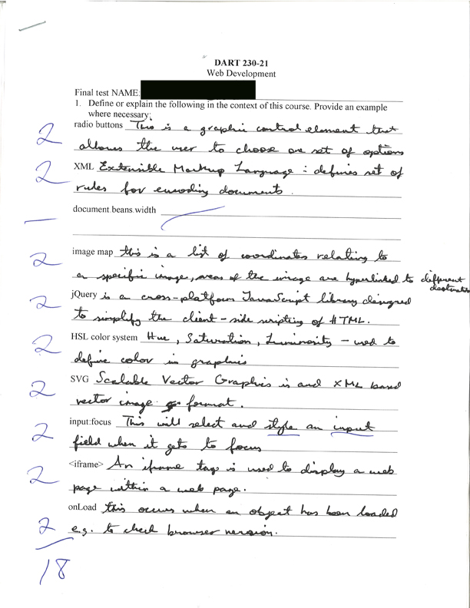
Test #3
Notice the language

Slide 9
Lessons
Digital environments are built on shared code; that’s what makes it too tempting to share work
You can fool some of the people some of the time …
A class is not a workplace for a reason: you need to learn the processes involved in understanding and creating code. If you needed to solve a problem on the job, it probably wouldn’t matter where the code came from (as long as it was free of copyright/royalty constraints)
You should want to learn this stuff—see if you can get things to work. If you don’t, this might not be the right environment

