Slide 1
R: fitting to an exponential fit using log-linear approach

Slide 2
Data from on how air pressure depends on altitude
Altitude (miles) | Pressure (psi)
0 | 14.696
1.708712 | 11.022
3.409091 | 7.348
5.204545 | 4.898177
10.02386 | 1.4696
19.20095 | 0.14696
30.1161 | 0.014696
43.16269 | 0.00147
53.61288 | 0.000147

Slide 3
Plot with Exponential fit from Excel

Slide 4
Enter the data into R
#copy and paste
altitude = c(0, 1.7087, 3.4091, 5.2045, 10.0239, 19.2010,
30.1161, 43.1627, 53.6129)
pressure = c(14.696, 11.022, 7.348, 4.8982, 1.4696,
0.14696, 0.014696, 0.00147, 0.000147)

Slide 5
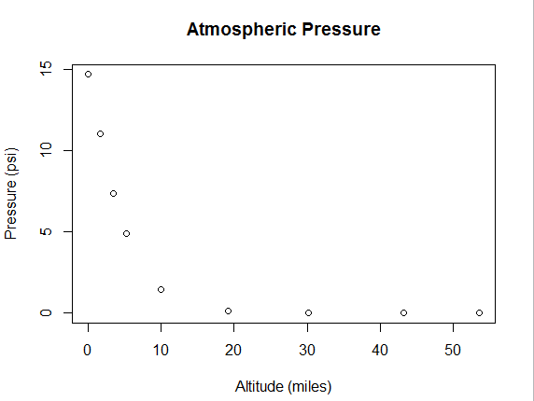
Plotting the data in R

Slide 6
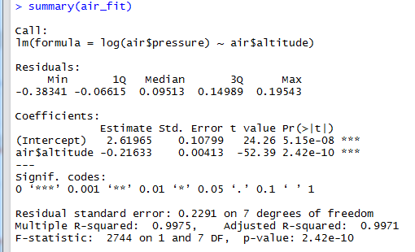
Compared to the log-log approach to obtain a power-law fit, this time take log-linear approach: log(y) but not log(x) and obtain an exponential fit
Only one log this time!
Once again the “slope” number looks familiar when compared to what we got from Excel

Slide 7
Cannot take log(0)
In this data x=0 is perfectly fine, but y=0 is not.
That is why if one gets the axes wrong, the exponential fit would not work.

Slide 8
Isolating the factor

Slide 9
Determining the coefficient

Slide 10
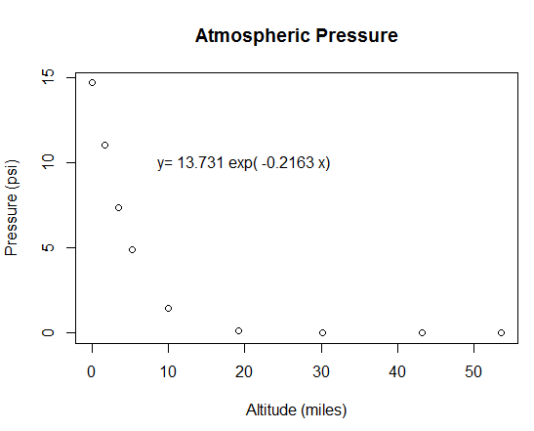
Displaying the equation

Slide 11
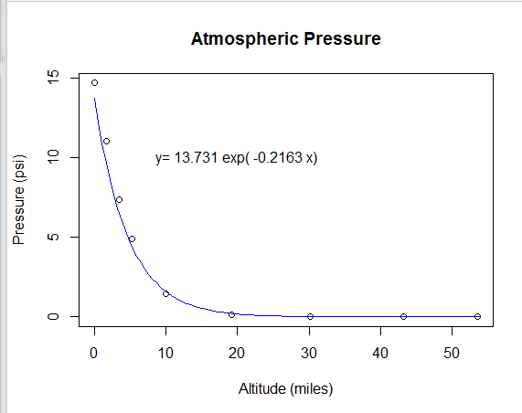
Displaying the curve

