Slide 1
Excel: Random Walk Simulation

Slide 2
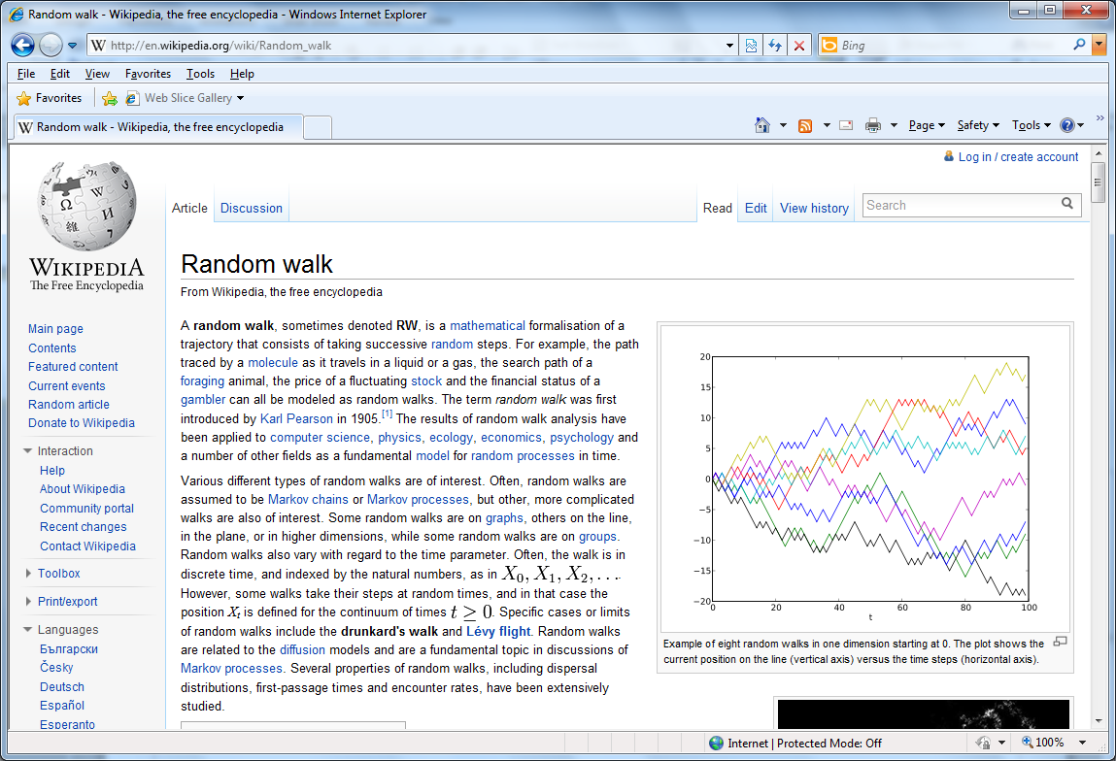
A “random walker” takes a path each step of which is chosen at random.

Slide 3
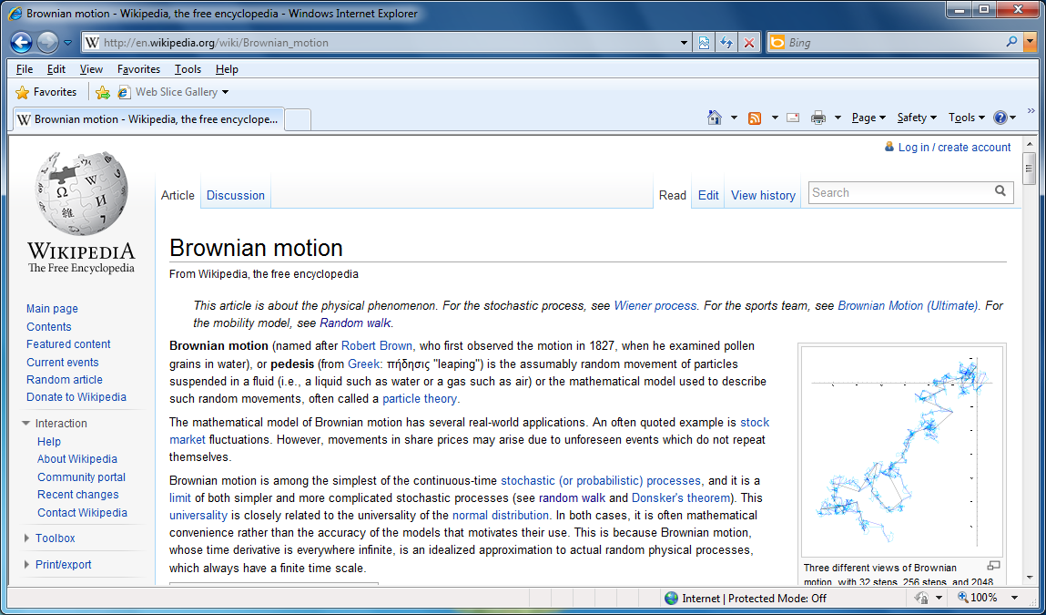
A random walk is a model for Brownian motion

Slide 4
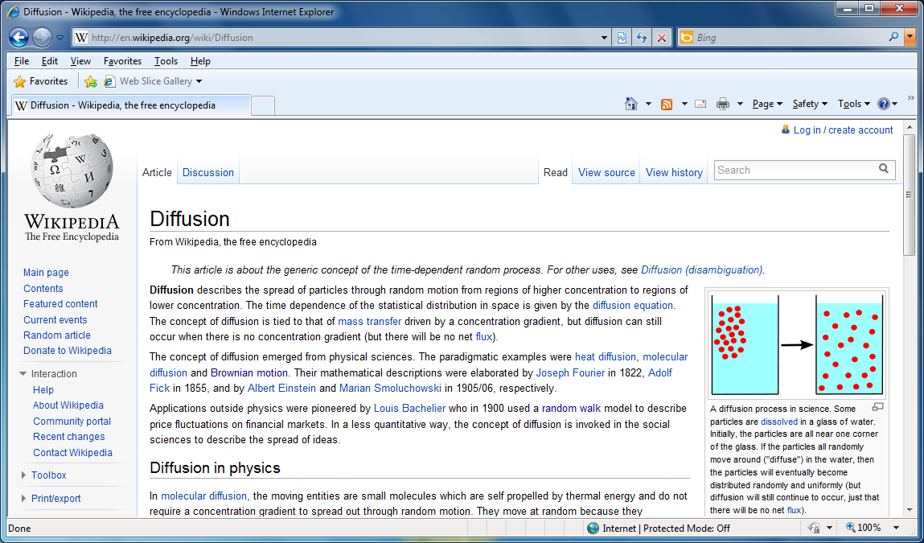
And diffusion

Slide 5
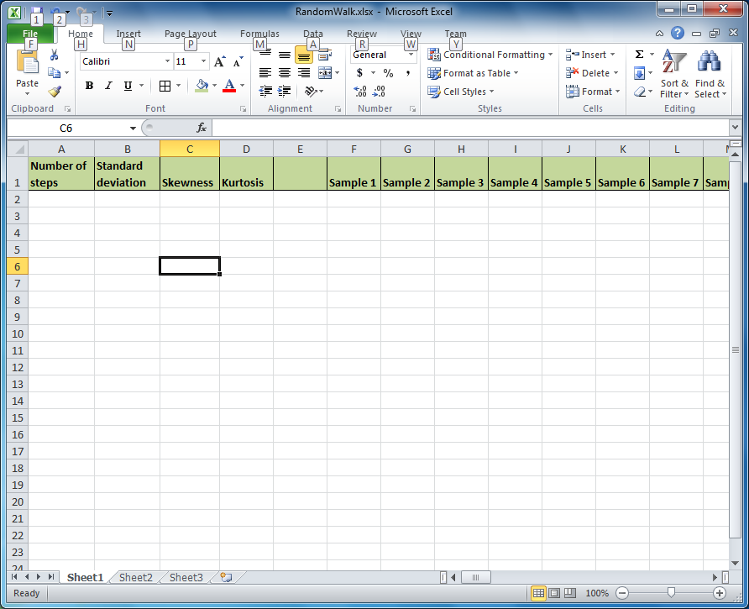
Set up for your simulation in Excel. If you type Sample 1 and Sample 2 in consecutive cells, highlight them and drag, Excel will update to Sample 3, etc. Make 100 samples.

Slide 6
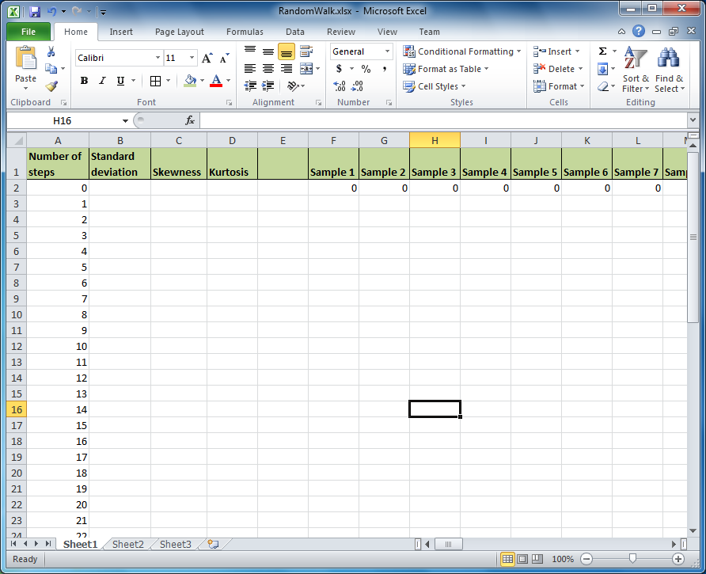
Enter the numbers 0, 1, …, 50 in the “number of steps” column. Also enter 0’s for the initial position of all 100 samples.

Slide 7
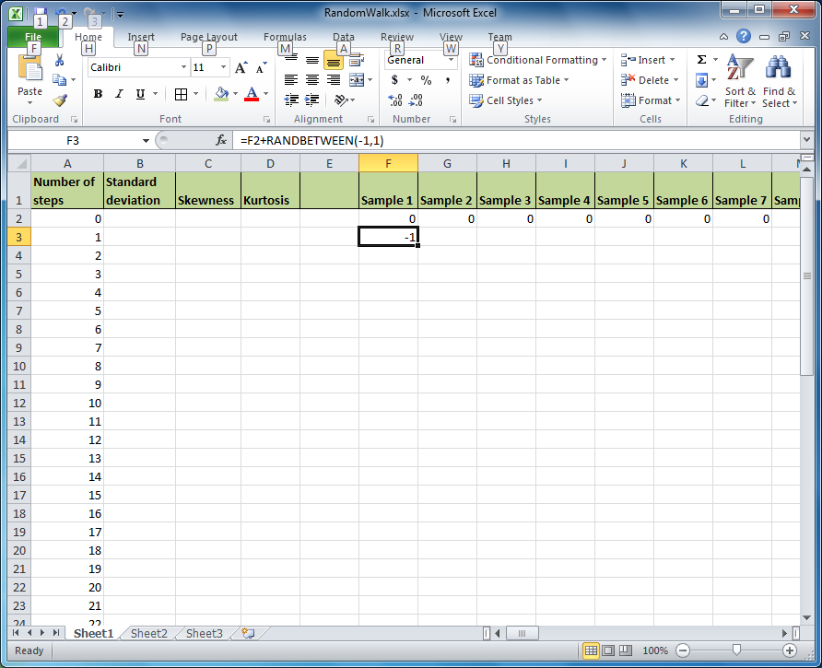
Enter the formula like =F2+RANDBETWEEN(-1,1).
The possible results of RANDBETWEEN(-1,1) are -1 which we will interpret as a taking a step to the left, a 0 which we will interpret as staying in place, and +1 which we will interpret as taking a step to the right.

Slide 8
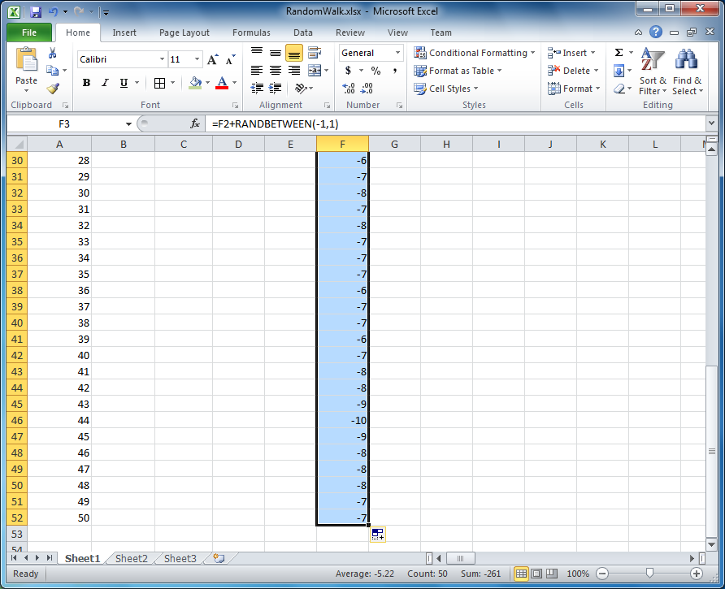
Copy the formula down The column corresponding to Sample 1.

Slide 9
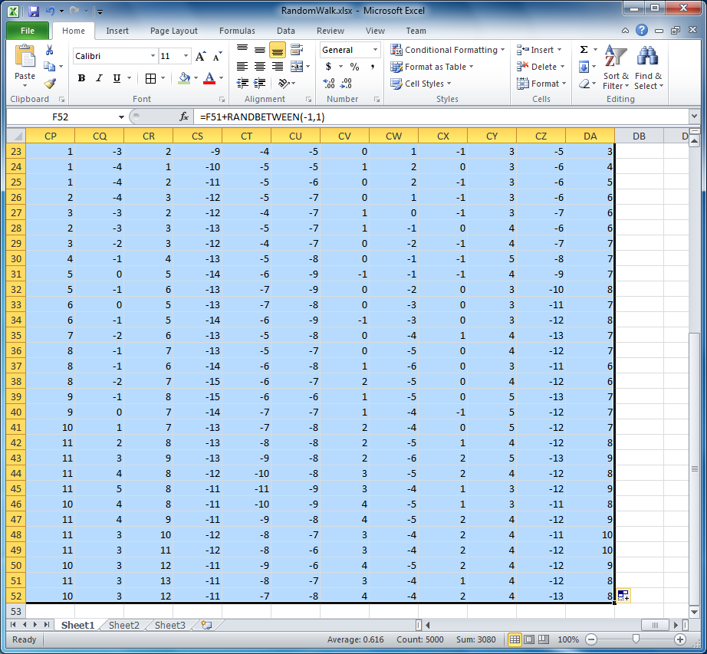
Copy the formula over to all of the sample columns (it was column DA in the example below).

Slide 10
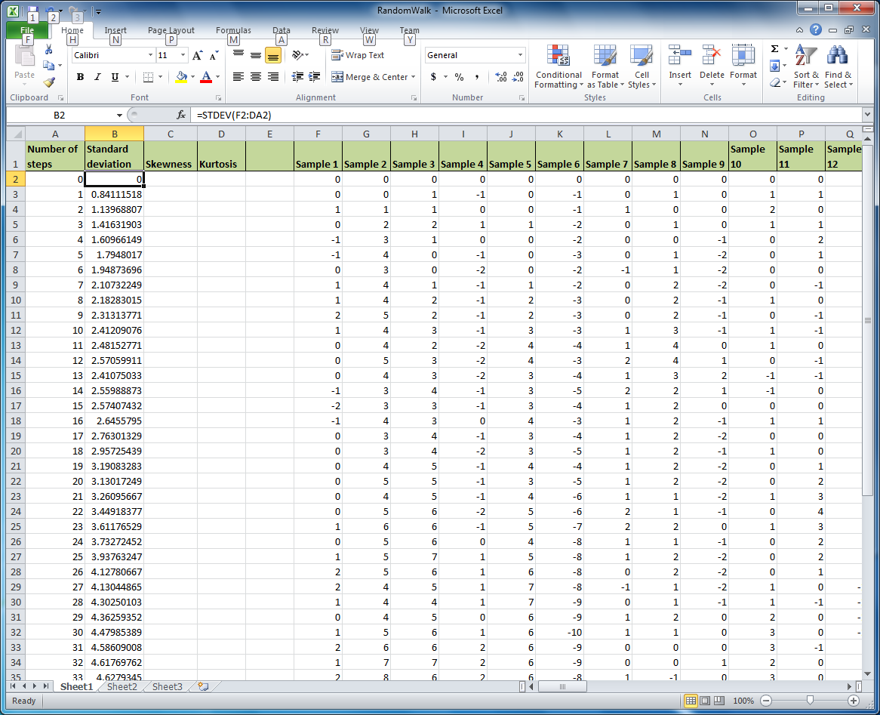
The average over the samples should be close to zero because samples are as likely to move to the left as to the right. Therefore we look at standard deviation.
Enter the formula to calculate the standard deviation of position over the various samples. Then copy that formula down over the various “times” (number of steps).

Slide 11
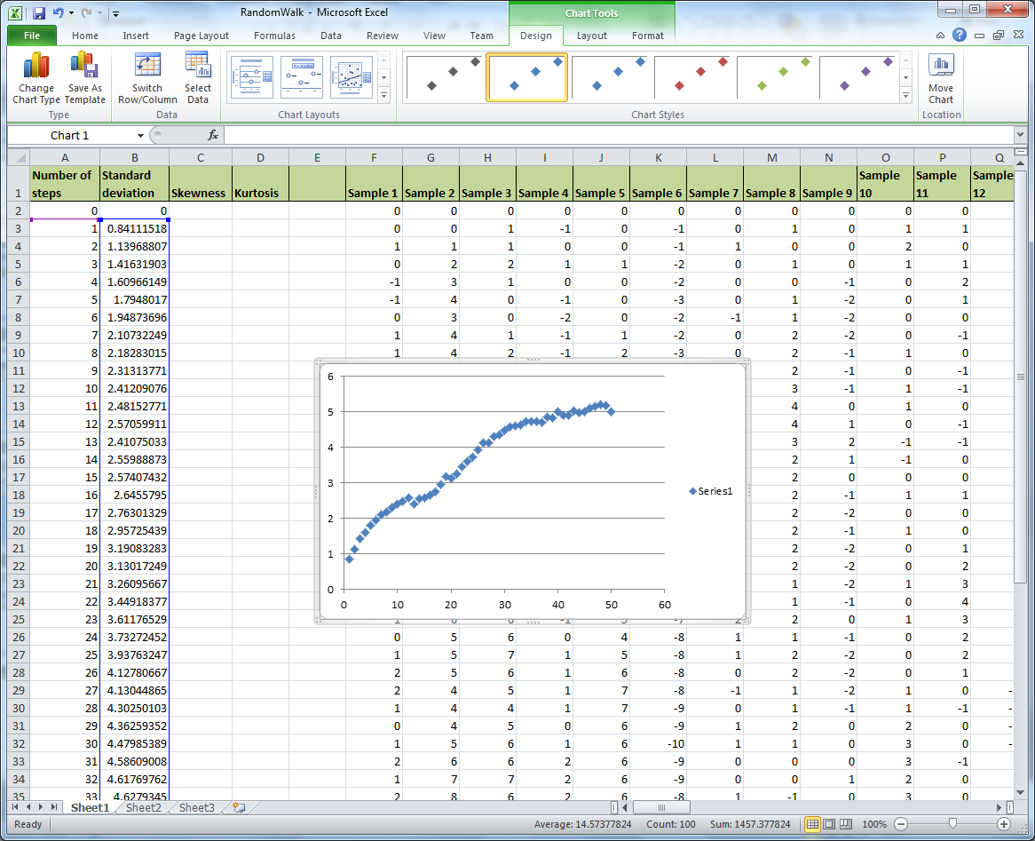
Highlight the data (EXCLUDING the first point 0,0) and make an XY-Scatter

Slide 12
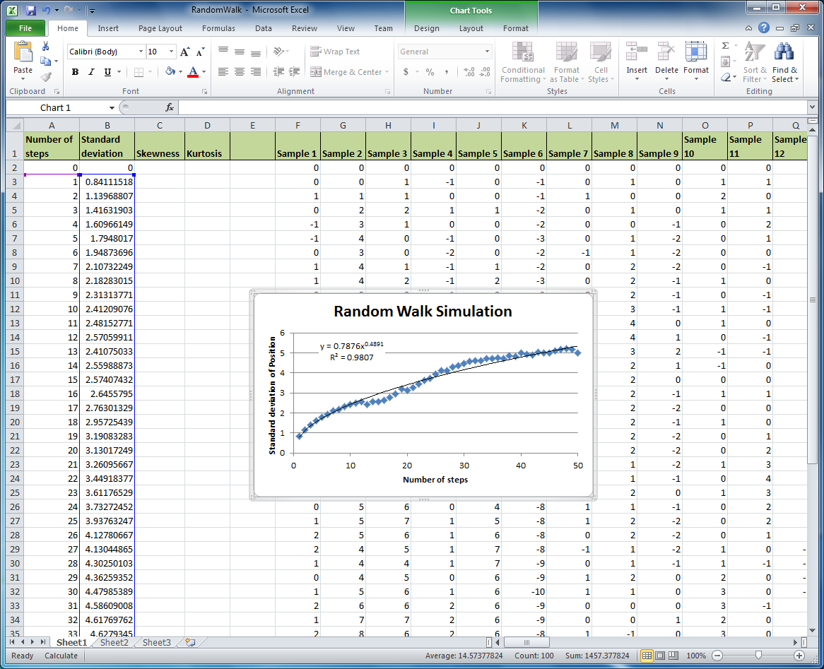
Choose layout #9. Choose a Power-Law fit (Trendline). Label the axes. Add a title.

Slide 13
Compare to theory
According to theory the standard deviation should have a power of ½.
How close was your value to this prediction?
What do you think you could do to improve your results?

Slide 14
Extrapolation
Use your formula to estimate the standard deviation after 100 steps.

Slide 15
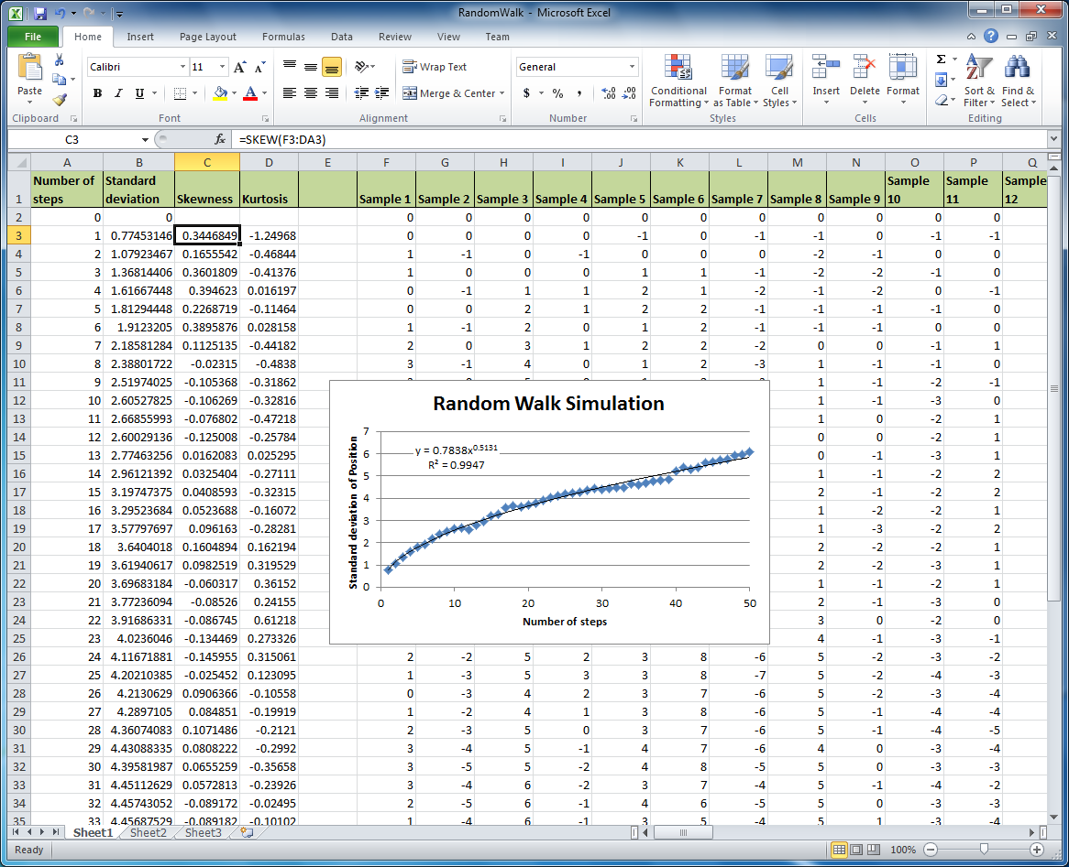
Calculate the skewness and kurtosis of the various samples. Then copy the formula down for the various times.
This is another one of those situations which should eventually have a normal distribution. So the skewness and kurtosis should go to zero as the number of step increases

