Slide 1
Excel: Nuclear Decay Simulation
CSC 152
1

Slide 2
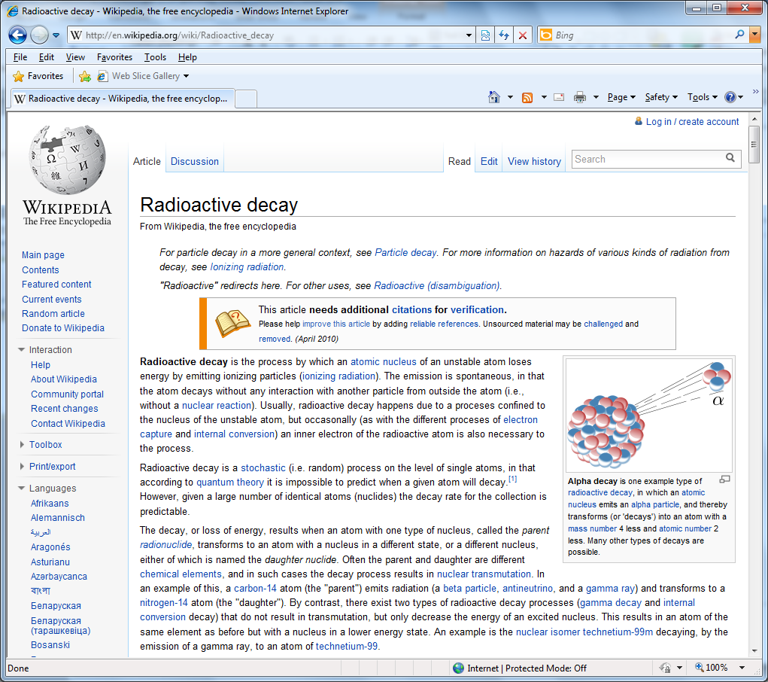
Nuclear decay
CSC 152
2

Slide 3
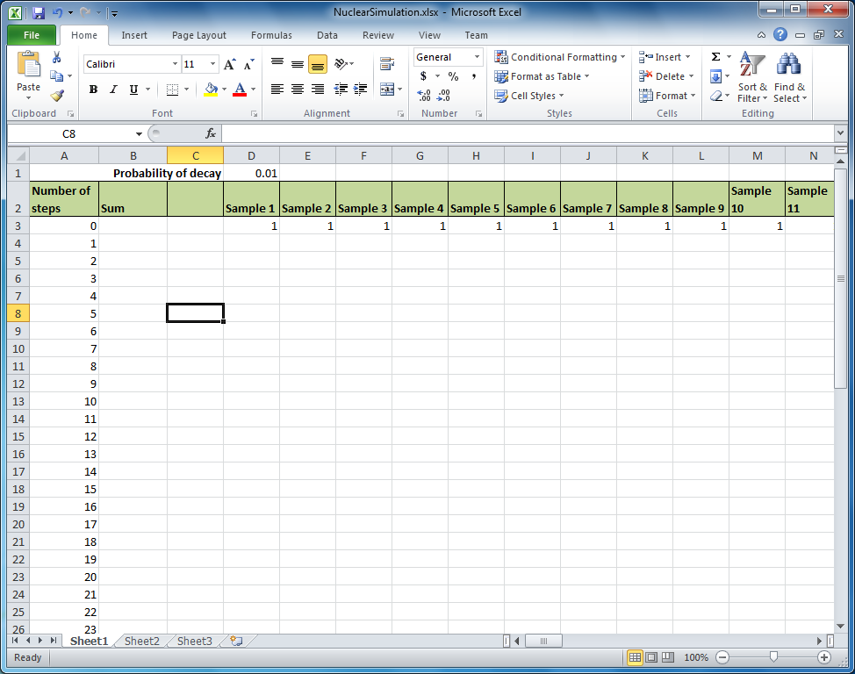
Create a setup similar to our previous simulation (50 steps down/100 samples across) but this time make a column for Sum and start all 100 sample cells at 1
Note the first row has an entry in cell D1 with a value of 0.01 .
The labels are in Row 2.
The starting values of 1 are in Row 3
CSC 152
3

Slide 4
Our representation
In our simulation we are going to use a 1 to represent an atom that has not undergone nuclear decay and a 0 to represent an atom that has undergone nuclear decay.
At each step, each atom that has not undergone decay has a probability of undergoing decay. (Cell D1)
That probability will be a parameter in our simulation.
CSC 152
4

Slide 5
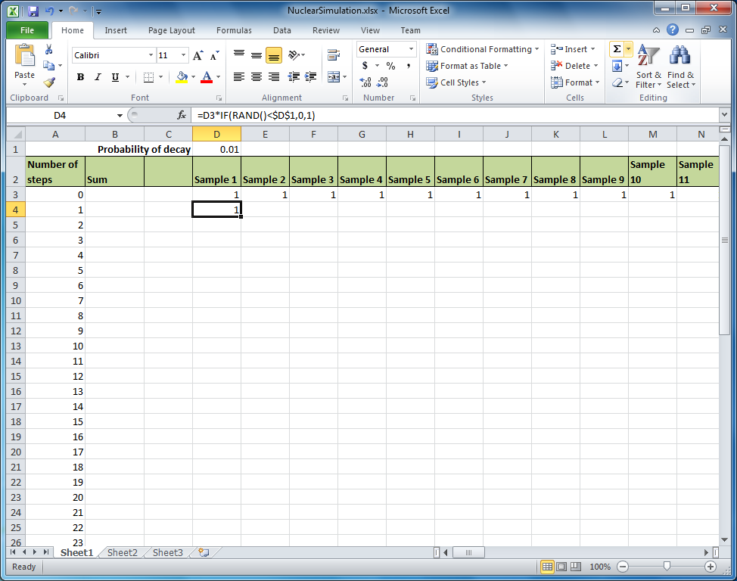
Enter a formula like =D3*IF(RAND()<$D$1,0,1).
If the formula the D3 corresponds to the atom, 1 if it has not decayed 0 if it has. The rand() function generates a “random” number between 0 and 1. If that number is less than our probability parameter we multiply by 0 – meaning that the atom decay. Otherwise we multiply by 1 to indicate that the atom has not decayed.
Note the formula refers to a probability p contained in cell D1 so you need to have something in there. It should be less than 1.
CSC 152
5

Slide 6
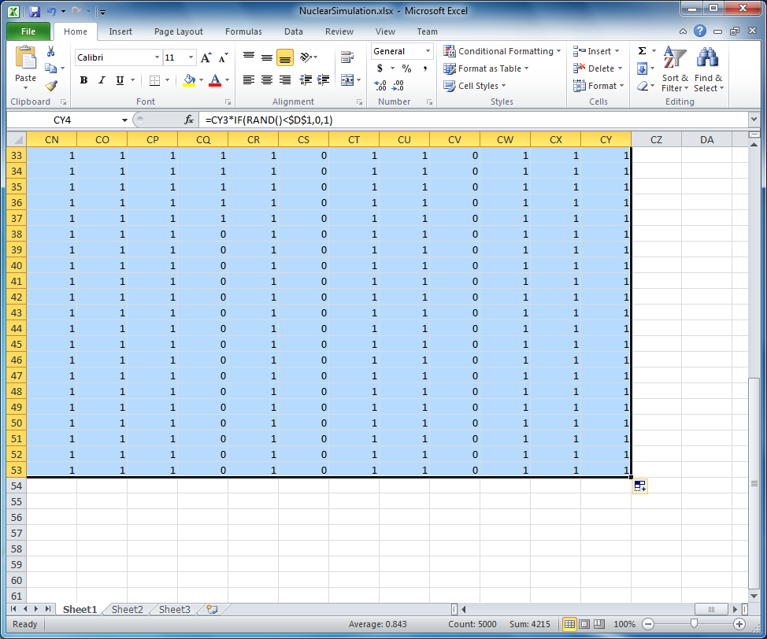
Copy the formula down and across
CSC 152
6

Slide 7
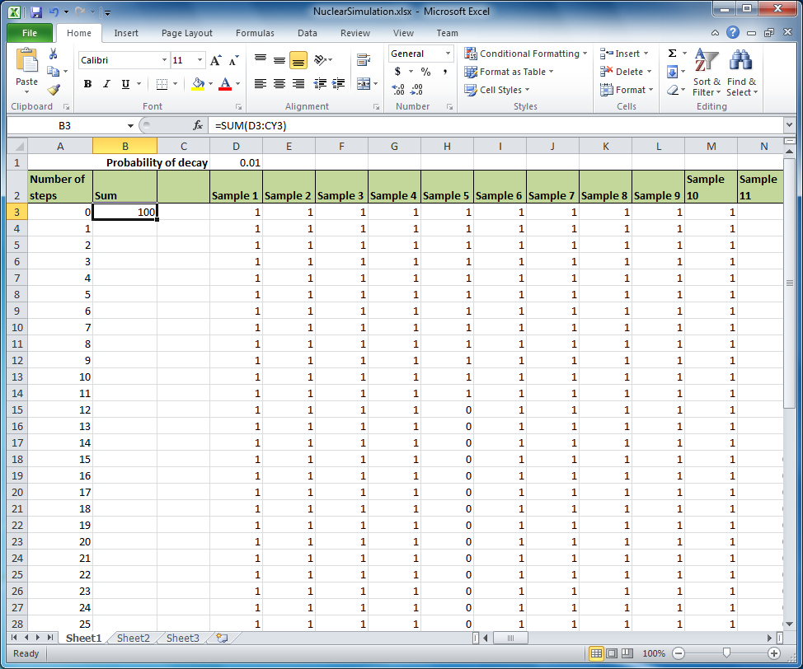
Enter a formula that sums all atoms in a sample at step 0.
CSC 152
7

Slide 8
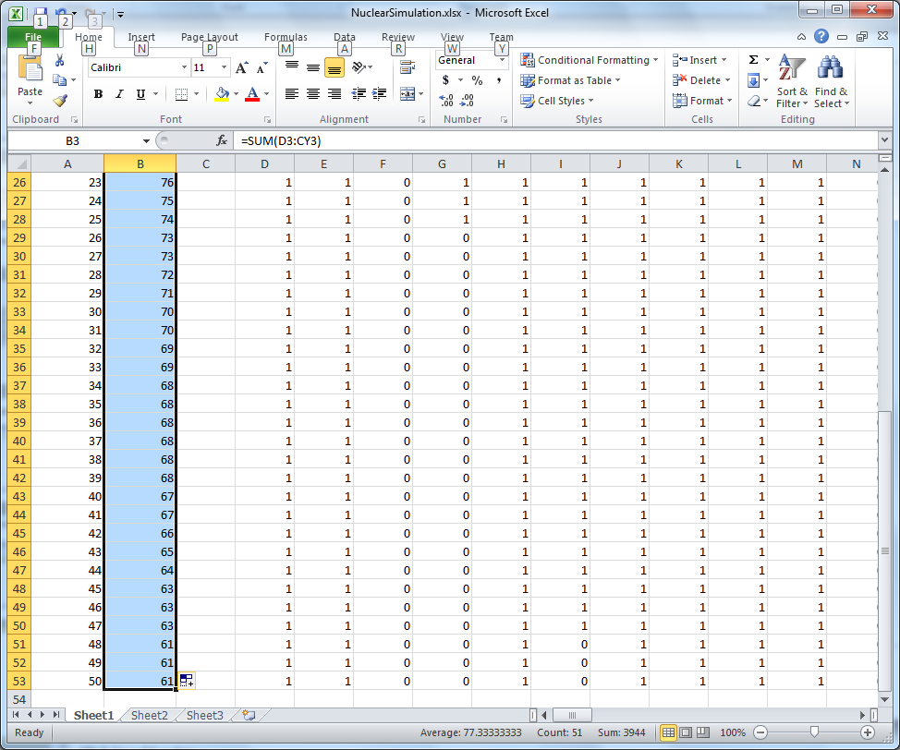
Copy the sum formula down for the different “times” (number of steps).
CSC 152
8

Slide 9
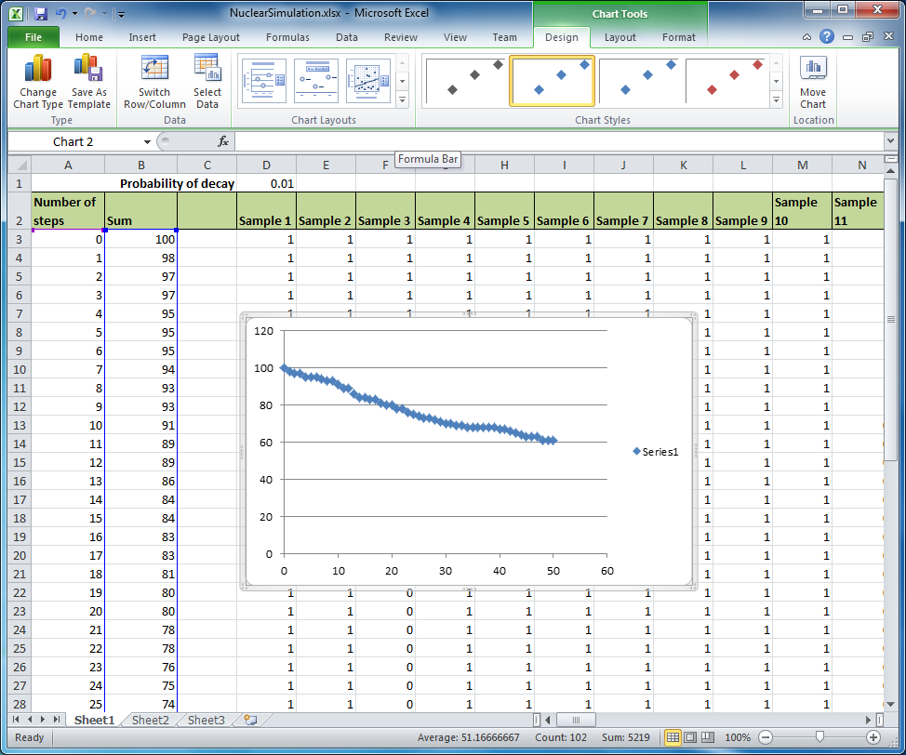
Make an XY Scatter graph of the Sum versus Number of Steps
CSC 152
9

Slide 10
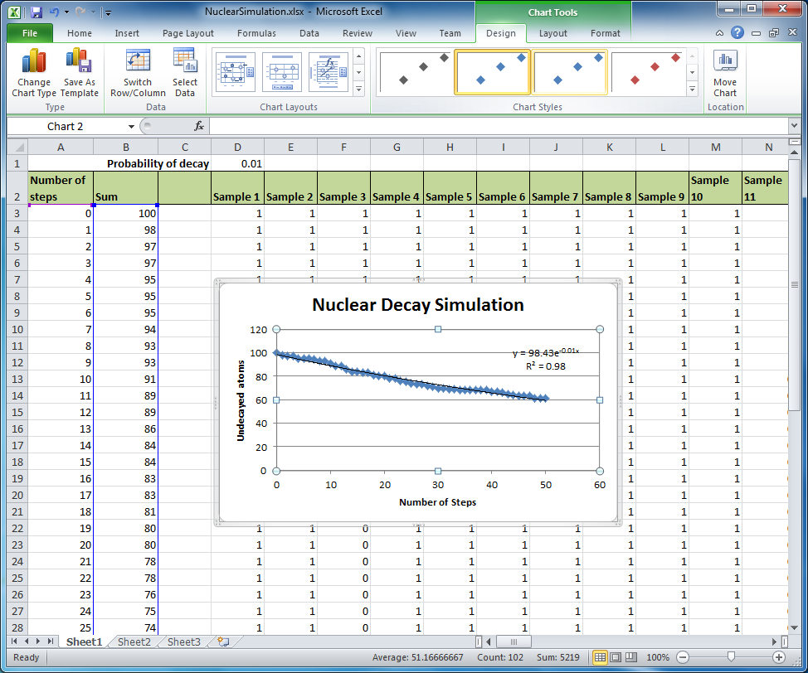
Use Layout 9, fit to Exponential, label axes.
CSC 152
10

Slide 11
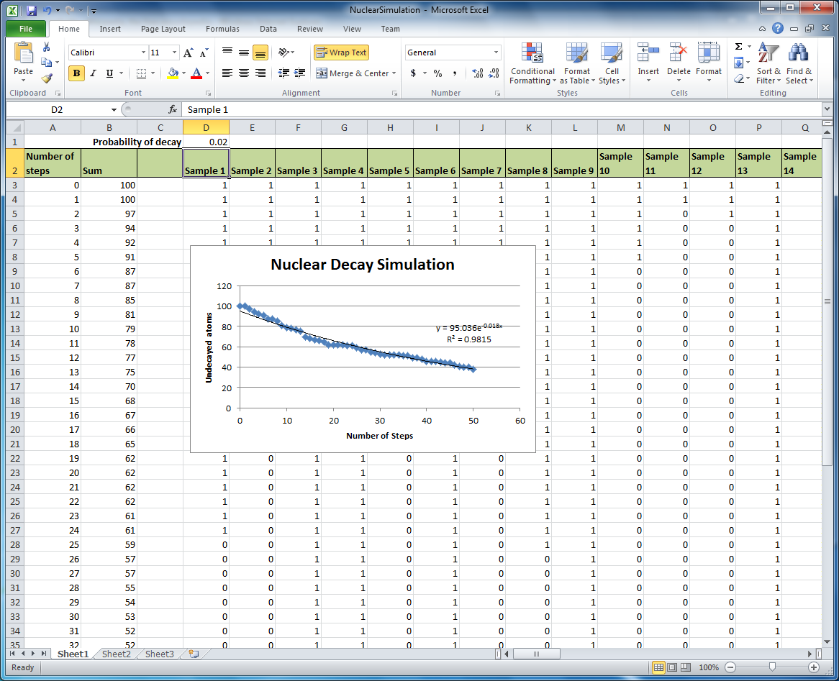
Changing the parameter p should update the calculations, graph and fit
Recall that if you resize or otherwise edit the displayed equation that it will not update.
CSC 152
11

Slide 12
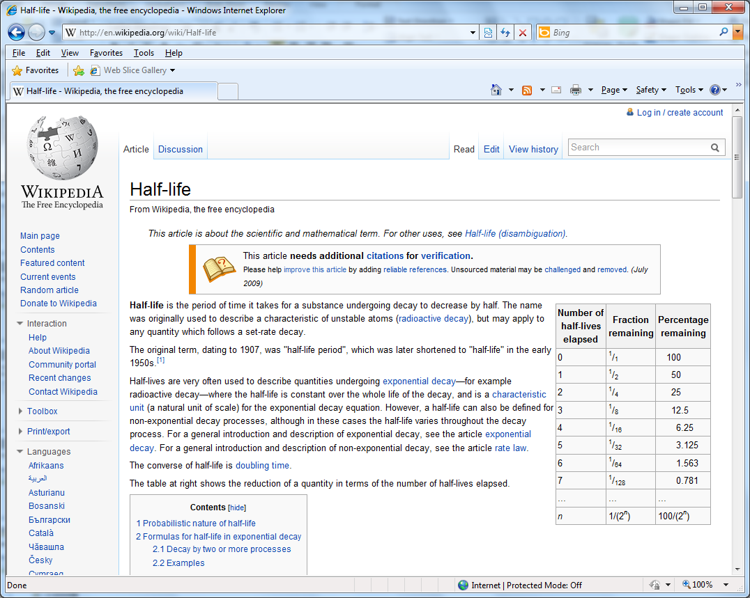
Half-life
CSC 152
12

Slide 13
Calculating half-life
The following steps are a derivation of a result – if you get lost just jump to the result in red in three slides
Start with equation from fit:
Y = 95.036 exp(-0.018 x)
Half life is when you get half the original amount, so
Y=95.036/2 and x=x_half_life
95.036/2 = 95.036 exp(-0.018 x_half_life)
CSC 152
13

Slide 14
Calculating half-life (2)
Divide 95.036 on both sides
½ = exp(-0.018 x_half_life)
The natural log function is the inverse of the exponential function
Ln(1/2) = ln(exp(-0.018 x_half_life))
Ln(1/2) = -0.69315

Slide 15
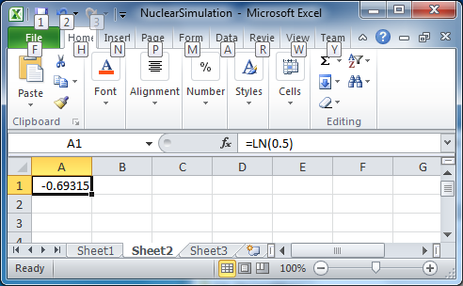
Natural log of ½ in Excel
CSC 152
15

Slide 16
Half-life Calculation (Continued)
Ln(1/2) = ln(exp(-0.018 x_half_life))
-0.69315 = -0.018 x_half_life
x_half_life = 0.69315/0.018
So the half-life takes the number 0.018 from the exponential trendline and divides that into 0.69315 (that number does not change)
CSC 152
16

Slide 17
Find experimental half-lives for different p’s. Change p (cell D1), extract the number from the TrendLine. Use it to find the half-life
Find experimental half-lives for different p’s. Change p (cell D1), extract the number from the TrendLine. Use it to find the half-life
Probability p | Half-life
0.02
0.03
0.04
0.05
0.06
0.07
0.08
CSC 152
17

Slide 18
Plot Half -Life versus p
Plot Half -Life versus p
Use the previous data to make a plot of half-life versus p. Pick a Trendline type for the data.

Slide 19
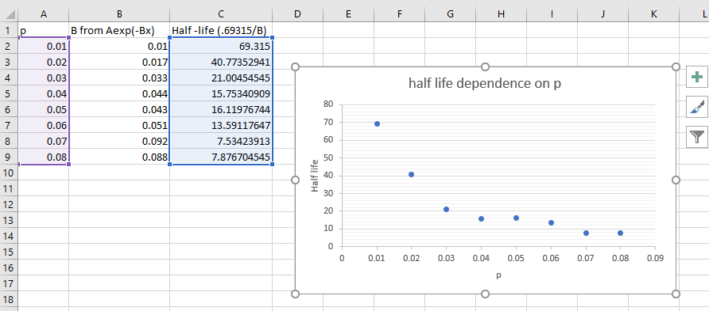
The data below is my version. Your numbers may/will vary because it’s based on
Random sampling.

Slide 20
How does half-life depend on p?
Make an XY Scatter plot of half-life versus p.
To what function do you think it should be fit?
Do you obtain a good fit?
How do you know?
CSC 152
20

