Slide 1
R: fitting to Power Law
Power-Law from log-log linear model
Pendulum Data

Slide 2
Recall the data used in an earlier lab that varied the length of a pendulum and measured its period (the time to swing back and forth)
Length (cm) | Period (s)
108 | 2.080
89 | 1.888
58 | 1.534
44 | 1.3352
25 | 1.0199

Slide 3
The Excel fit to a power-law yielded

Slide 4
Entering the same data into R looks like
# copy and paste
length = c(108, 89,58,44,25)
period = c(2.080, 1.888, 1.534, 1.3352, 1.0199)

Slide 5
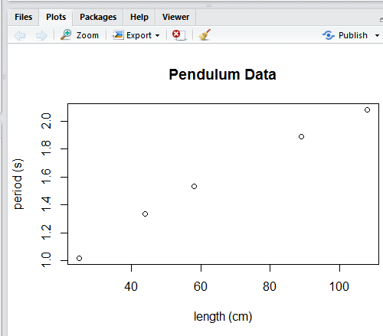
Plotting the data in R looks like

Slide 6
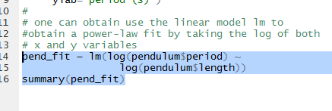
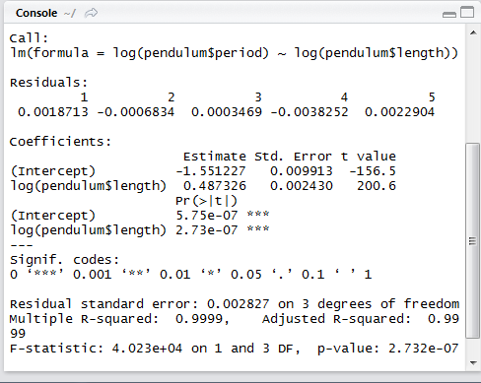
Log-log linear model
Take note of the log's above!!!!!
That 0.4873 number looks familiar from the Excel Power-law fit. It was the power.

Slide 7
Can’t take log of 0 or negative numbers
In the Random Walk simulation we did not include the first step in our fit of the data.
One cannot take the log of zero or a negative number.
Behind the scenes in Excel there are log’s being taken, and it cannot handle the negative numbers

Slide 8
Isolating the power

Slide 9
Breaking it down
pend_fit is the name we gave to the model
The model has coefficients (what we usually call slope and intercept)
Our x’s are log(pendulum$length) so we are getting the coefficient associated with the x – what we would normally call the slope
Originally it was the power

Slide 10
Breaking it down
y = A x^b
log(y) = log(A x^b)
log(y) = log(A) +log(x^b)
log(y) = log(A) + b log(x)
We see that the slope in log(y) versus log(x) is b – what was originally the power in the power law
By log() in R we mean the natural log ln()
intercept = log(A)
exp(intercept) = A
The exponential function and natural log functions are inverses

Slide 11
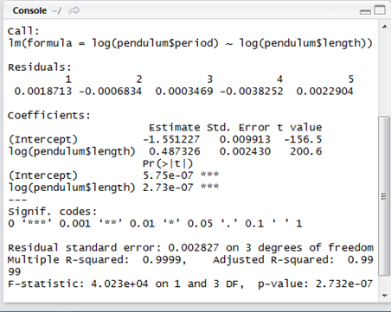
Obtaining the Coefficient

Slide 12
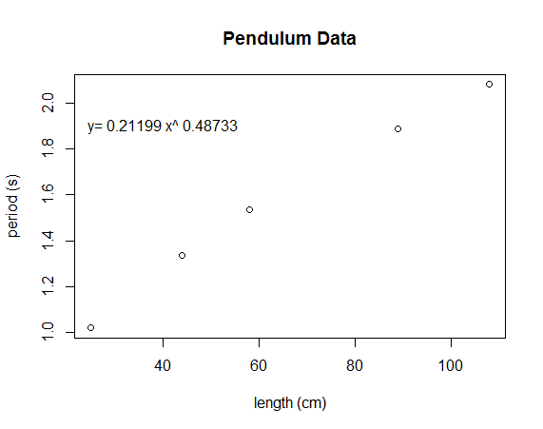
Displaying fit equation

Slide 13
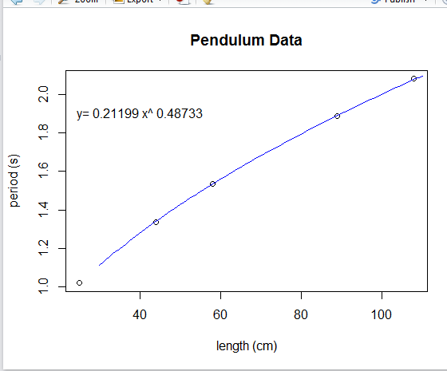
Displaying the fit curve

