Slide 1
Excel: Latitude, Longitude, and the Distance between Cities
An exercise in Absolute addressing

Slide 2
Enter the following data into Excel
City | Latitude (degrees) | Longitude (degrees)
New York City | 40.704234 | -73.917927
Las Vegas | 36.194168 | -115.22206
Orlando | 28.5333513 | -81.375789
Chicago | 41.840675 | -87.679365
Miami | 25.787676 | -80.224145
San Francisco | 37.759881 | -122.437392
Honolulu | 21.30895 | -157.826182
Portland | 45.52304 | -122.640155
Philadelphia | 39.998012 | -75.144793

Slide 3
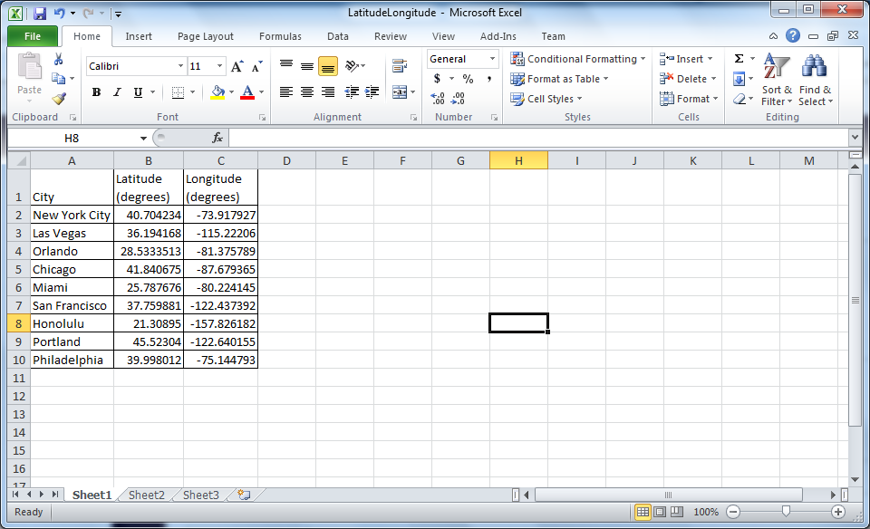
Data entered into Excel

Slide 4
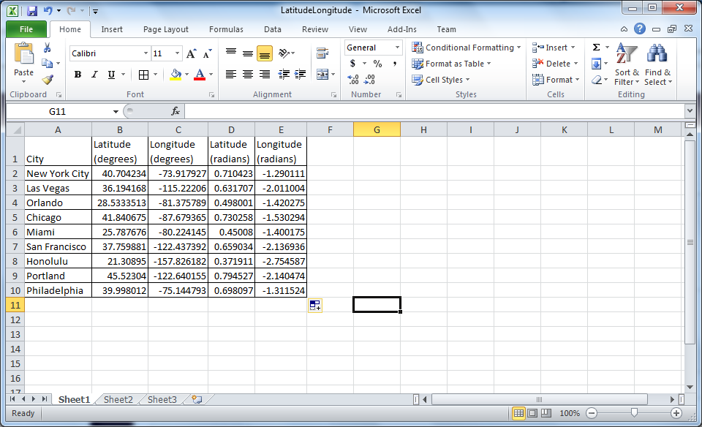
Convert the Latitude and Longitude from degrees to radians. 180 degrees corresponds to π radians. There is a radians() function in Excel for this purpose

Slide 5
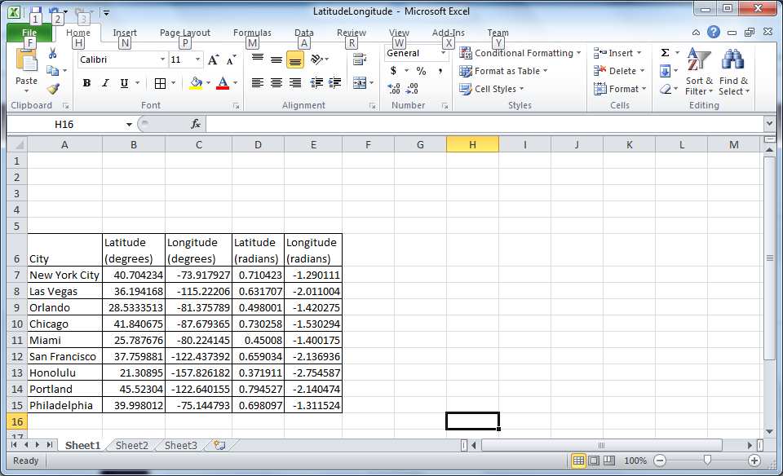
Insert 5 rows above

Slide 6
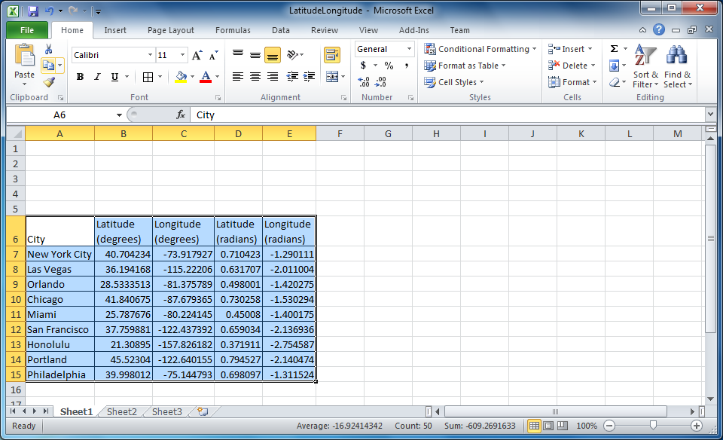
Highlight data and click on Copy

Slide 7
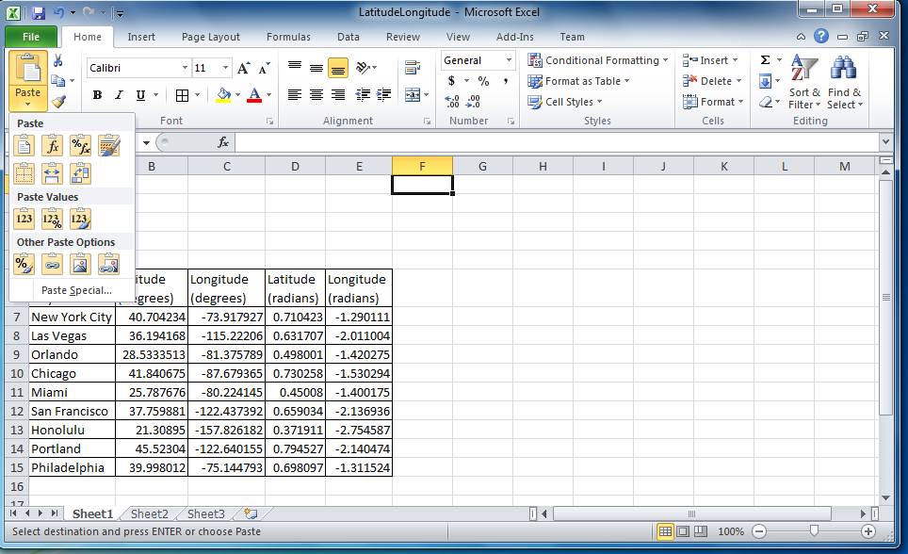
Highlight the cell F1, then click on the arrow under Paste. Choose the “Transpose” option.

Slide 8
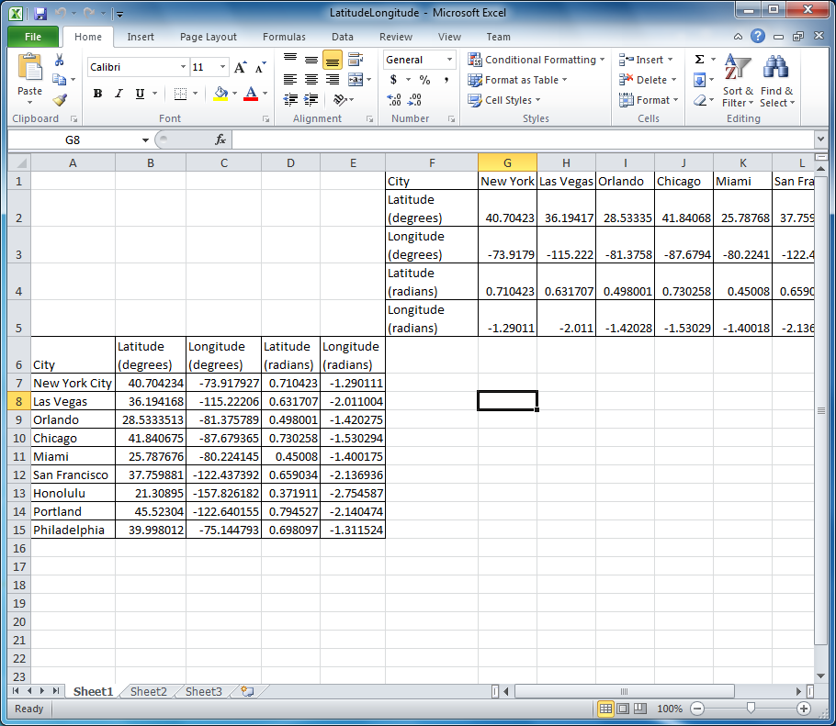
Result of transposed paste.

Slide 9
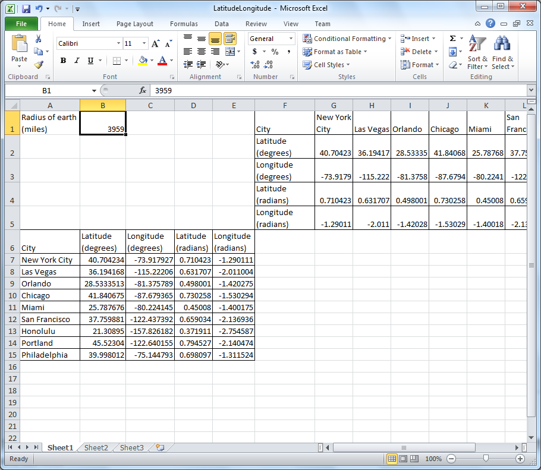
Enter the radius of the Earth in miles in some cell.

Slide 10
Enter the formula for the distance between two cities (City1 and City 2) based on their latitude and longitude
=ACOS(SIN(LAT1)*SIN(LAT2)+COS(LAT1)*COS(LAT2)*COS(LONG2-LONG1))*RADIUS
For LAT1 and LONG1 use a $ before the letter;
for LAT2 and LONG2 use a $ before the number;
for RADIUS use a $ before the letter and the number.
=ACOS(SIN($D7)*SIN(G$4)+COS($D7)*COS(G$4)*COS(G$5-$E7))*$B$1

Slide 11
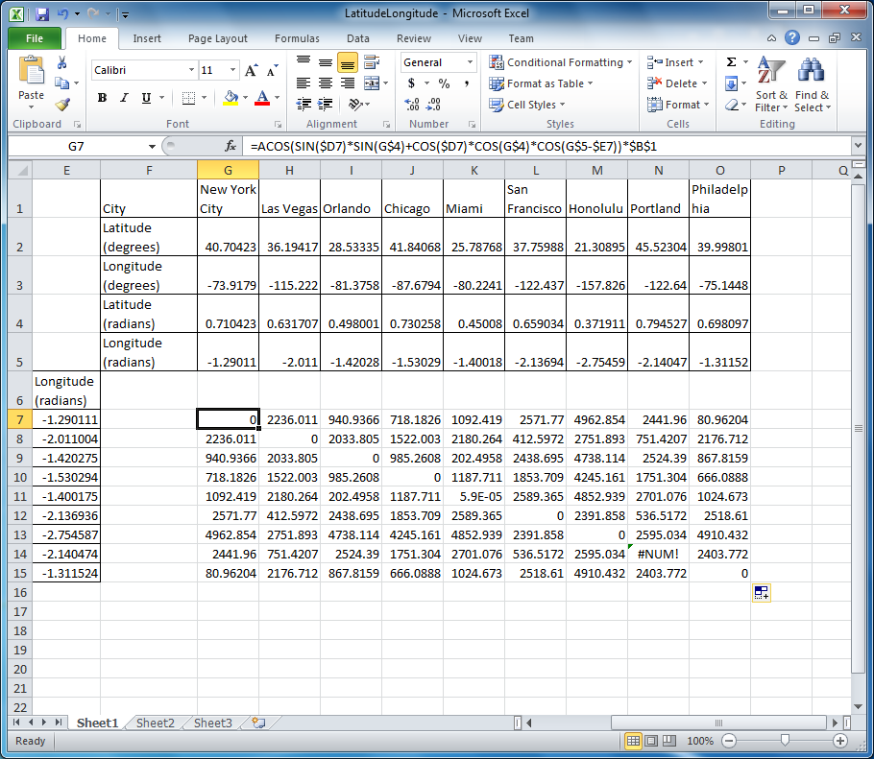
Enter the formula for the distance and copy it across rows and down columns

