Slide 1
Some tricks for copying data from the web to make a vector in R Studio

Slide 2
Copy the multi-country population data from the macrotrends website
https://www.macrotrends.net/global-metrics/countries/USA/united-states/population
Highlight the data, right click, and choose Copy

Slide 3
We will start off pasting the data into Excel
Open Excel
Right click in the first cell (A1)
Choose Paste (Match destination)

Slide 4
Highlight all of the data
Click on the gray area to the left of the gray A and above the gray 1 to highlight the data
Next, place your mouse between the gray A and gray B so that the cursor becomes a double-headed arrow.
Then double click.
This should make the columns wide enough to display all of the data

Slide 5
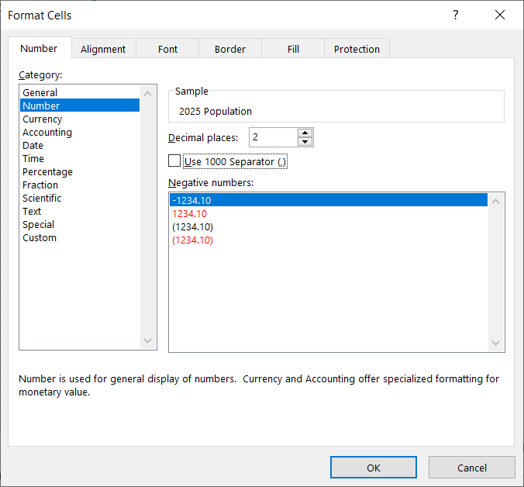
Highlight the numbers, Right click, choose Format Cells. Choose Number Category. Check Use 1000 Separator, then uncheck the same. (Removes commas from the numbers.)

Slide 6
Highlight the numbers, right click and choose copy. Open Word. Right click in empty document, choose Paste. Use the last option (Keep text only)

Slide 7
On Home tab, click on Replace.

Slide 8
Click on More

Slide 9
Click on the Special button, choose Paragraph Mark. That puts ^p in the “Find what”. Enter a comma and a space in “Replace with” Click “Replace All”

Slide 10
Result of the replace

Slide 11
Fix the beginning and the end into the syntax for a vector in R

Slide 12
Copy and paste from Word to an R script in RStudio

Slide 13
Enter the code to make a box and whiskers plot. Note all of those outliers!

Slide 14
Use R to calculate the mean and median

