Slide 1
Introduction to Word 2007

Slide 2
Open Word by double clicking desktop icon

Slide 3
Alternative (if there is no desktop icon) Start/All Programs

Slide 4
On the menu click on the Microsoft Office Folder and then Microsoft Office Word 2007

Slide 5
Enter some text (such as the lyrics of a song)

Slide 6
Click on the Office Button and then Save

Slide 7
Close the file by clicking the red X in the upper right-hand corner
The icon that looks like a floppy disk (that aren’t used much any more) is to save. Get into the habit of saving often!

Slide 8
Choose the name and location of your saved file.
This location is on the “C drive.” The file will only be accessible on this particular computer.

Slide 9
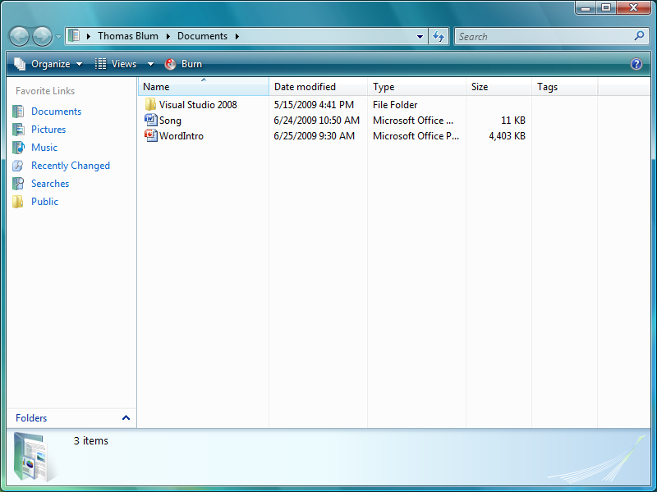
Finding the file version 1 (Since it was in Documents, go to Start/Documents)

Slide 10
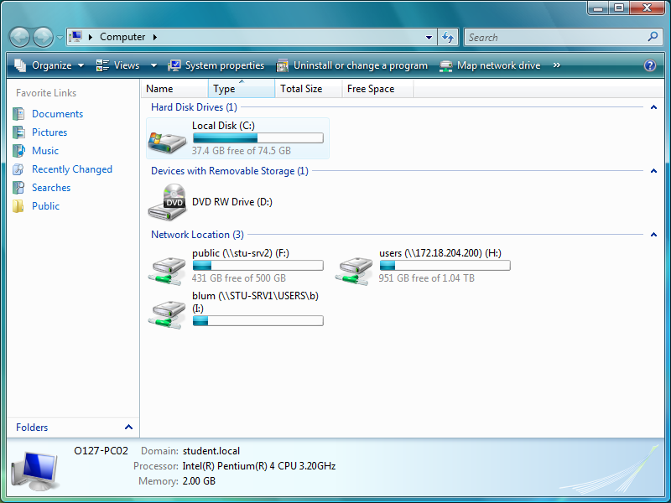
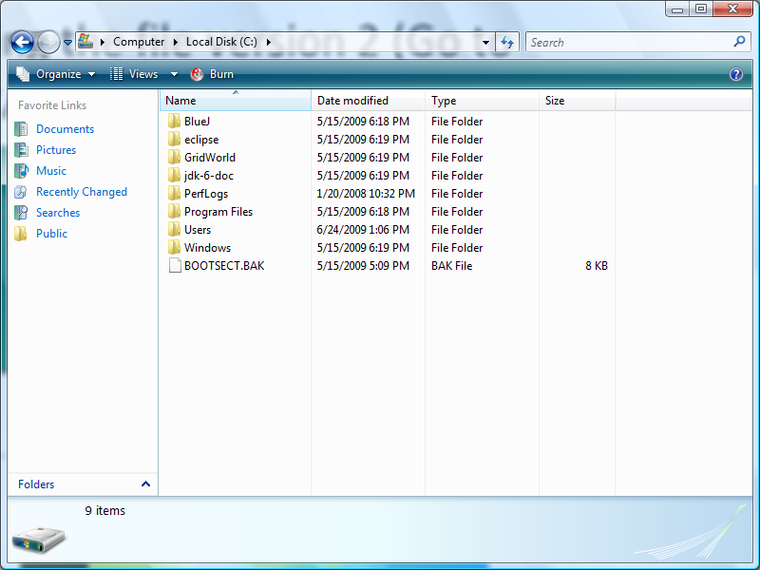
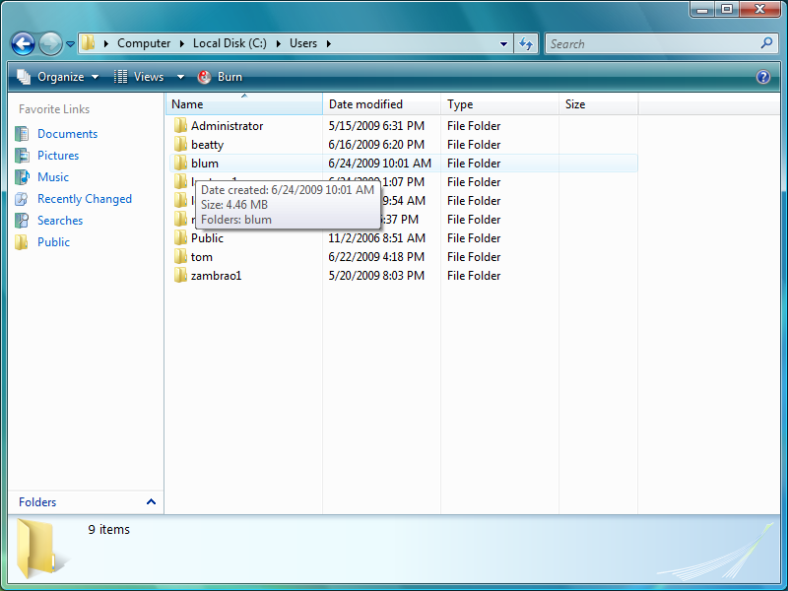
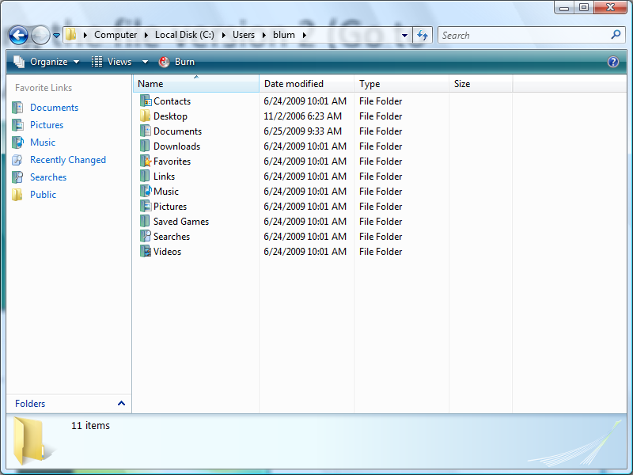
Finding the file version 2 (Go to Start/Computer, the Local Disk C:/Users/“username”/Documents )

Slide 11
Finding the file version 3 (Go to Recent Items)

Slide 12
Finding the file version 4 (Open Word, click on the Office button, look under Recent Documents)

Slide 13
Under the Home tab, choose Select/Select All

Slide 14
Under the Home tab, use the drop-down list to change the font

Slide 15
Under the Home tab, use the drop-down list to change the font size

Slide 16
Fonts are usually measured in a unit called “points”

Slide 17
Highlight the title by dragging the mouse across it and click the Bold button
The bold button is called a toggle switch. Clicking it makes the text bold if it was not bold – and not bold if it was bold.

Slide 18
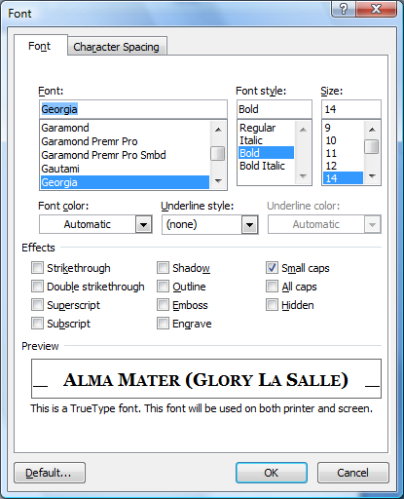
Click on the Font Quick Access Toolbar and choose an effect (such as Small caps) and Click OK

Slide 19
Select all of the text again and click on the Paragraph Quick Access Toolbar

Slide 20
Use the drop-down list to make the spacing after a paragraph 0 points and click OK.

Slide 21
Highlight the beginning of a stanza and using the Paragraph Quick Access Toolbar give it more spacing before. (Do the same for other stanzas.)

Slide 22
Click on the show/hide paragraph mark toggle button
Note that there is no blank line with just a paragraph mark between stanzas

Slide 23
Put something in your song in italics: highlight the text and click on the italics toggle.

Slide 24
Go to the Page Layout tab and then to the Page Setup Quick Access Toolbar

Slide 25
Change the left margin by using the up-down arrows, then click OK.

Slide 26
Go to the Review tab and click on the Spelling and Grammar button
I didn’t write this text, so I am only looking for any typo’s I might have made in typing in the lyrics.

Slide 27
Highlight the first stanza, look to the bottom left to see how many words in the stanza and the total number of words in the document.
The first stanza (highlighted) contains 16 words out of the 82 words in the document.

Slide 28
Search for an image to include in your document

Slide 29
Right click on the image and choose Save Picture As … make sure you know the name and location of the file. Click Save.

Slide 30
Place the cursor where you want the image, then click on the Insert tab and then the Picture button

Slide 31
Use the Insert Picture dialog box to find the image file, highlight it, then click Insert

