Slide 1
MSDN Academic Alliance Software Center
AKA ELMS

Slide 2
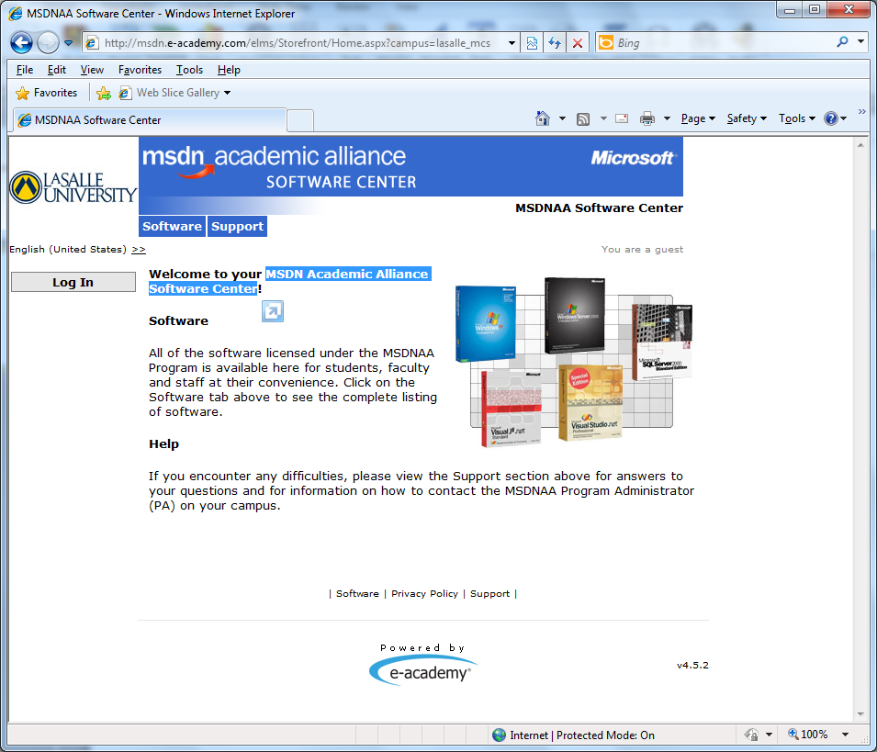
Go to http://msdn.e-academy.com/lasalle_mcs, click Log In

Slide 3
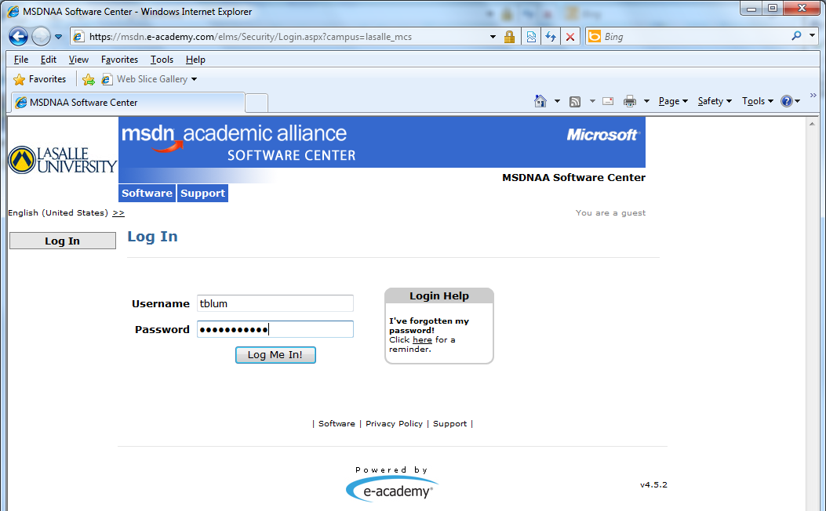
Enter the username and password sent to your La Salle email account from elms_support@e-academy.com and click Log Me In!
Student alliance usernames tend to be username@lasalle.edu
If you want to try using the Login Help

Slide 4
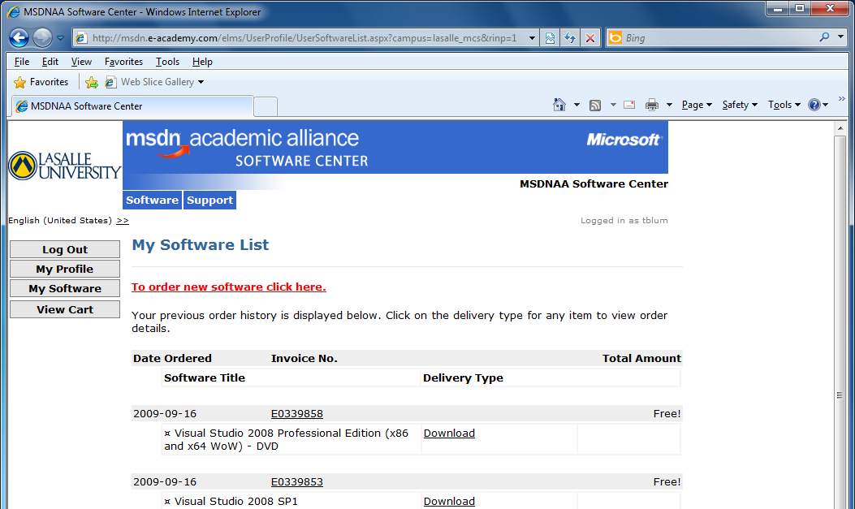
Click on the link To order new software click here.

Slide 5
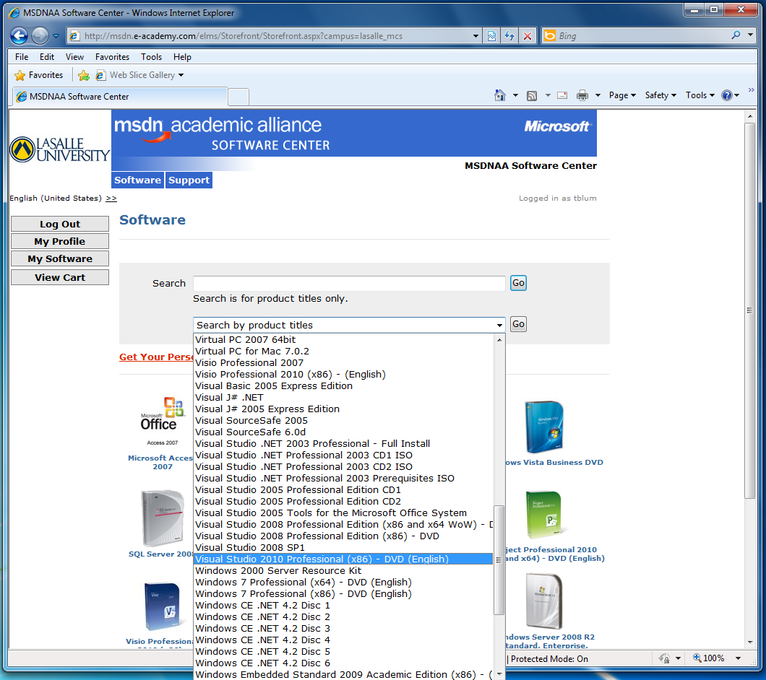
Use the search by product toitles drop-down list to locate the desired software (in this case Visual Studio 2010 professional (x86)) and click Go

Slide 6
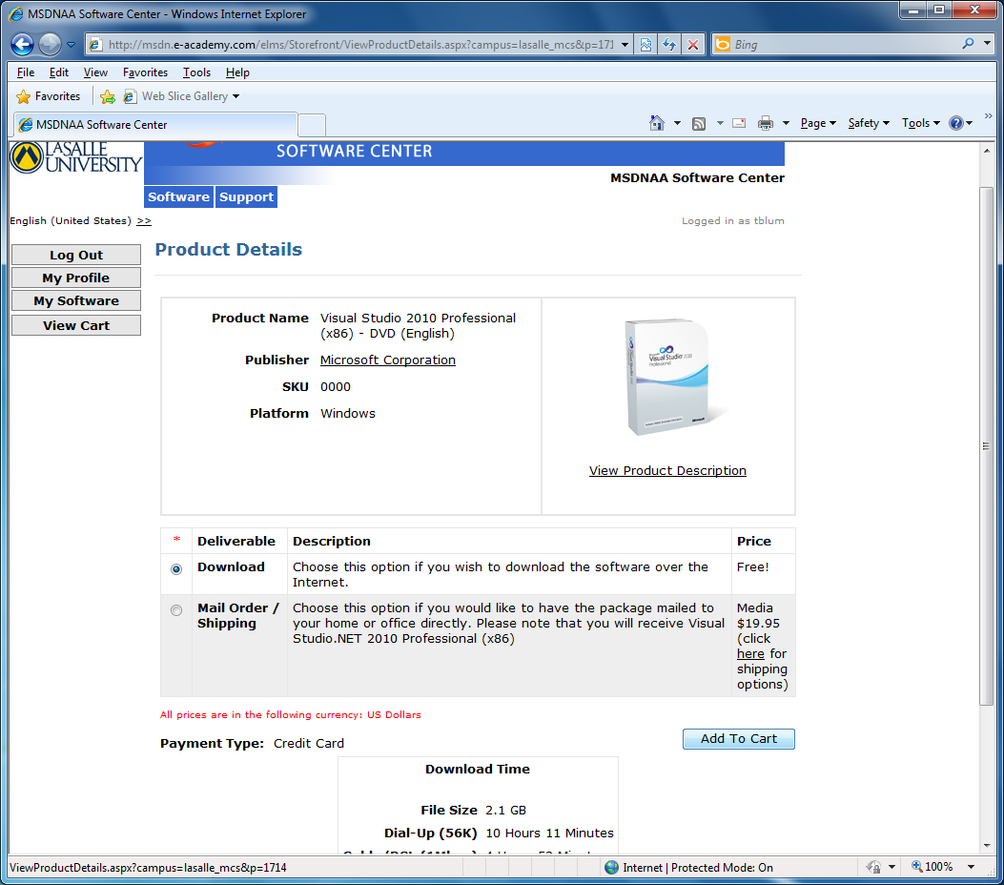
Choose to Download and click Add to Cart

Slide 7
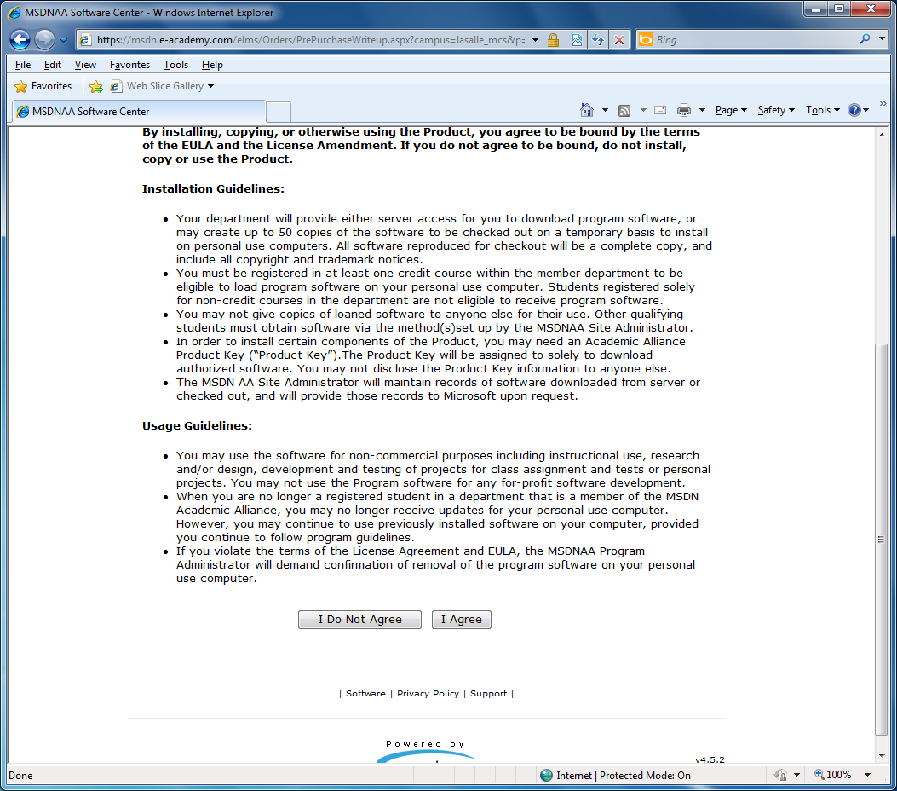
Read End User License Agreement and click I agree

Slide 8
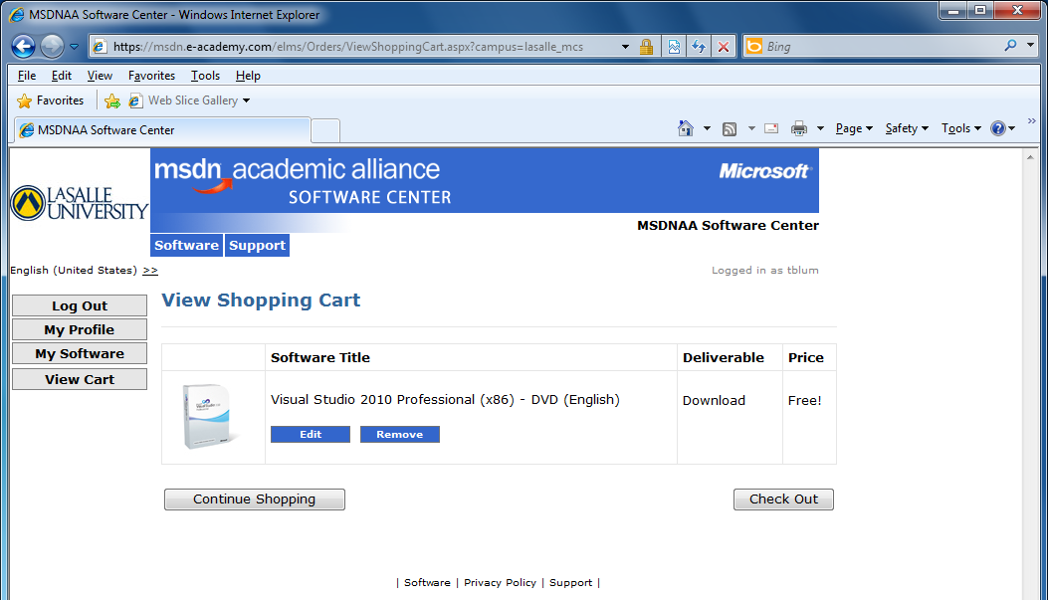
Click Check Out

Slide 9
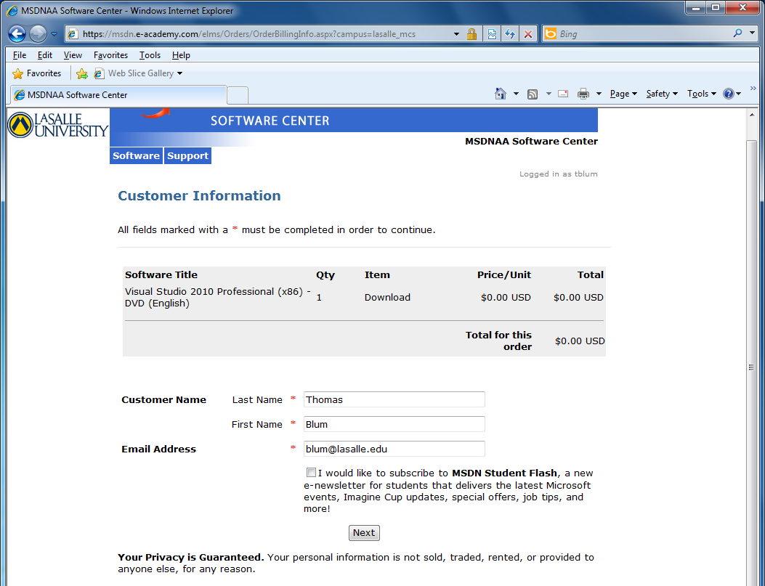
Click Next

Slide 10
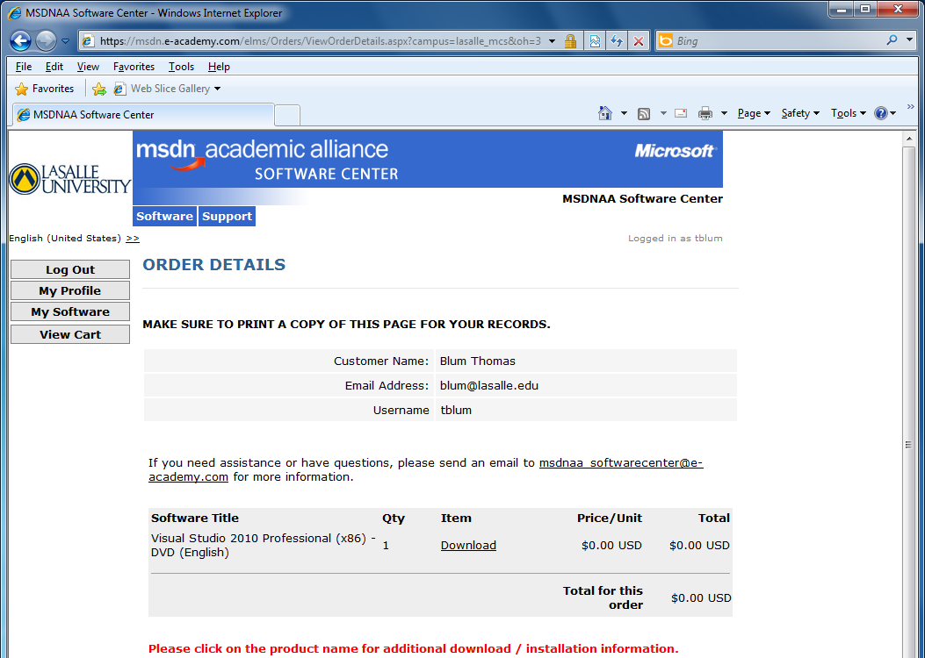
Click on the Download link

Slide 11
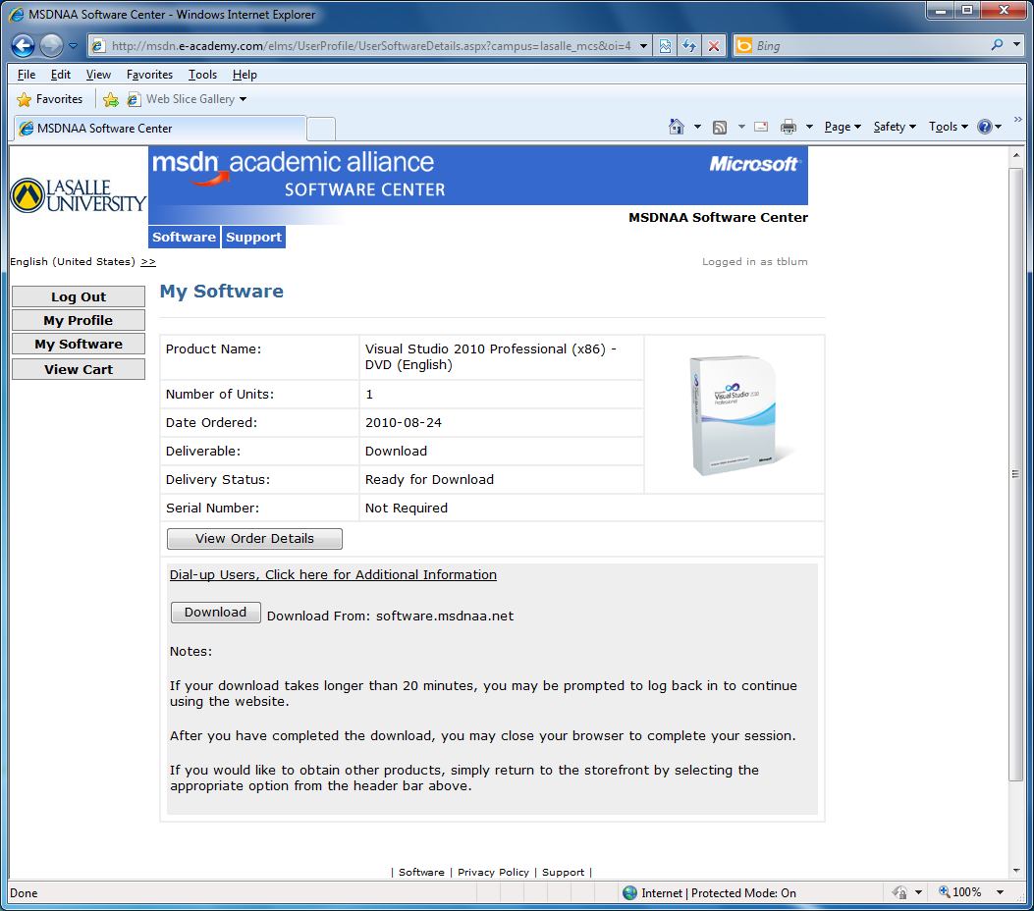
Click on the Download button

Slide 12
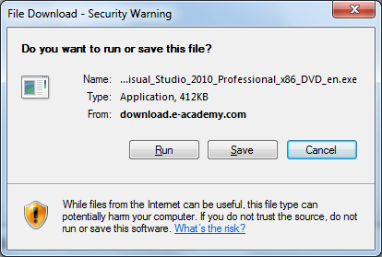
Choose either to 1. Run or 2. Save the exe and then run it (can only do later if using FireFox)

Slide 13
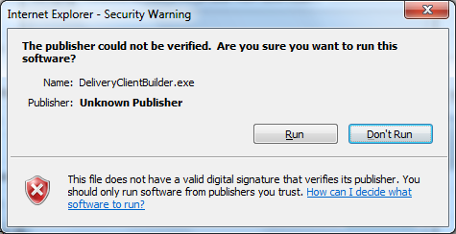
Allow the file to be run by clicking Run.

Slide 14
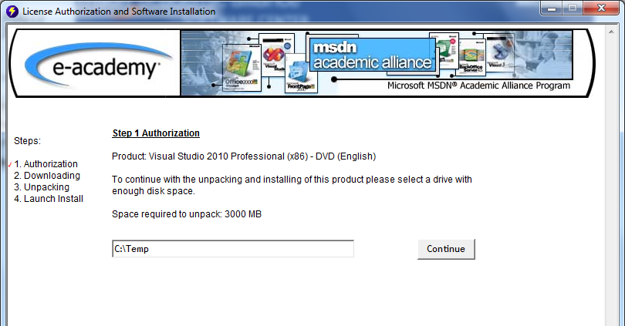
Decide where the “image” will be downloaded and click Continue

Slide 15
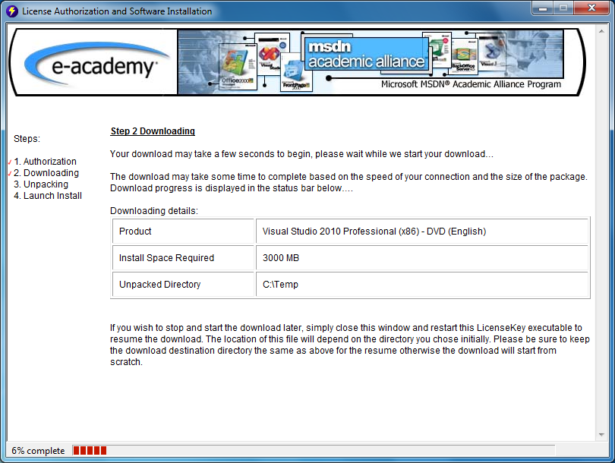
Downloading – this is the part that can take awhile. Progress monitored at bottom

Slide 16
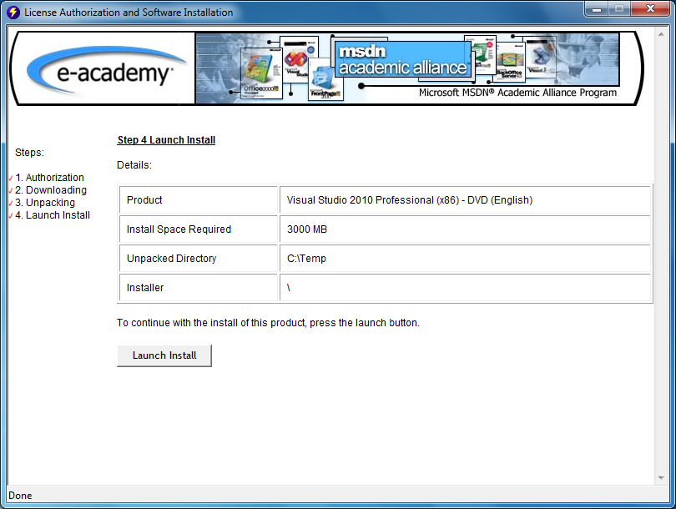
Click Launch Install to place yourself in the folder where the image has been downloaded

Slide 17
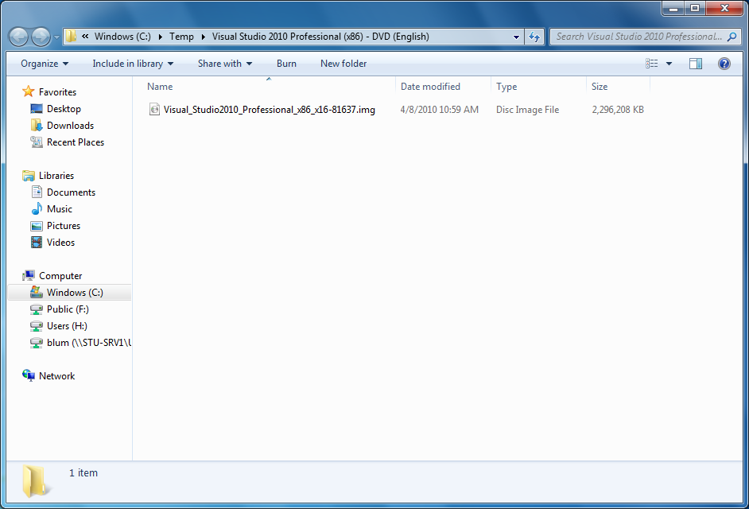
Note that file that has been downloaded has a(n) .img extension

Slide 18
In Windows 7 (!), you can right click on the file and choose Burn disc image

Slide 19
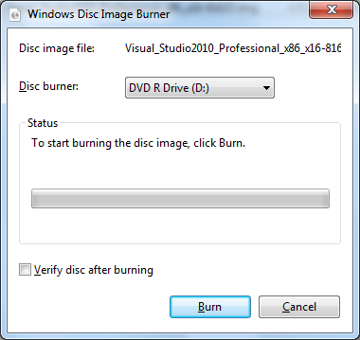
Place a DVD in the drive and click on Burn

Slide 20
Burning on older systems
Burning the DVD on older Windows systems may require you to have a burner application that is separate from the operating system or you may need an application that “bust” the image.
Also note on older hardware, you may have to be careful about whether your DVD’s are +R or –R.

Slide 21
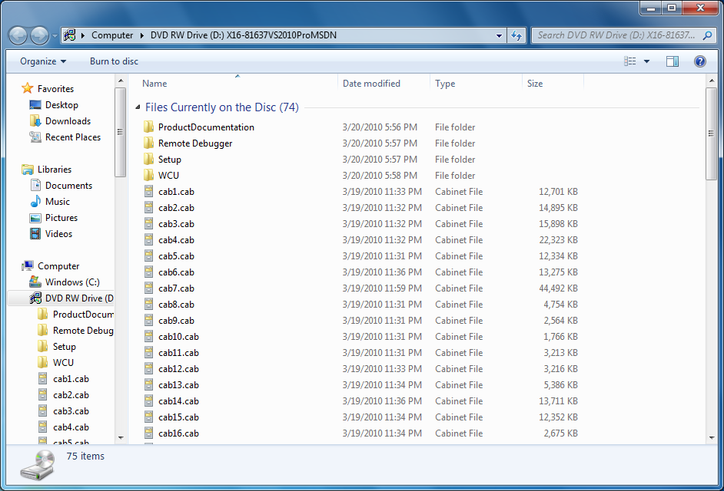
What’s on the DVD

Slide 22
Run the autorun.exe

Slide 23
Click on Install Microsoft Visual Studio 2010

Slide 24
Decide whether or not to send setup info to Microsoft and click Next

Slide 25
Accept license terms and click Next

Slide 26
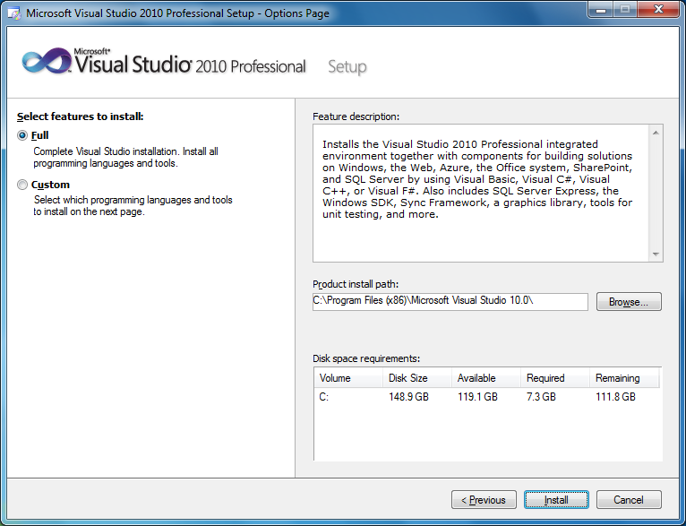
Decide between full and custom, choose a location, click Install

Slide 27
The long part …

Slide 28
Decide if you want Help

Slide 29
Location for Help

Slide 30
Select what you want to add

Slide 31
Updating

Slide 32
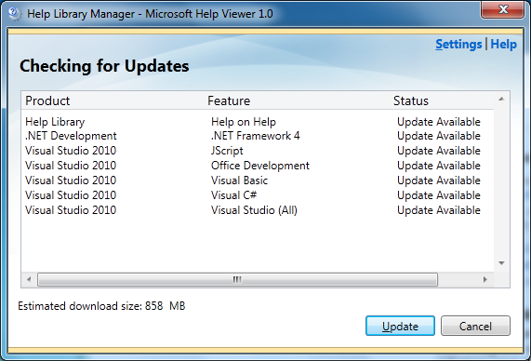
Look for updates

Slide 33
Finish

Slide 34
Check for service releases

Slide 35
Check for updates

Slide 36
Download updates

