Slide 1
Android: Shapes

Slide 2
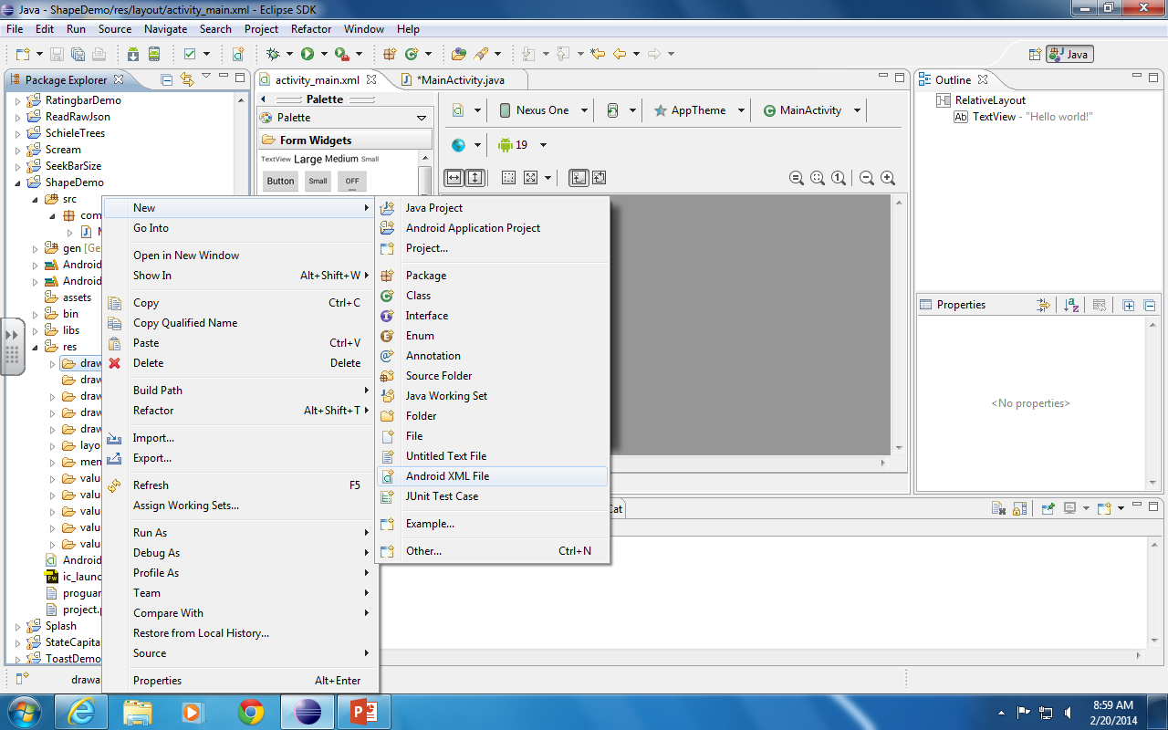
Right click on res/drawable select New/Android XML

Slide 3
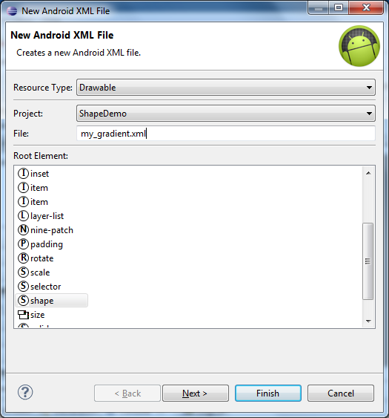
Supply a filename (small letters) Choose shape as the root element. Click Finish.

Slide 4
Enter a gradient element, supply its startColor and endColor attributes.
<?xml version="1.0" encoding="utf-8"?>
<shape xmlns:android="http://schemas.android.com/apk/res/android" >
<gradient android:startColor="#cccccc" android:endColor="#333333" />
</shape>

Slide 5
In your layout add a background attribute and set its value to the xml file you just placed in drawable

Slide 6
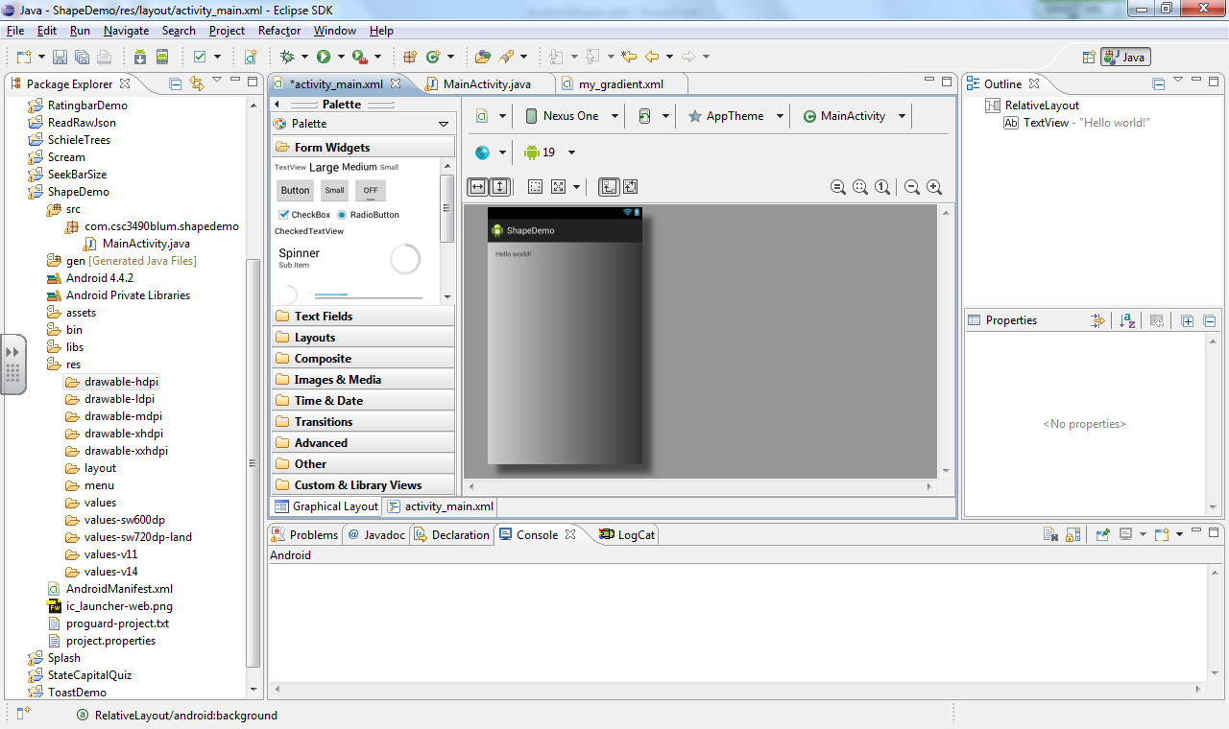
The result in Graphical Layout mode.

