Slide 1
Where are my Android files?

Slide 2
So many files! Where are the important ones?
Android Studio projects contain a lot of files, yet a typical programmer only explicitly edits a handful of them.
Files we might edit
  The .kt (kotlin code) files
  The .xml (layout) files
  The build.gradle files (the Module one)
  The AndroidManifest.xml

Slide 3
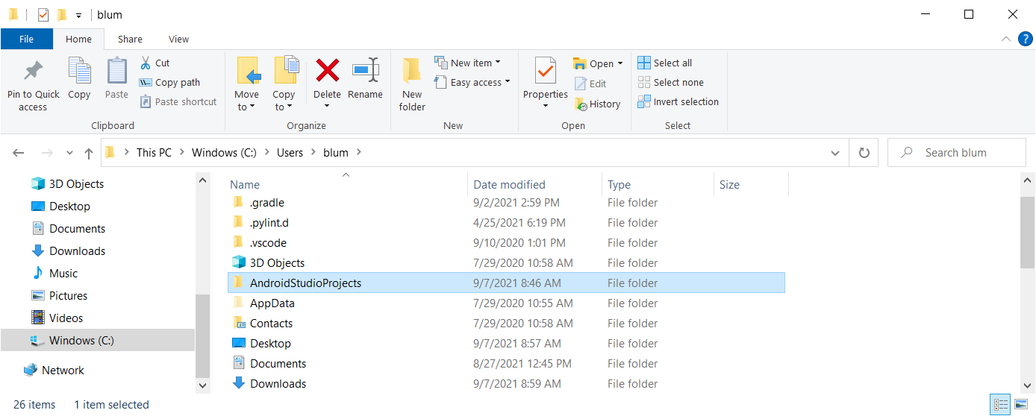
Since I accepted the default location on my Windows machine, my Android Studio projects are in c://Users/blum/AndroidStudioProjects

Slide 4
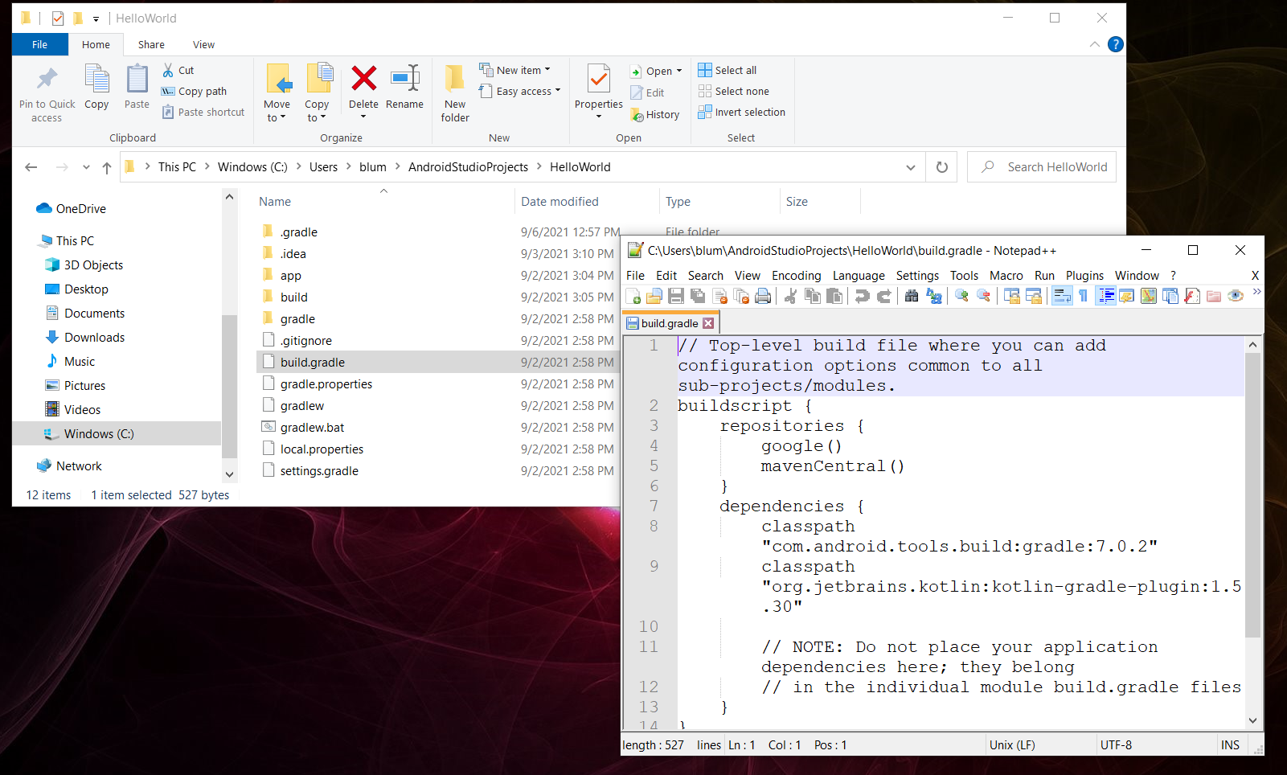
Digging down: NOT this build.gradle

Slide 5
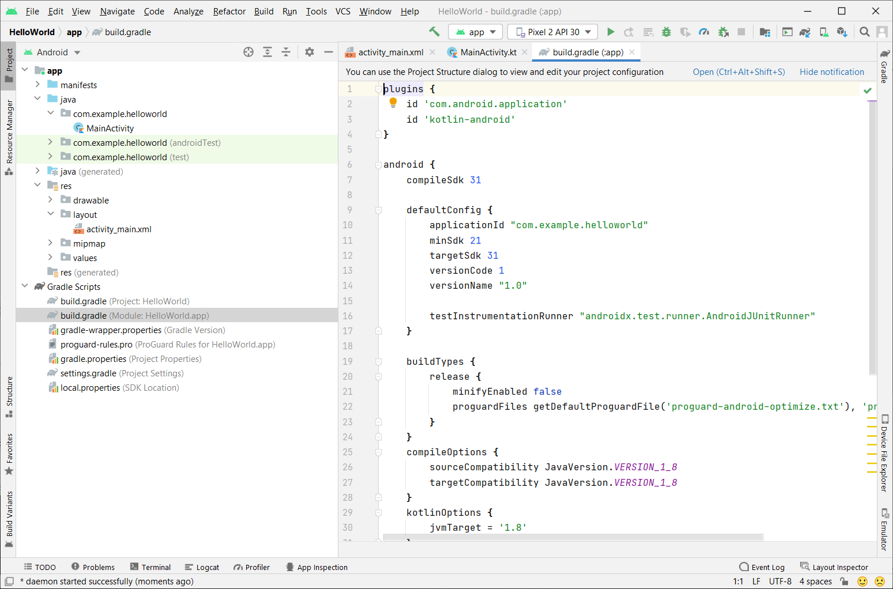
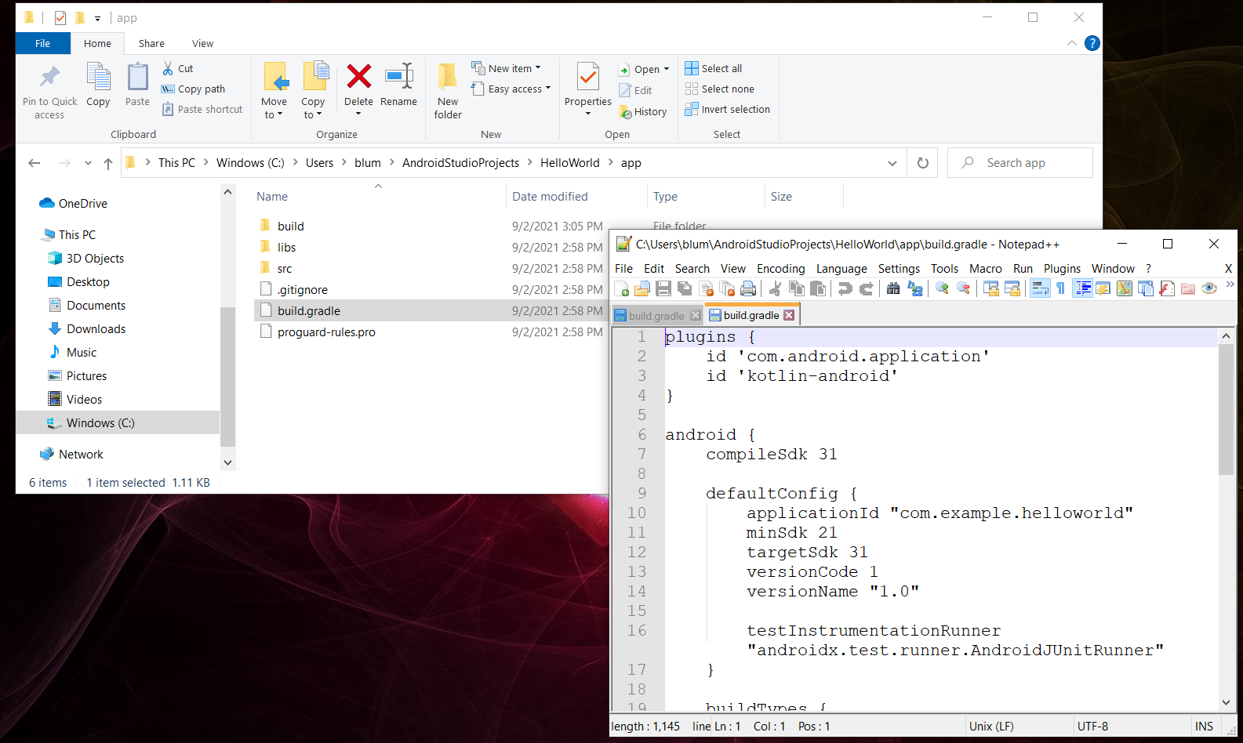
The build.gradle in the app folder is the one we are more likely to edit.

Slide 6
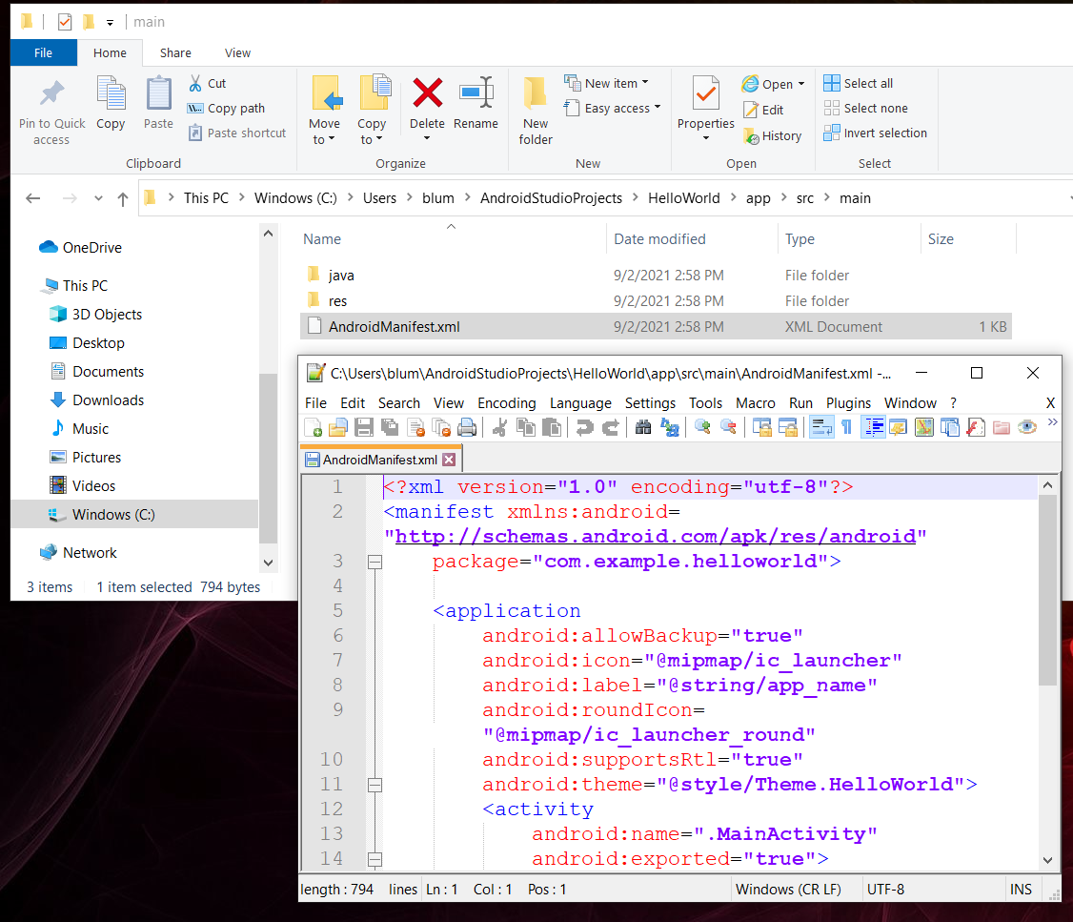
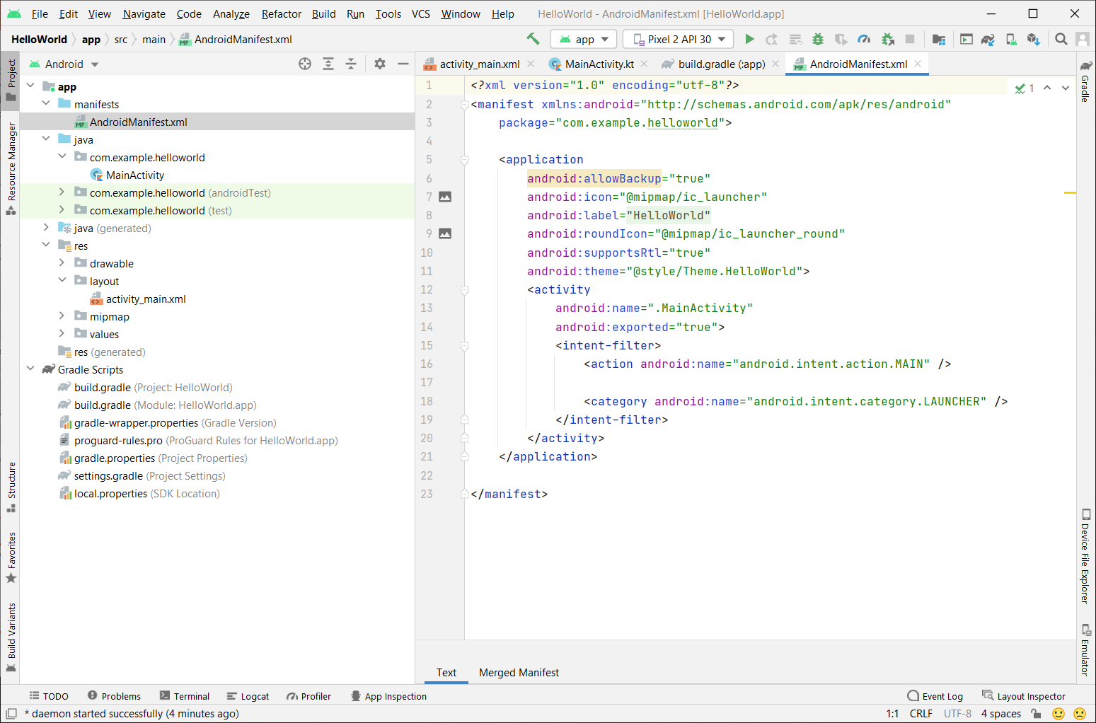
Getting down to the “main” thing: AndroidManifest

Slide 7
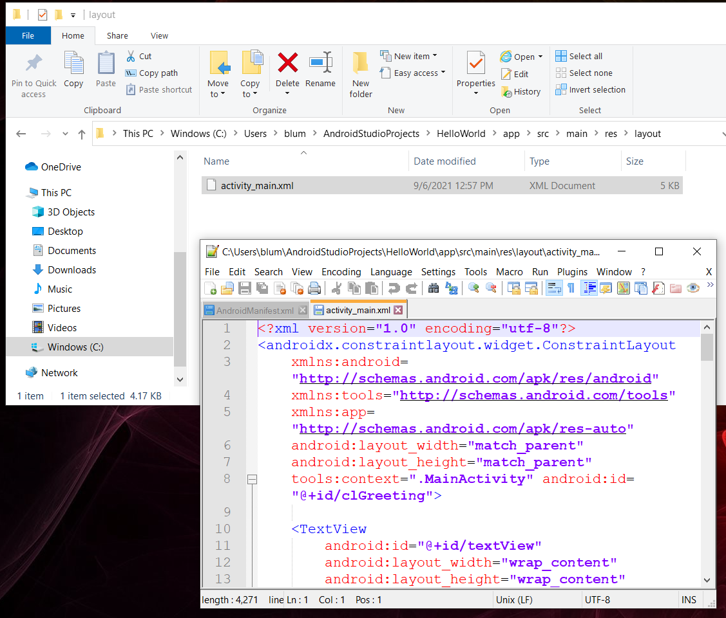
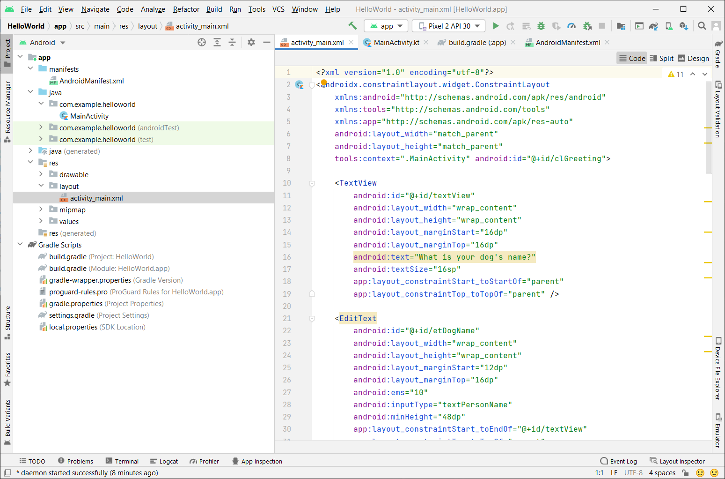
Main→Resource→Layout

Slide 8
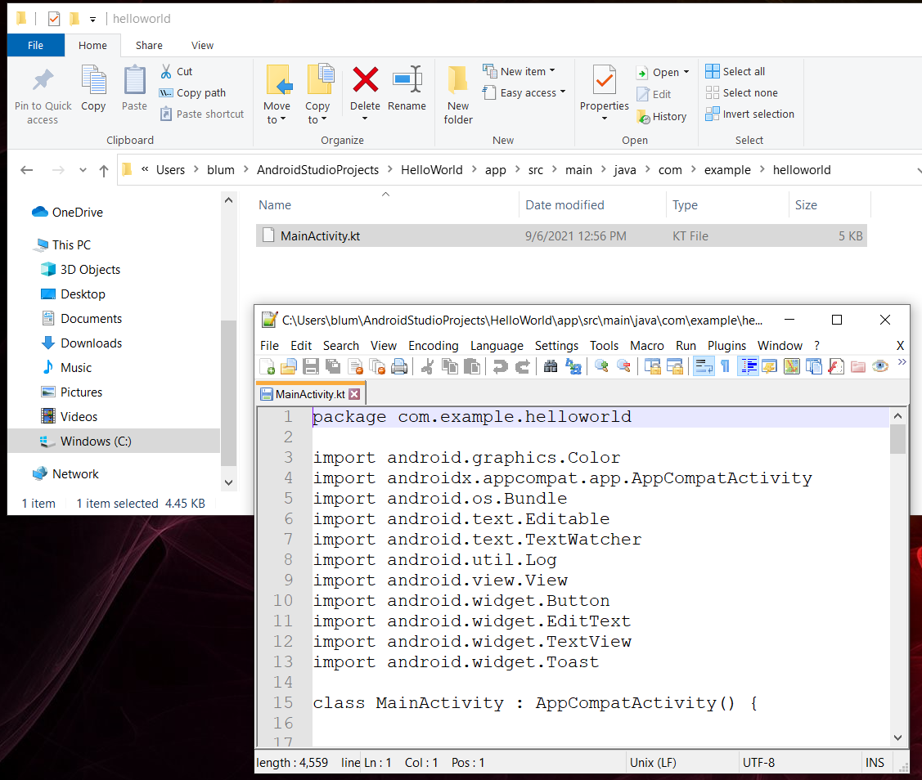
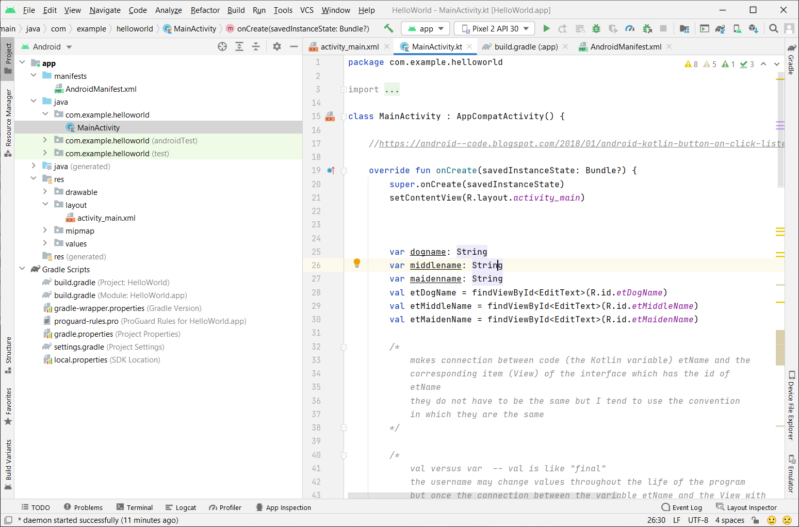
Main→java→ com→example→helloword

