Slide 1
Bottom Navigation Activity

Slide 2
Start a New Project and choose a Bottom Navigation Views Activity

Slide 3
A lot more stuff!

Slide 4
Issue when trying to run Bottom Navigation “Hello World”

Slide 5
Change the 33’s to 34’s and Re-Sync

Slide 6
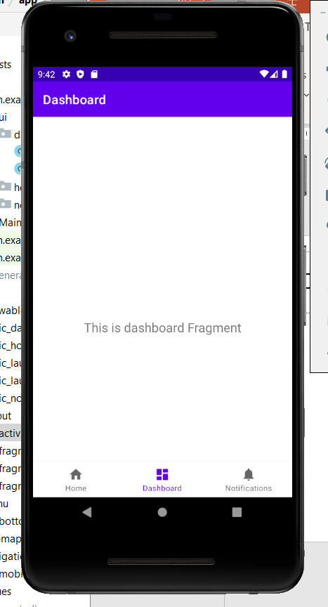
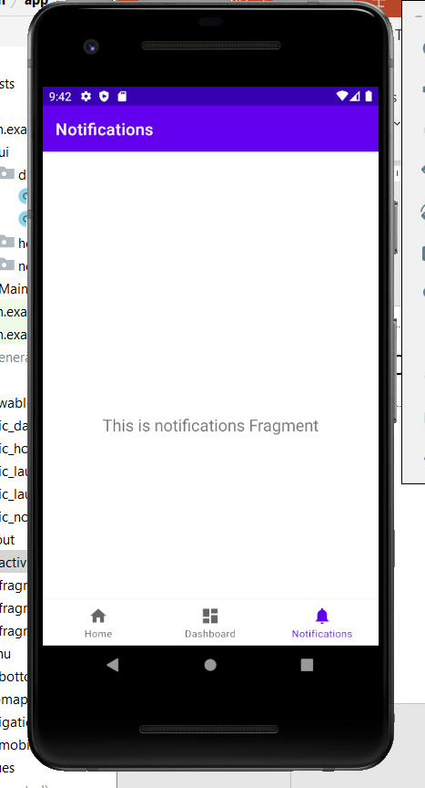
Running “Hello World” Bottom navigation – Three “fragments”

Slide 7
Navigation icon and bottom menu. Drawable. bottom_nav_menu.xml <item>

Slide 8
I changed the title.

Slide 9
Editing the fragment xml. (It didn’t want me to type text, but it finally let me.)

Slide 10
Edit corresponding Fragment class

Slide 11
Edit fragment xml – not much has changed here from a regular View Activity. One change was in setting ids; I added an SL to indicate the Straight Line tab. (e.g. etSLInitial)

Slide 12
Edit Fragment. Connect to interface changed.

Slide 13
Not much change to Button click handler. The Toast’s makeText’s first argument is now root.context

Slide 14
Straight-Line Depreciation fragment

