Slide 1
Kotlin Tabbed Activity

Slide 2
Start a new project, select Tabbed Activity and click Next

Slide 3
Name your project and click Finish

Slide 4
You get more stuff than you do with an Empty Activity. More .kt and more .xml

Slide 5
SectionsPagerAdapter controls moving between tabs. The FragmentPageAdapter (with one argument) is deprecated

Slide 6
Add a second argument, and viola not deprecated

Slide 7
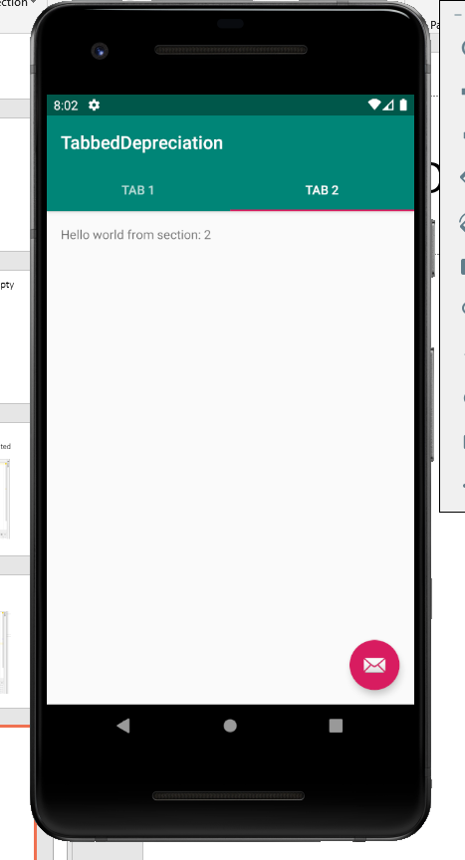
Emulator so far

Slide 8
Getting rid of the email floating thing. Part 1. Find the FloatingActionButton in activity_main.xml and delete it.

Slide 9
Find the corresponding code in MainActivity.kt and delete it.

Slide 10
Floating button gone.

Slide 11
Right click on res/layout and choose New Layout resource file.

Slide 12
Name it. Convention – all small letters with underscores between words

Slide 13
Design the fragment. This was a (vertical) Linear Layout – so it was a pretty simple design.

Slide 14
Right click on parent of MainActivity and chose to make a New Kotlin class

Slide 15
Naming convention: Start with capital letters and use camel case – starting each word with a capital letter

Slide 16
Initial code for the StraightLineFragment class – more to come

Slide 17
Edit the getItem method in the SectionsPageAdapter

Slide 18
Default tab is now turned into your designed tab

Slide 19
Edit the strings.xml file to change the name of the tab

Slide 20
Result of changing tab name

Slide 21
Code almost like before

