Slide 1
Read a “raw” text file

Slide 2
Right click on res folder, choose New and Directory. Name it raw.

Slide 3
Result of adding raw directory

Slide 4
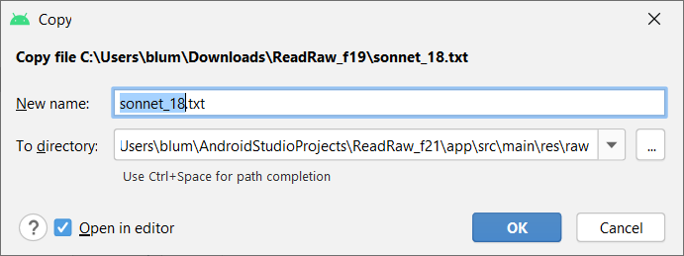
Copy text file. Right click on raw, choose Paste.

Slide 5
Naming rules
Small letters
Numbers
Underscore
Period
CANNOT start with a number

Slide 6
Code

