Slide 1

Organic Chemistry I
CHM 201
William A. Price, Ph.D.
price@lasalle.edu

Slide 2
Structure and Bonding
Atomic structure
Lewis Structures
Resonance
Structural Formulas
Hybridization

Slide 3
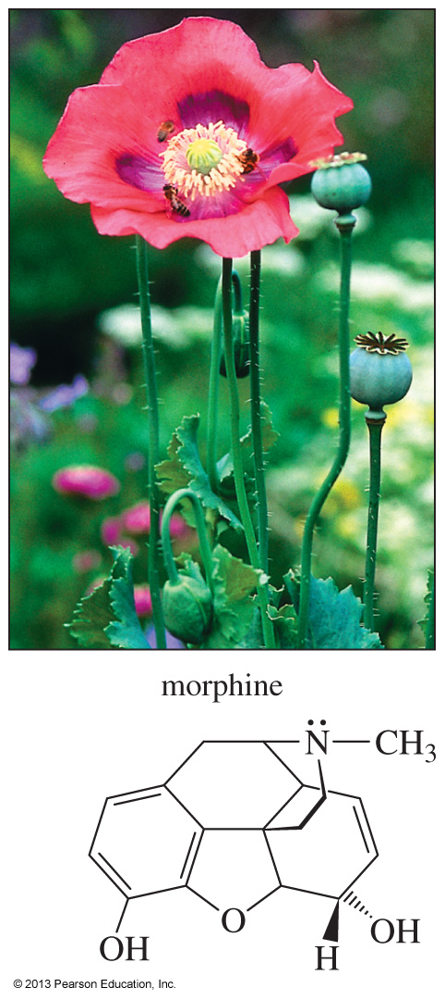
Notes:
Chapter 1, Unnumbered Figure 4, Page 2

Slide 4
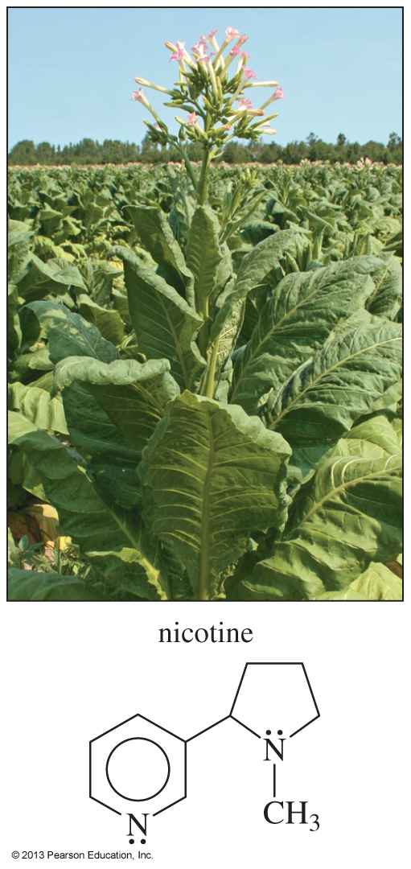
Notes:
Chapter 1, Unnumbered Figure 1, Page 2

Slide 5
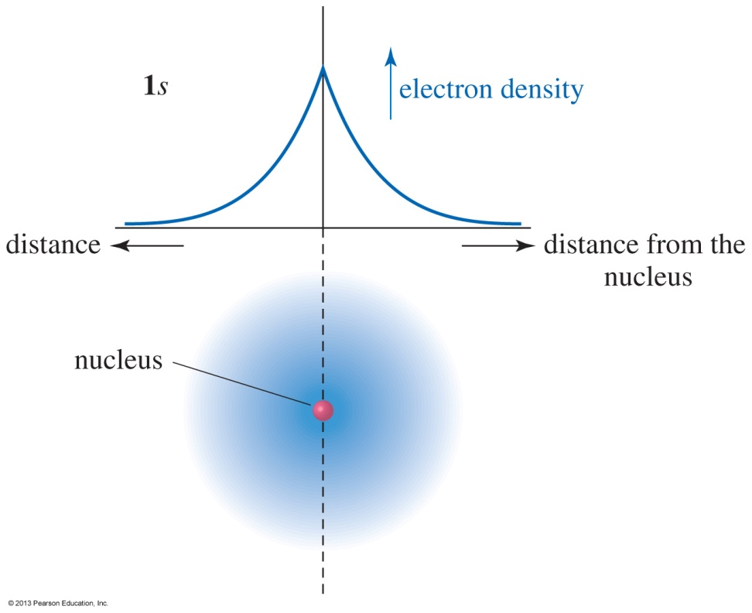
Electronic Structure of the Atom
An atom has a dense, positively charged nucleus surrounded by a cloud of electrons.
The electron density is highest at the nucleus and drops off exponentially with increasing distance from the nucleus in any direction.
Notes:
Fig 01-02.jpg
File Name: AAAKOZP0

Slide 6
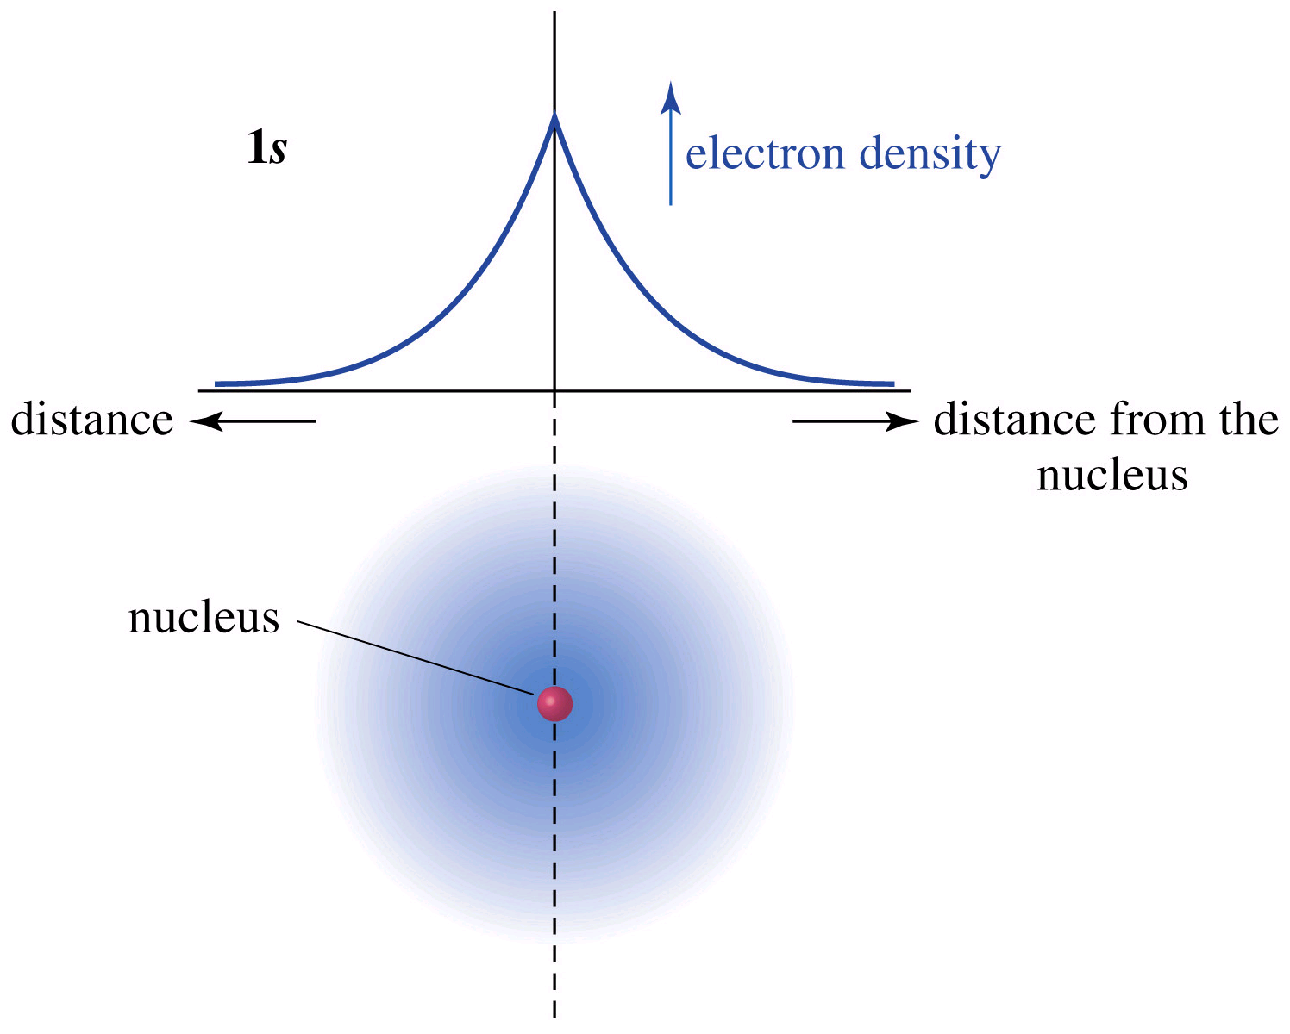
Orbitals are Probabilities

Slide 7
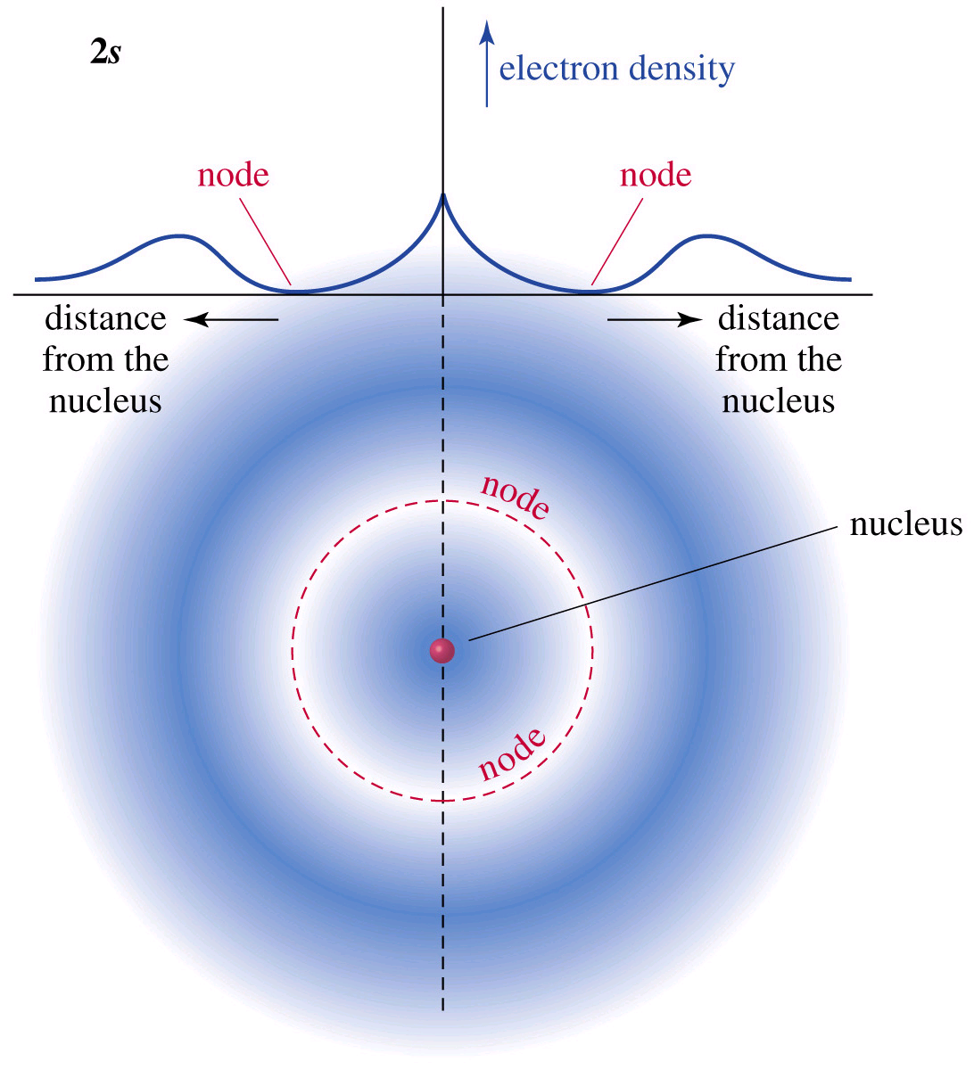
2s Orbital Has a Node

Slide 8
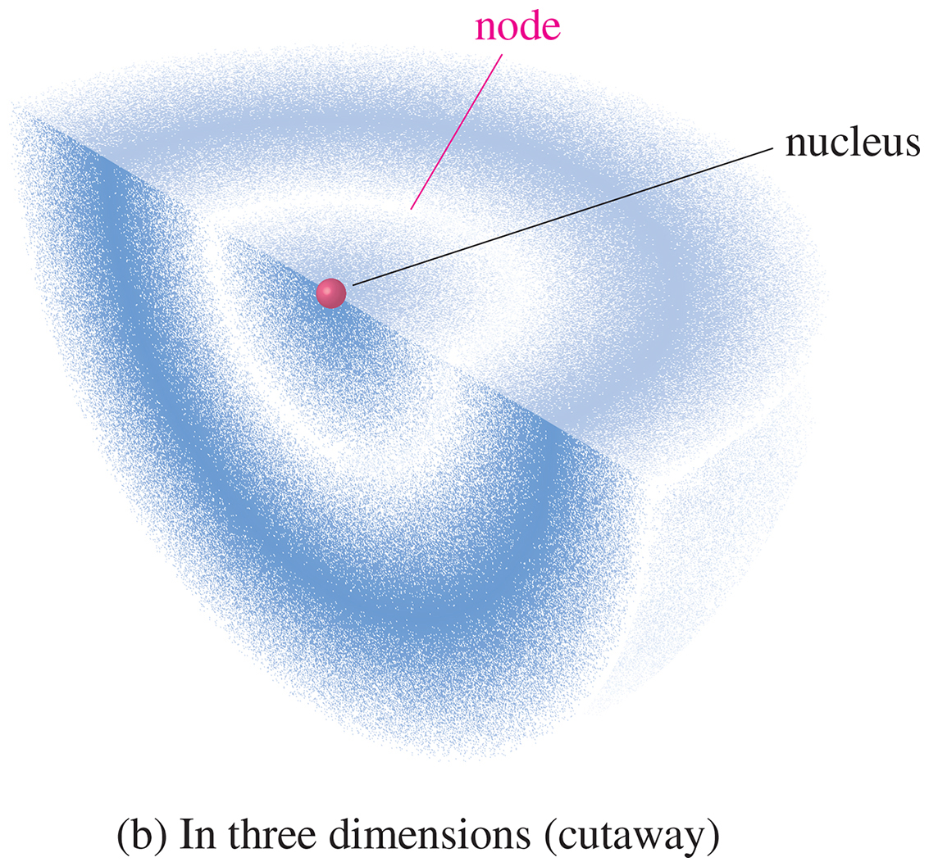
Notes:
Chapter 1, Figure 1.4B

Slide 9
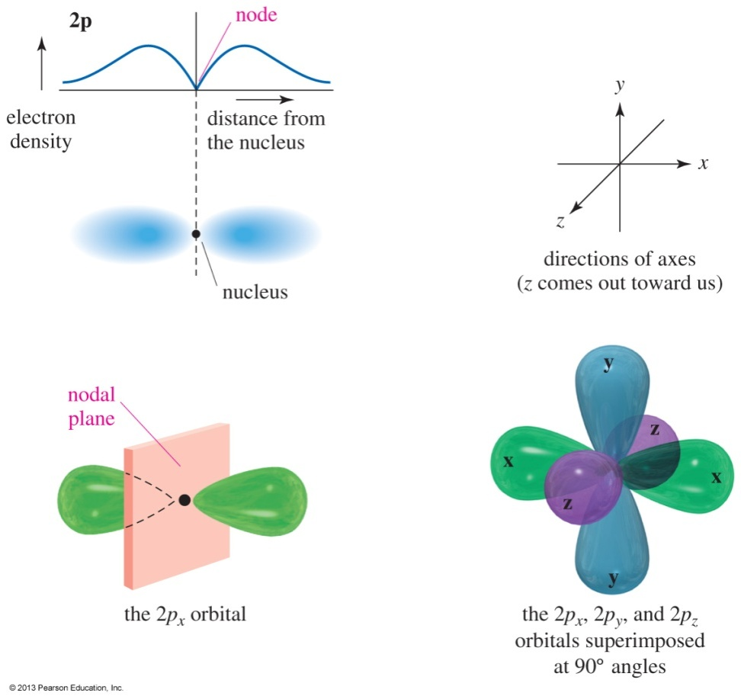
The 2p Orbitals
There are three 2p orbitals, oriented at right angles to each other.
Each p orbital consists of two lobes.
Each is labeled according to its orientation along the x, y, or z axis.
Notes:
Figure: 01-04.jpg
File Name: AAAKOZR0

Slide 10
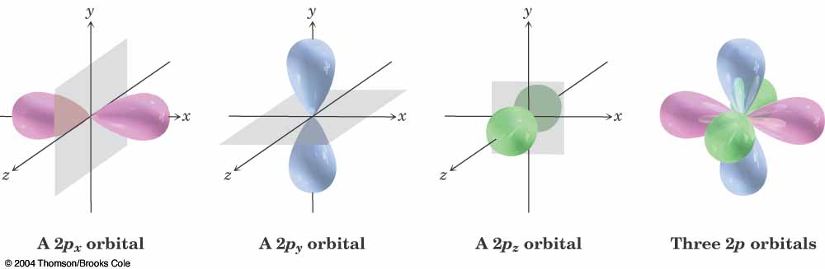
p_{x}, p_{y}, p_{z}

Slide 11
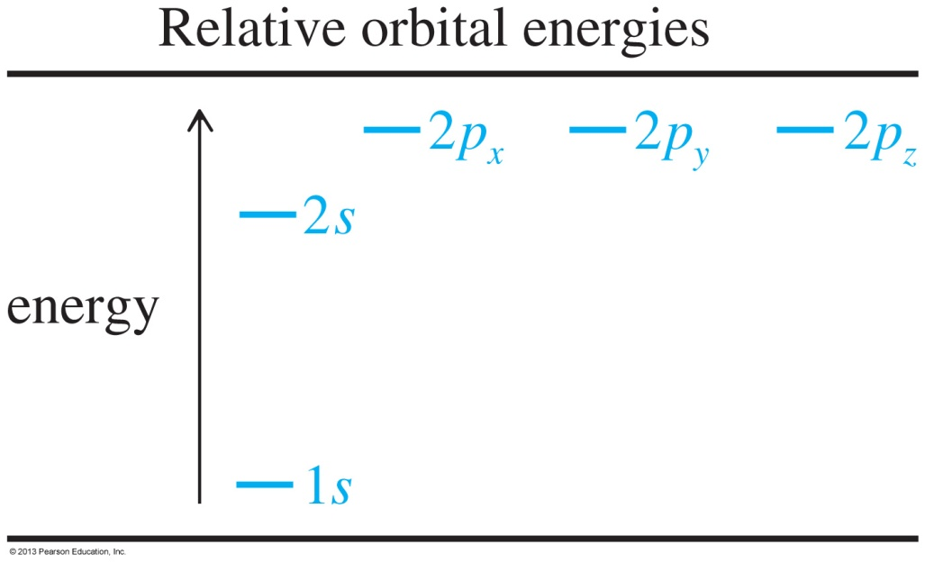
Electronic Configurations
The aufbau principle states to fill the lowest energy orbitals first.
Hund’s rule states that when there are two or more orbitals of the same energy (degenerate), electrons will go into different orbitals rather than pairing up in the same orbital.
Notes:
Figure: 01-01-01un.jpg
File Name: AABXOWK0

Slide 12
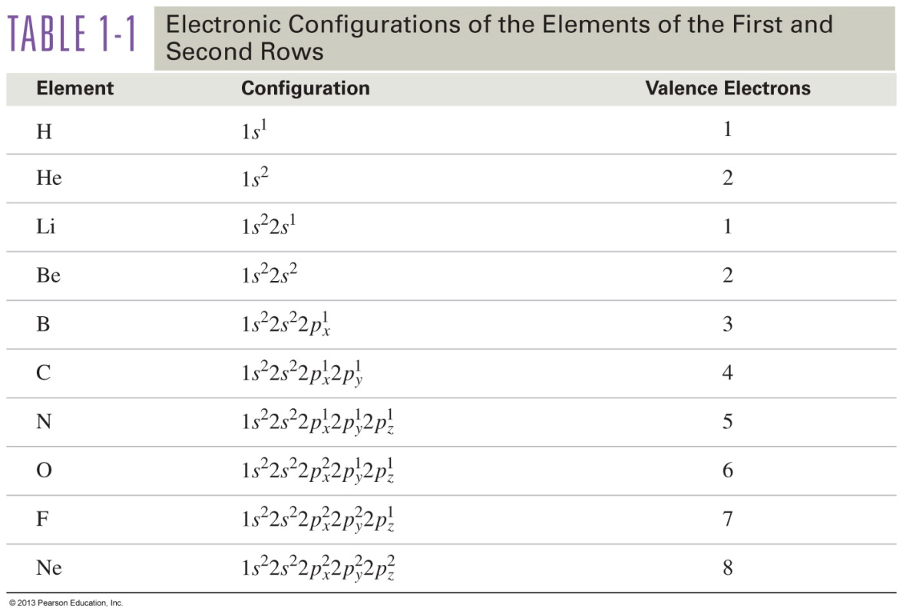
Electronic Configurations of Atoms
Valence electrons are electrons on the outermost shell of the atom.
Notes:
Table: 01-T01.jpg
Table 1-1 page 5 on the 8t edition.
Not found in art manuscript

Slide 13
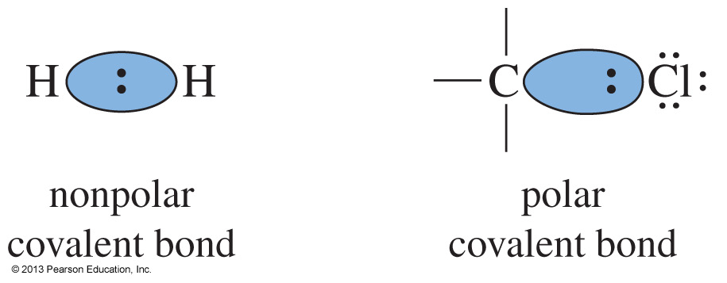
Covalent Bonding
Electrons are shared between the atoms to complete the octet.
When the electrons are shared evenly, the bond is said to be nonpolar covalent, or pure covalent.
When electrons are not shared evenly between the atoms, the resulting bond will be polar covalent.
Notes:
File Name: AAAKPAB0
Figure: 01-05-10un.jpg (only the first two images on the left side of the figure are used)

Slide 14
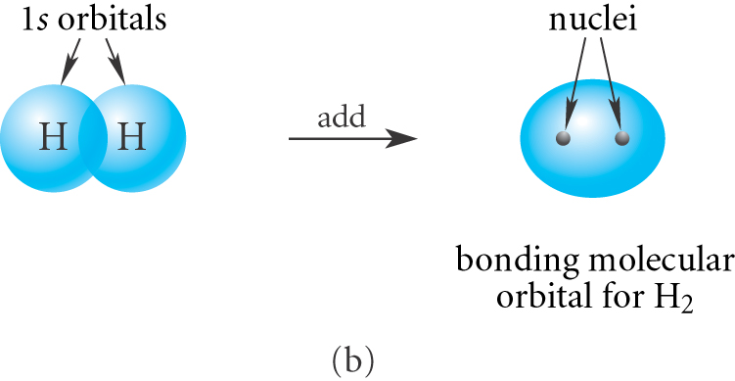
Bonding in H₂
The Sigma (σ) Bond

Slide 15
Sigma Bonding
Electron density lies between the nuclei.
A bond may be formed by s—s, p—p, s—p, or hybridized orbital overlaps.
The bonding molecular orbital (MO) is lower in energy than the original atomic orbitals.
The antibonding MO is higher in energy than the atomic orbitals.
Chapter 2
15

Slide 16
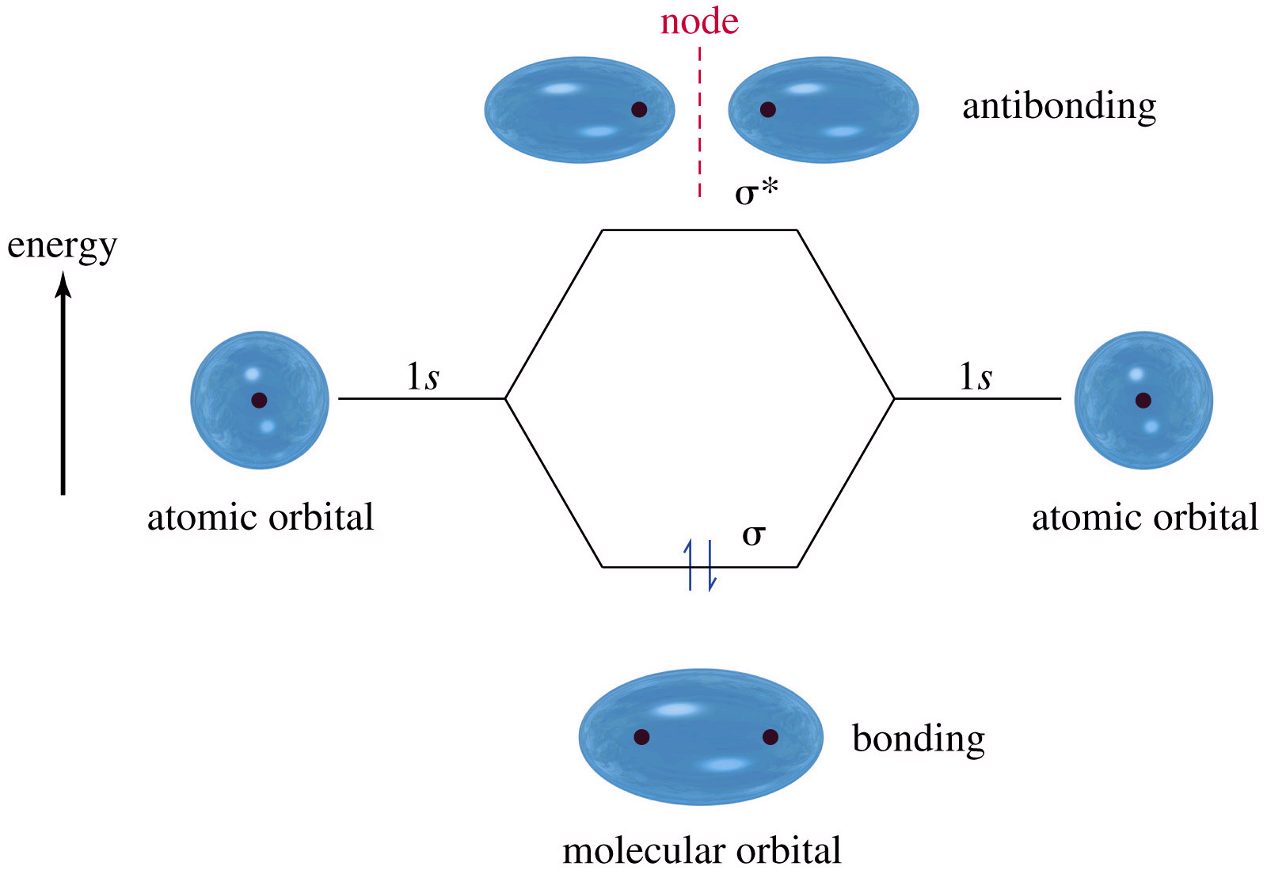
σ and σ* of H₂

Slide 17
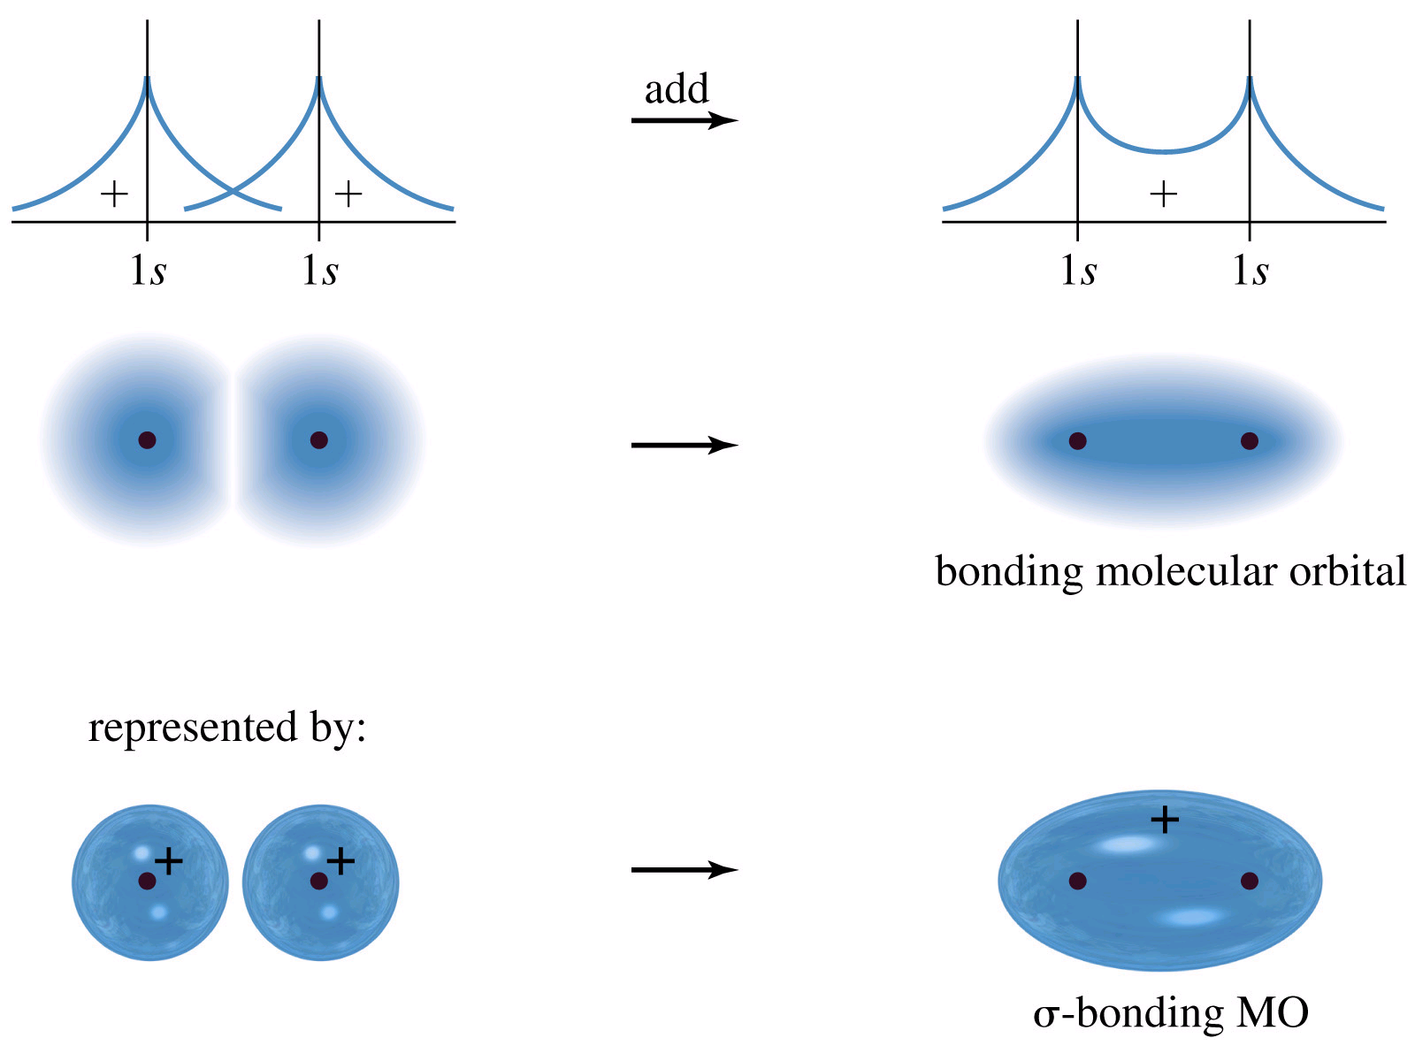
Molecular Orbitals
Mathematical Combination of Atomic Orbitals

Slide 18
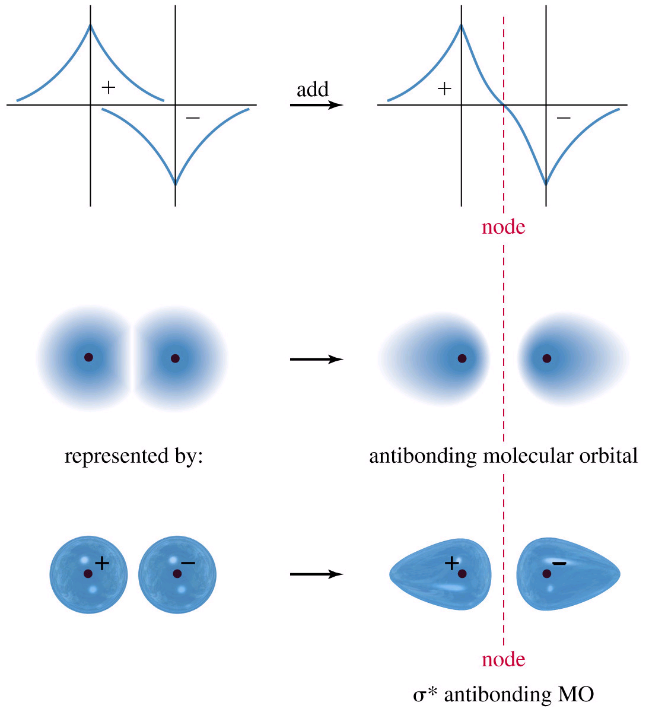
Antibonding Molecular Orbital Destructive Overlap Creates Node

Slide 19
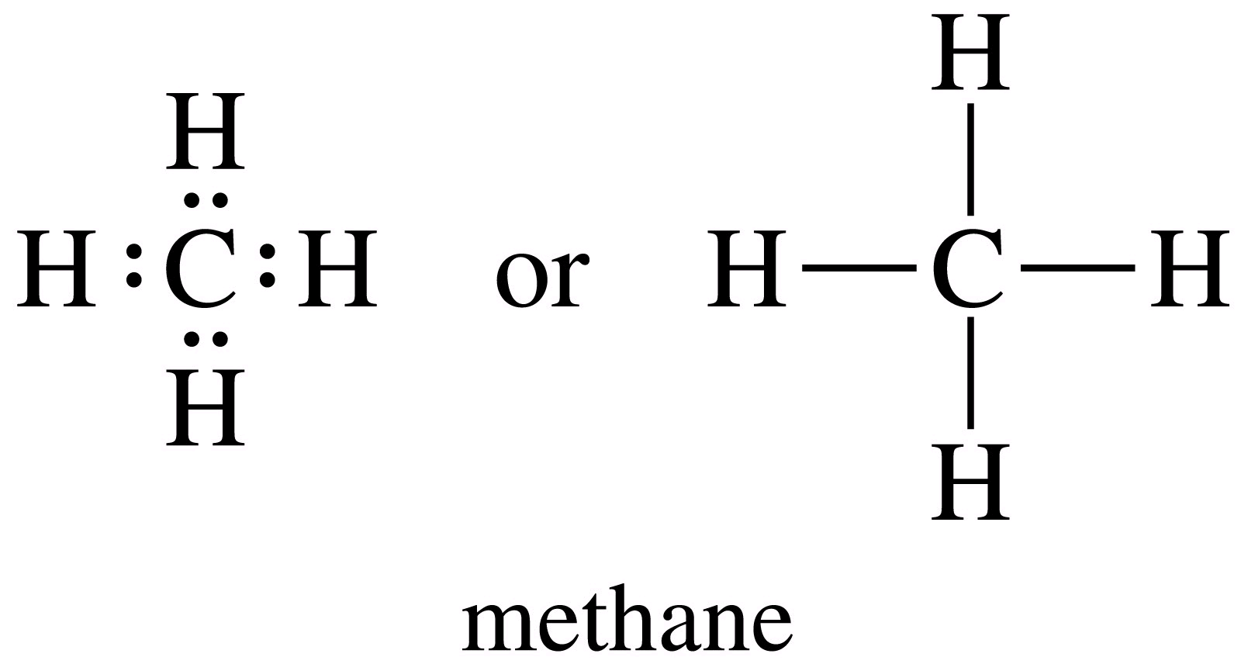
Lewis Dot Structure of Methane

Slide 20
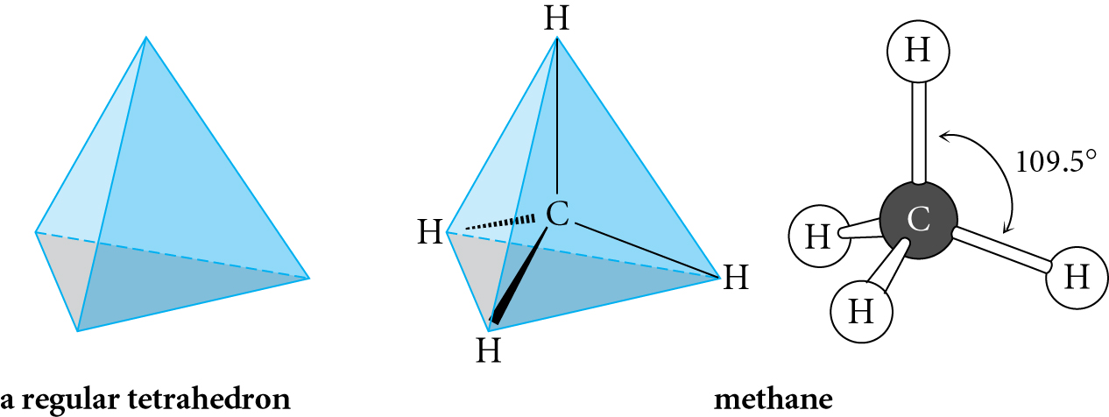
Tetrahderal Geometry

Slide 21
Lewis Structures
CH₄ NH₃
H₂O Cl₂
Nitrogen: 5 e
3 H@1 e ea: 3 e
8 e
Carbon: 4 e
4 H@1 e ea: 4 e
8 e
Oxygen: 6 e
2 H@1 e ea: 2 e
8 e
2 Cl @7 e ea: 14 e

Slide 22
Bonding Patterns
 | Valence electrons (group #) | # Bonds | # Lone Pair Electrons
C
N
O
Halides (F, Cl, Br, I)
4
4
0
5
3
1
6
2
2
7
1
3

Slide 23
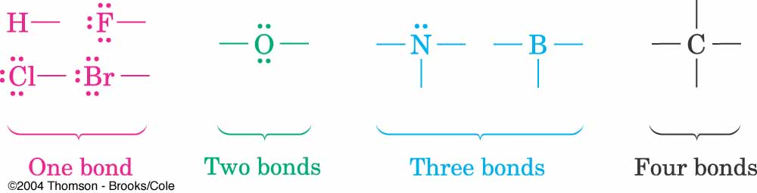

Slide 24
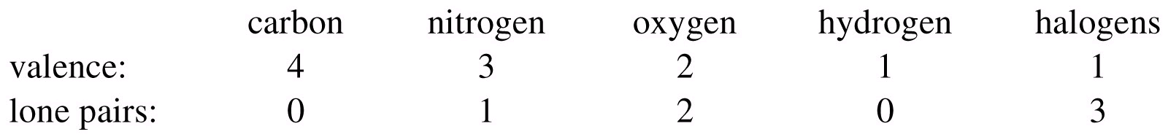
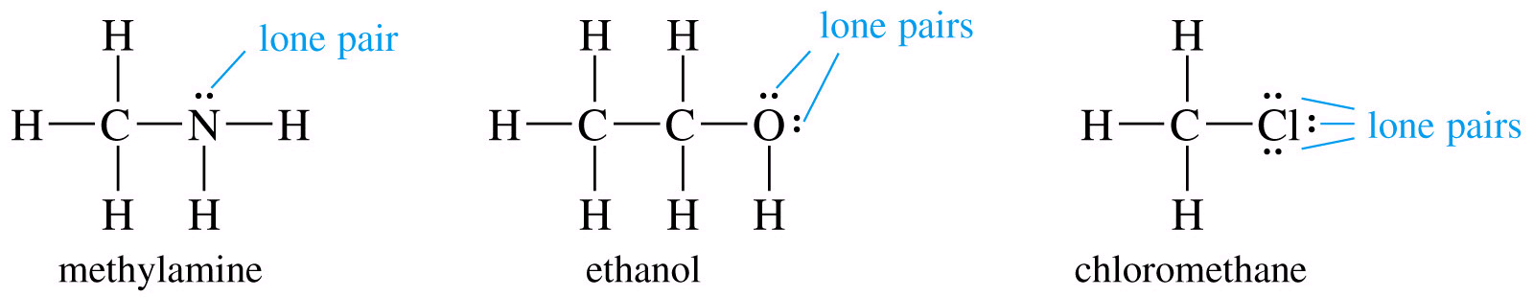
Bonding Characteristics of Period 2 Elements

Slide 25
Hint
Lewis structures are the way we
write organic chemistry.
Learning now to draw them
quickly and correctly will help
you throughout this course.

Slide 26
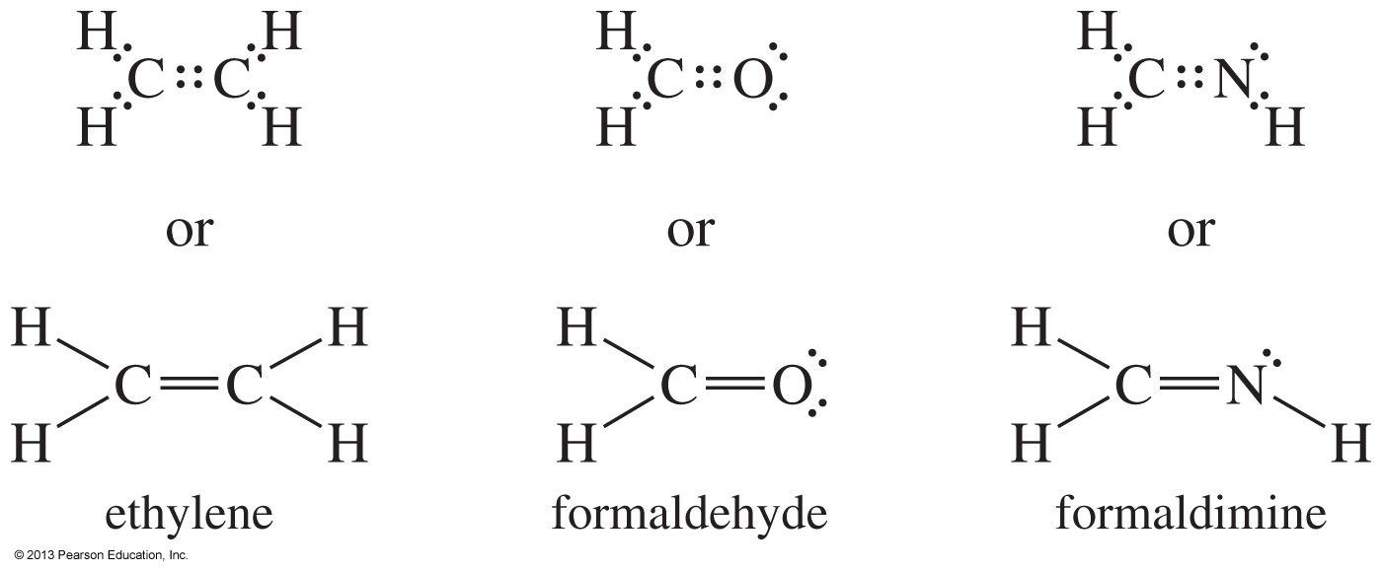
Multiple Bonding
Sharing two pairs of electrons is called a double bond.
Sharing three pairs of electrons is called a triple bond.
Notes:
Figure: 01-05-06un.jpg
File Name: AAAKOZY0

Slide 27
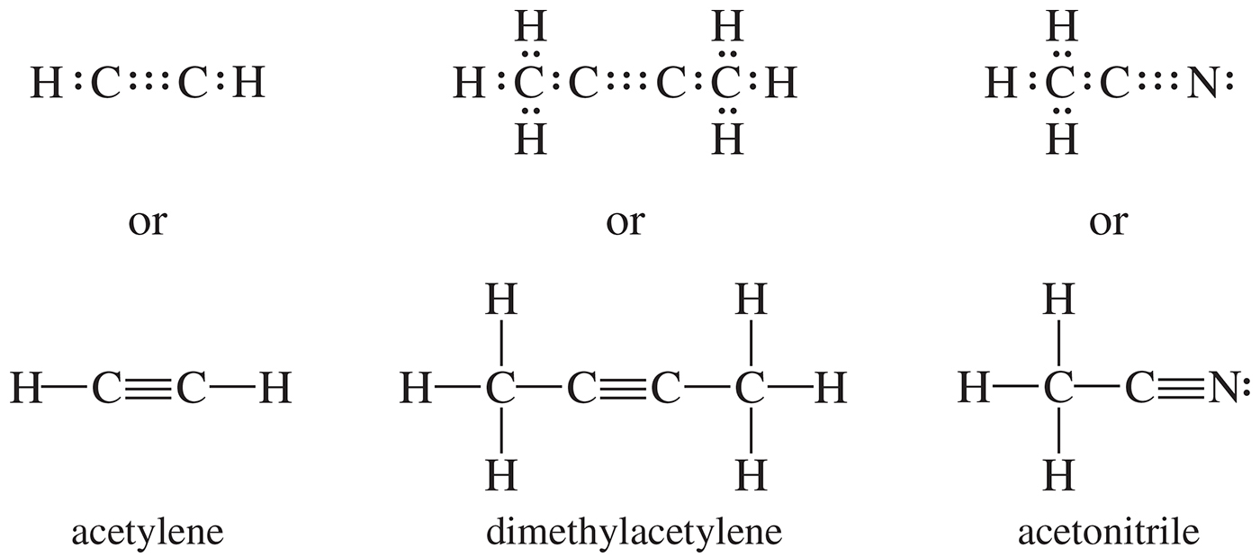
Notes:
Chapter 1, Unnumbered Figure 2, Page 9

Slide 28
Convert Formula into Lewis Structure
HCN
HNO₂
CHOCl
C₂H₃Cl
N₂H₂
O₃
HCO₃⁻
C₃H₄

Slide 29
Formal Charges
Formal charge = [group number ] – [nonbonding electrons ] – ½ [shared electrons]
H₃O⁺ NO⁺
6 – 2 – ½ (6) = +1
6 – 2 – ½ (6) = +1
+
+
5 – 2 – ½ (6) = 0
Formal charges are a way of keeping track of electrons.
They may or may not correspond to actual charges in the molecule.

Slide 30
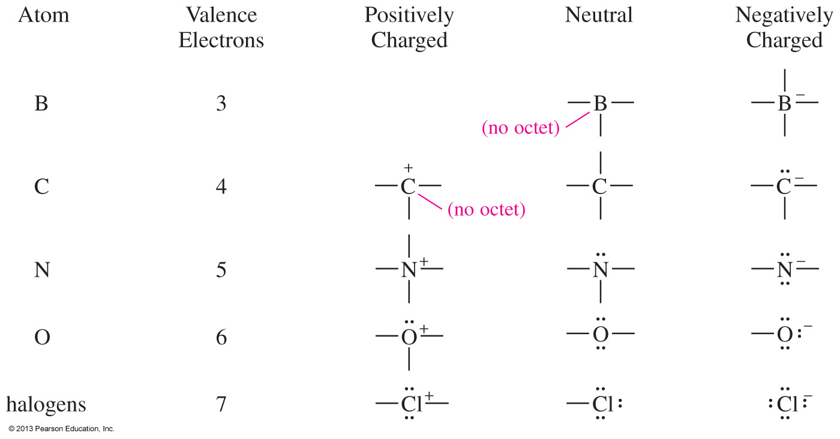
Common Bonding Patterns
Notes:
Figure: 01-07-007un.jpg
File Name: AAAKPAJ0

Slide 31
Hint
Work enough problems to
become familiar with these
bonding patterns so you can
recognize other patterns as
being either unusual or wrong.

Slide 32
Nitromethane has 2 Formal Charges

Slide 33
Both Resonance Structures Contribute to the Actual Structure

Slide 34
Dipole Moment reflects Both Resonance Structures

Slide 35
Resonance Rules
Cannot break single (sigma) bonds
Only electrons move, not atoms
3 possibilities:
  Lone pair of e⁻ to adjacent bond position
    Forms π bond
  − π bond to adjacent atom
  − π bond to adjacent bond position

Slide 36
Curved Arrow Formalism
Shows flow of electrons

Slide 37
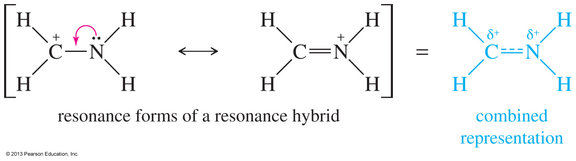
Resonance Forms
The structures of some compounds are not adequately represented by a single Lewis structure.
Resonance forms are Lewis structures that can be interconverted by moving electrons only.
The true structure will be a hybrid between the contributing resonance forms.
Notes:
Figure: 01-07-009un.jpg
File Name: AAAKPAM0

Slide 38
Resonance Forms
Resonance forms can be compared using the following criteria, beginning with the most important:
  Has as many octets as possible.
  Has as many bonds as possible.
  Has the negative charge on the most electronegative atom.
  Has as little charge separation as possible.

Slide 39
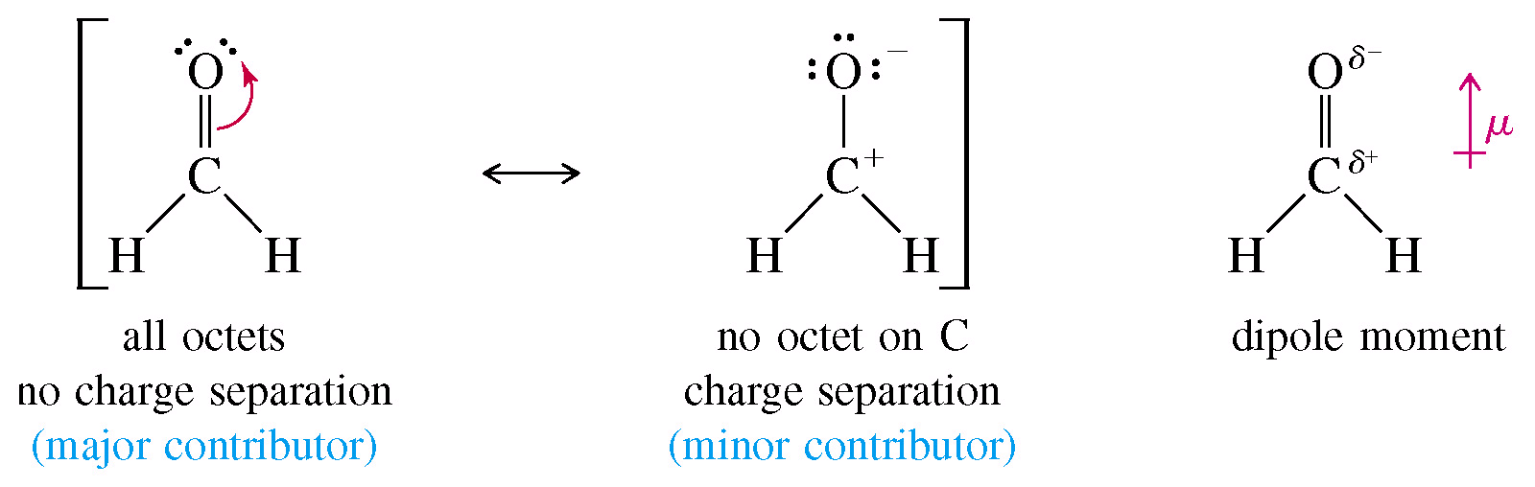
Two Nonequivalent Resonance Structures in Formaldehyde

Slide 40
Major and Minor Contributors
When both resonance forms obey the octet rule, the major contributor is the one with the negative charge on the most electronegative atom.
MAJOR MINOR
The oxygen is more electronegative,
so it should have more of the negative
charge.

Slide 41
Resonance Stabilization of Ions
Pos. charge is “delocalized”

Slide 42
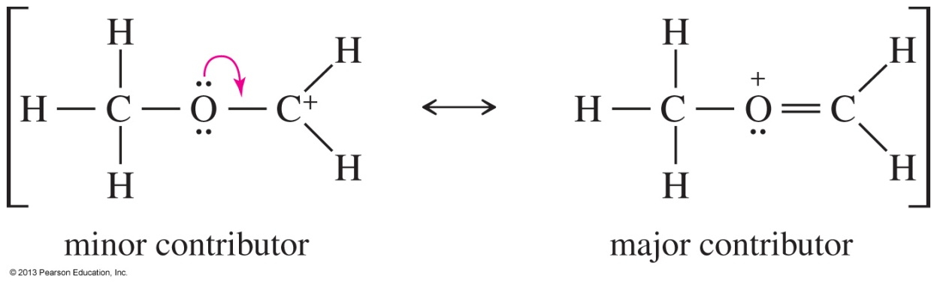
Solved Problem 2
Draw the important resonance forms for [CH₃OCH₂]⁺. Indicate which structure is the major and minor contributor or whether they would have the same energy.
Solution
The first (minor) structure has a carbon atom with only six electrons around it. The second (major) structure has octets on all atoms and an additional bond.
Notes:
File Name: AAAKPAR0
Figure 01-07-017un.jpg

Slide 43
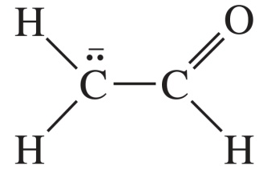
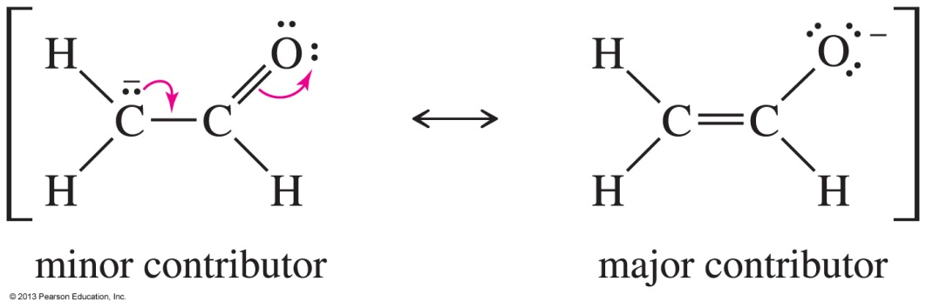
Solved Problem 3
Draw the resonance structures of the compound below. Indicate which structure is the major and minor contributor or whether they would have the same energy.
Solution
Both of these structures have octets on oxygen and both carbon atoms, and they have the same number of bonds. The first structure has the negative charge on carbon, the second on oxygen. Oxygen is the more electronegative element, so the second structure is the major contributor.
Notes:
Copyright © 2006 Pearson Prentice Hall, Inc.
Figure 01-07-018un.jpg (divided into two parts - problem & solution)

Slide 44
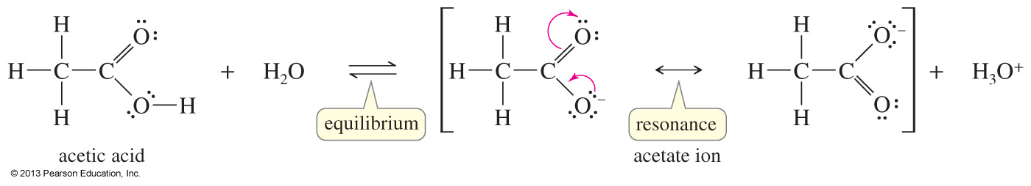
Resonance Forms for the
Acetate Ion
When acetic acid loses a proton, the resulting acetate ion has a negative charge delocalized over both oxygen atoms.
Each oxygen atom bears half of the negative charge, and this delocalization stabilizes the ion.
Each of the carbon–oxygen bonds is halfway between a single bond and a double bond and is said to have a bond order of 1½.
Notes:
Figure 01-07-010un.jpg
File Name: AAAKPAN0

Slide 45
Condensed Structural Formulas
Lewis Condensed
1 2
Condensed forms are written without showing all the individual bonds.
Atoms bonded to the central atom are listed after the central atom (CH₃CH₃, not H₃CCH₃).
If there are two or more identical groups, parentheses and a subscript may be used to represent them.

Slide 46
Drawing Structures

Slide 47
Octane Representations

Slide 48
Line-Angle Structures are Often Used as a Short-hand

Slide 49
Line-Angle Structures

Slide 51
Line-Angle structure Superimposed on Lewis Structure

Slide 52
Line-Angle Drawings
1 2 3 4 5 6
1 2 3 4 5 6
Atoms other than carbon must be shown.
Double and triple bonds must also be shown.

Slide 53
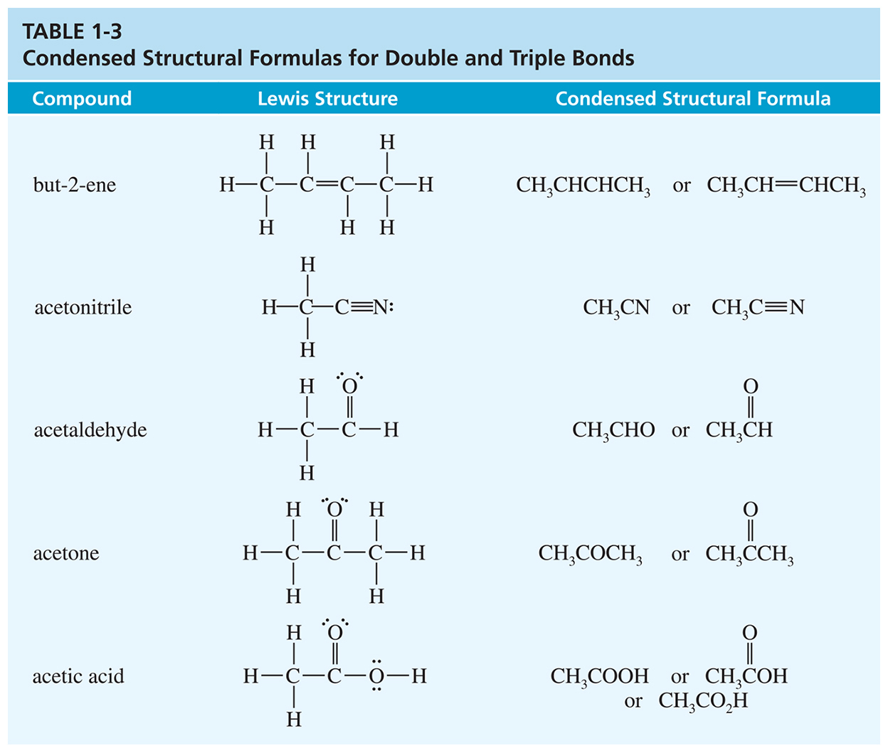
Notes:
Chapter 1, Table 1.3

Slide 54
For Cyclic Structures, Draw the Corresponding Polygon

Slide 55
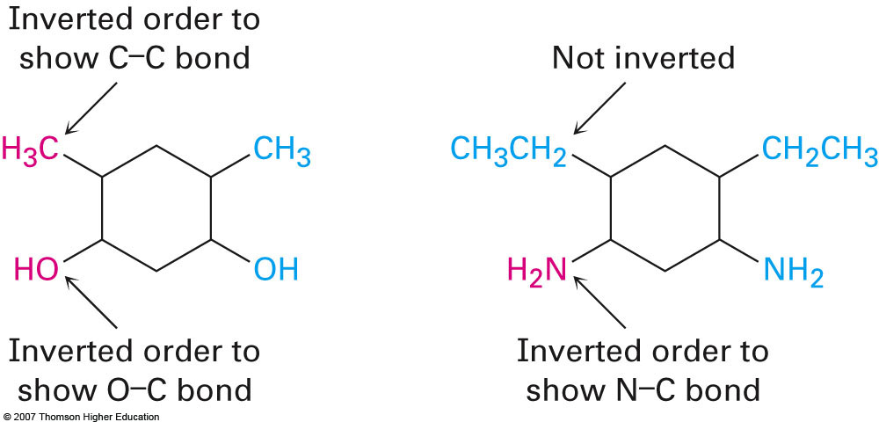
Drawing Clear Structures

Slide 56
Some Steroids

Slide 57
For CARBON, In the Ground State
2 bonding sites, 1 lone pair

Slide 58
sp³ Hybridization
4 Regions of electron Density link

Slide 59
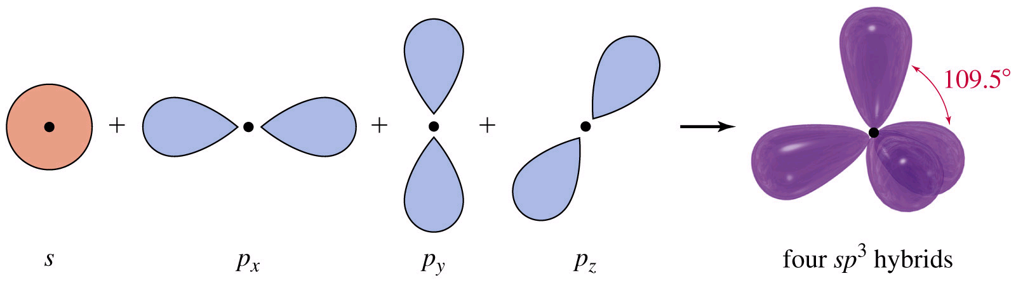
Hybridization of 1 s and 3 p Orbitals gives 4 sp³ Orbitals

Slide 60
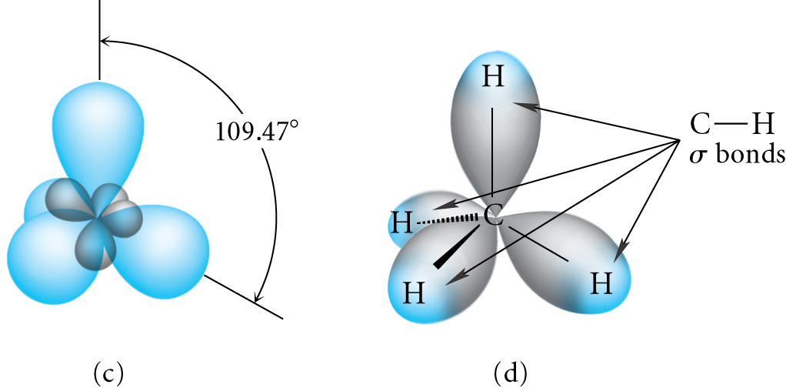
sp³ is Tetrahedral Geometry
Methane

Slide 61
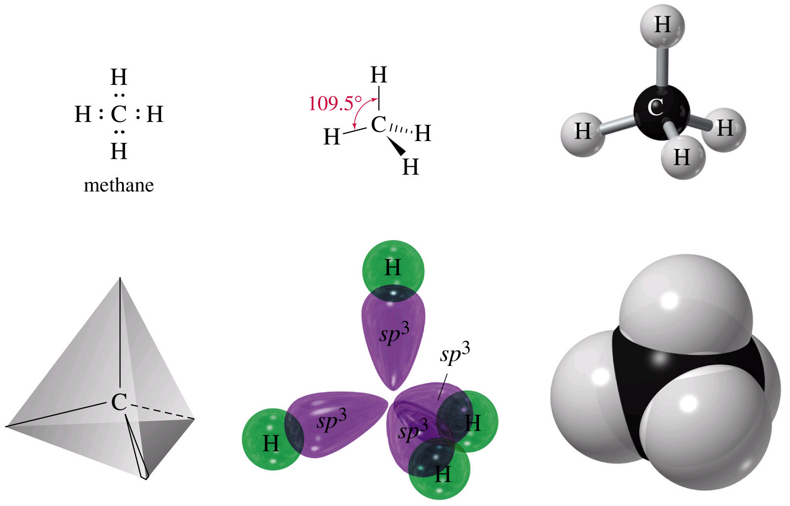
Methane Representations

Slide 62
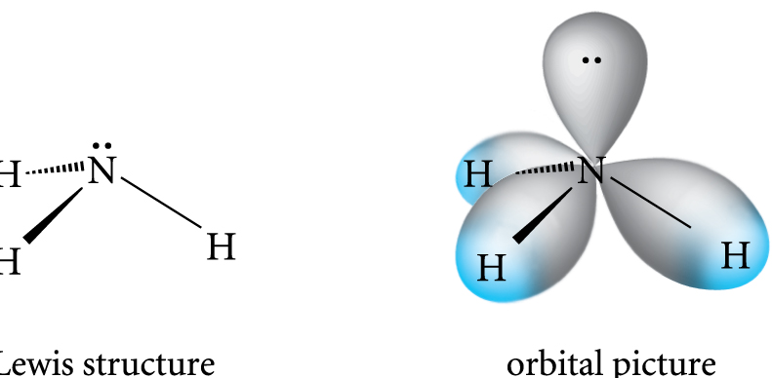
Ammonia
Tetrahedral Geometry
Pyramidal Shape

Slide 63
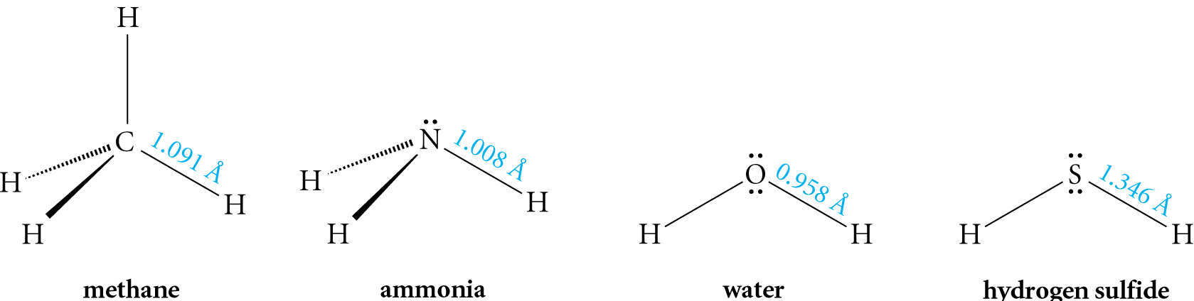
All Have the Same Geometry
All Have 4 Regions of Electron Density
All are sp³ Hybridized

Slide 64
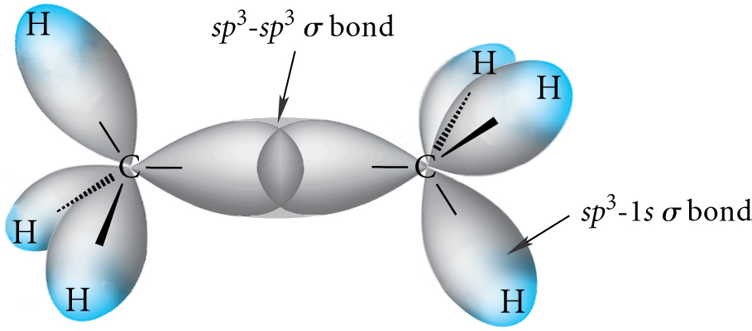
Orbital Depiction of Ethane, C₂H₆ , the σ bond

Slide 65
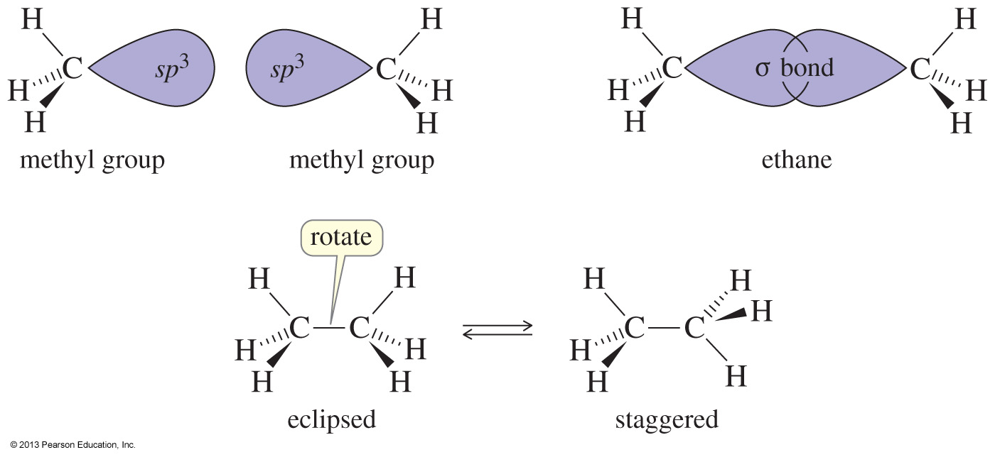
Rotation of Single Bonds
Ethane is composed of two methyl groups bonded by the overlap of their sp³ hybrid orbitals.
There is free rotation along single bonds.
Chapter 2
65
Notes:
File Name: AAAKPFL0
Figure: 02-20.jpg

Slide 66
Isomerism
Molecules that have the same molecular formula but differ in the arrangement of their atoms are called isomers.
Constitutional (or structural) isomers differ in their bonding sequence.
Stereoisomers differ only in the arrangement of the atoms in space.
Chapter 2
66

Slide 67
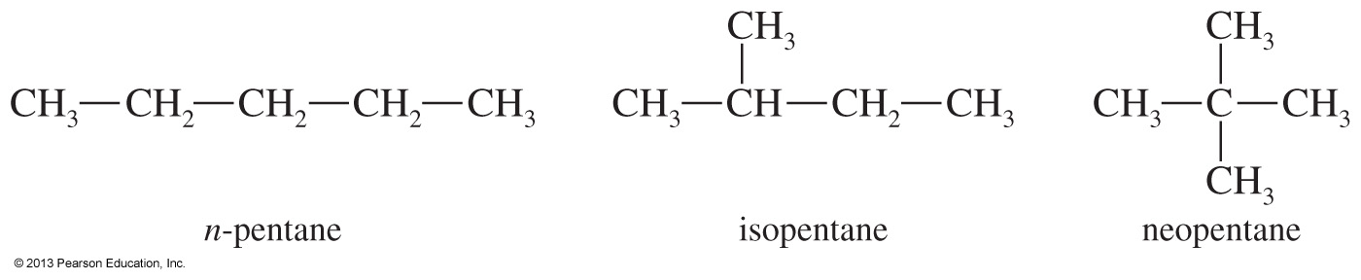
Constitutional Isomers
Constitutional isomers have the same chemical formula, but the atoms are connected in a different order.
Constitutional isomers have different properties.
The number of isomers increases rapidly as the number of carbon atoms increases.
Chapter 2
67
Notes:
File Name: AAAKPFP0
Figure: 02-20-05un.jpg

Slide 68
sp² Hybridization
3 Regions of Electron Density

Slide 69
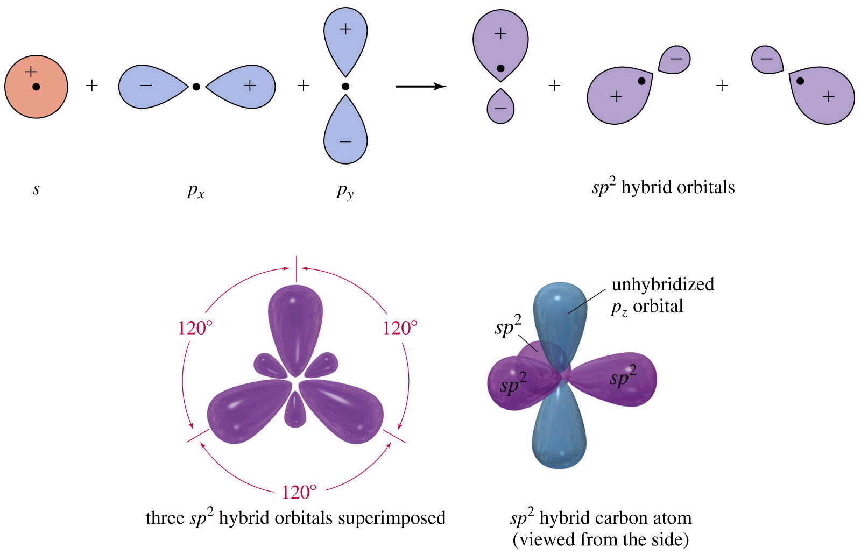
Hybridization of 1 s and 2 p Orbitals – sp²

Slide 70
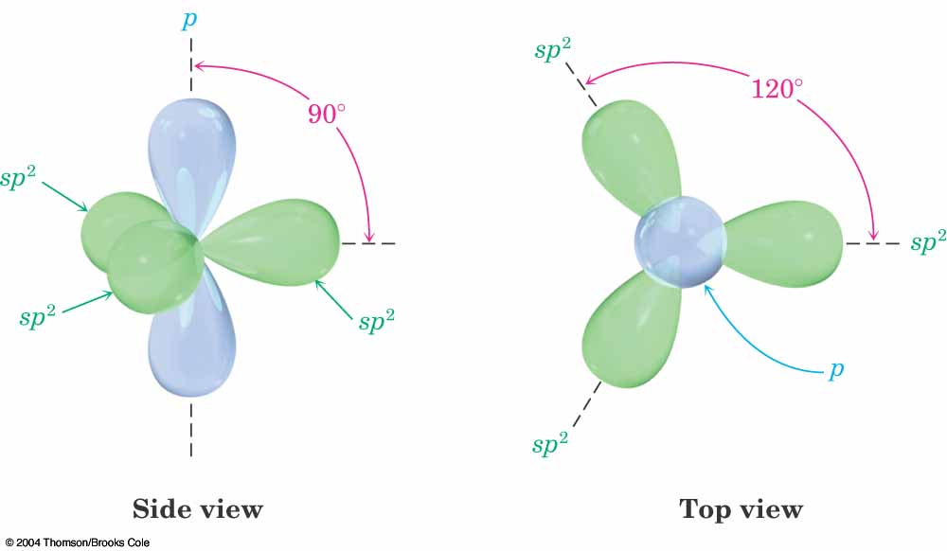
An sp² Hybridized Atom

Slide 71
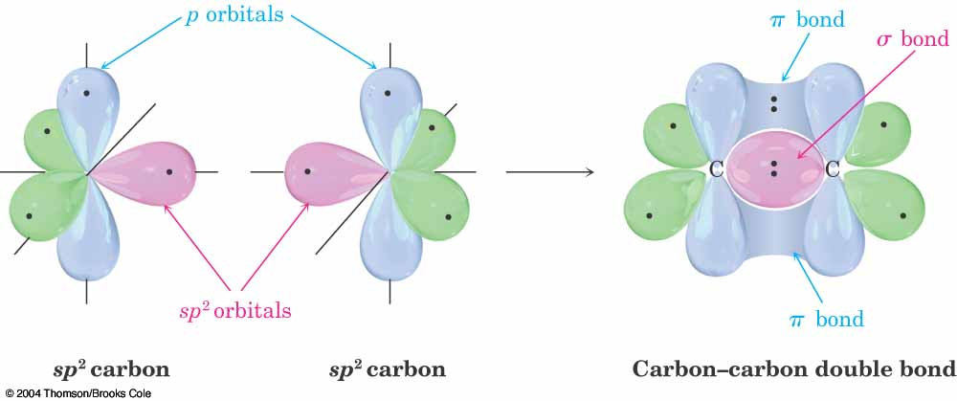
Ethylene CH₂=CH₂

Slide 72
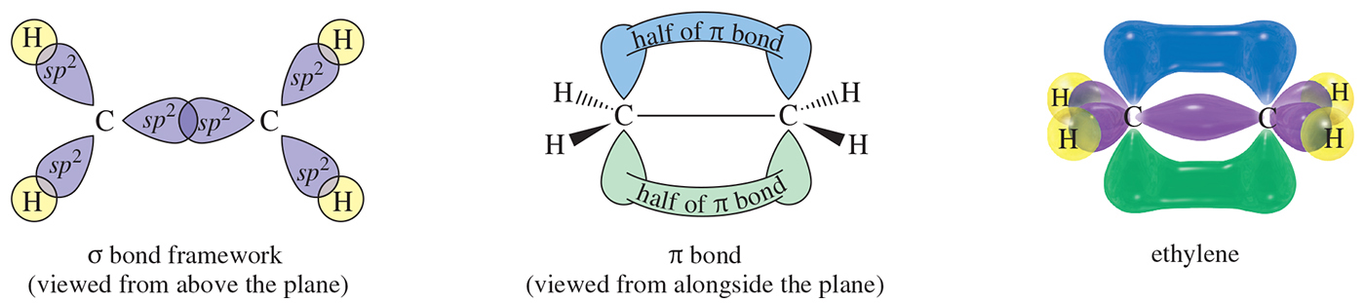
Notes:
Chapter 1, Figure 1.25

Slide 73
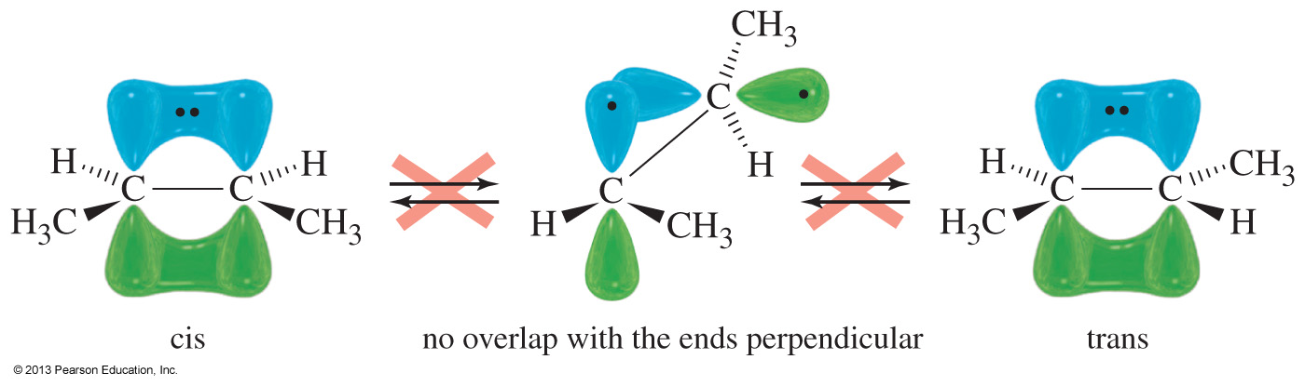
Rotation Around Double Bonds?
Double bonds cannot rotate.
Compounds that differ in how their substituents are arranged around the double bond can be isolated and separated.
Chapter 2
73
Notes:
File Name:AAAKWGU0 (this image is in chapter 7)
Figure: 07_02.jpg

Slide 74
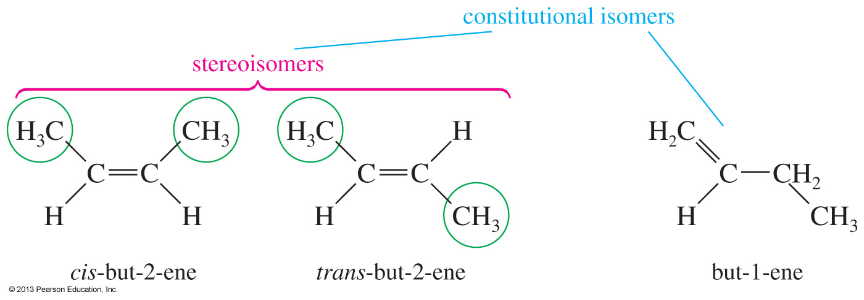
Geometric Isomers: Cis and Trans
Stereoisomers are compounds with the atoms bonded in the same order, but their atoms have different orientations in space.
Cis and trans are examples of geometric stereoisomers; they occur when there is a double bond in the compound.
Since there is no free rotation along the carbon–carbon double bond, the groups on these carbons can point to different places in space.
Chapter 2
74
Notes:
File Name: AAAKPFQ0
Figure: 02-20-07un.jpg

Slide 75
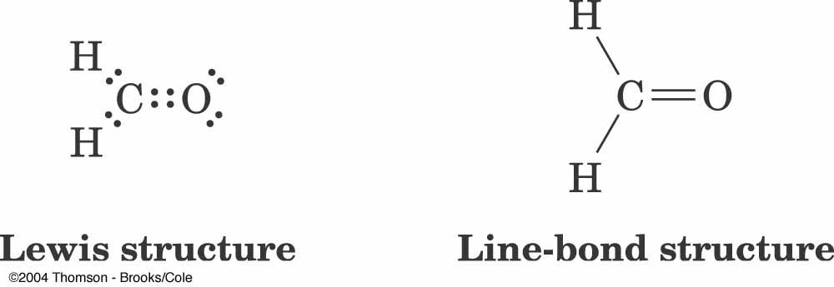
Formaldehyde – C and O both sp2 hybridized

Slide 76
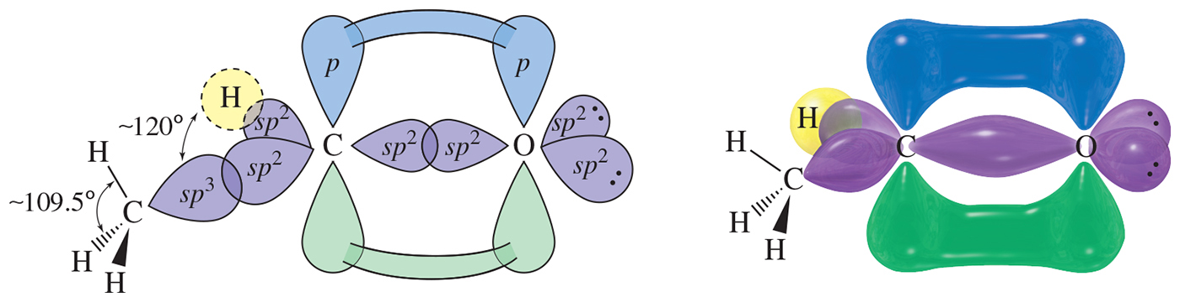
Notes:
Chapter 1, Figure 1.27

Slide 77
sp Hybridization
2 Regions of Electron Density

Slide 78
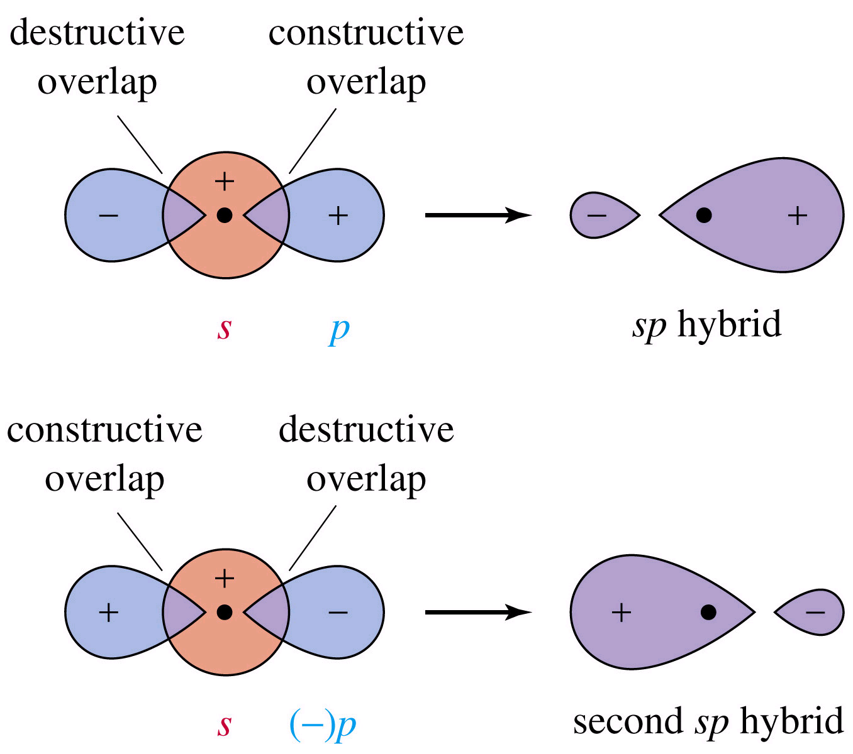
The sp Orbital

Slide 79
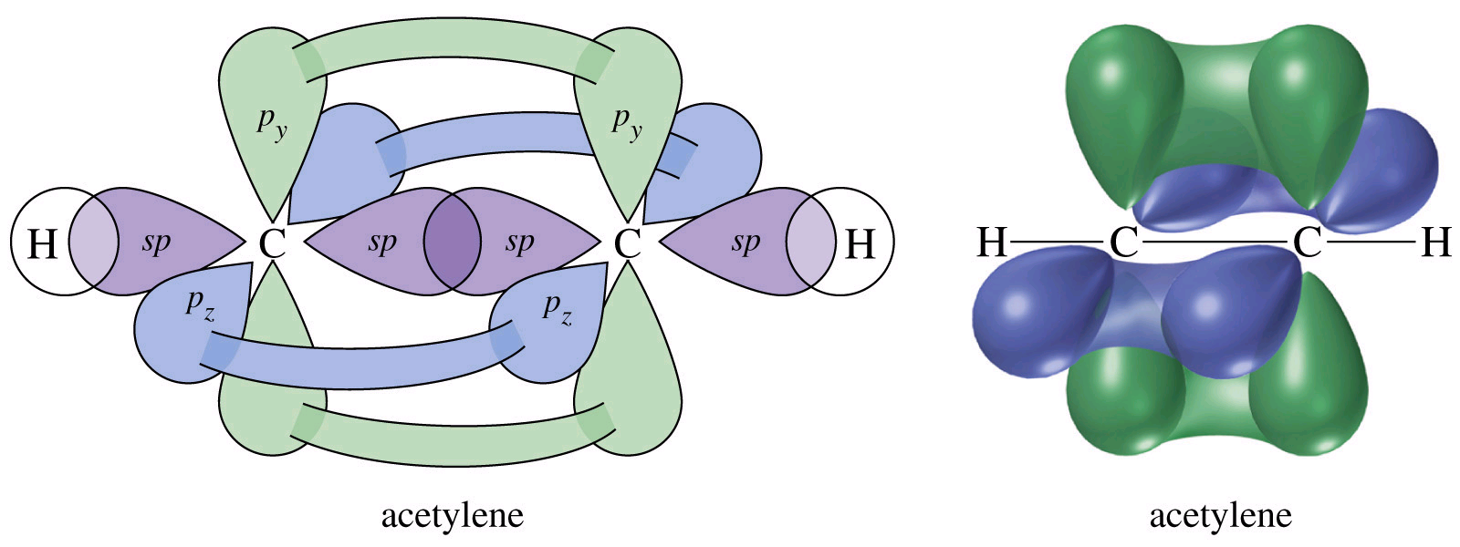
Acetylene, C₂H₂,
1 σ bond
2 perpendicular π bonds

Slide 80
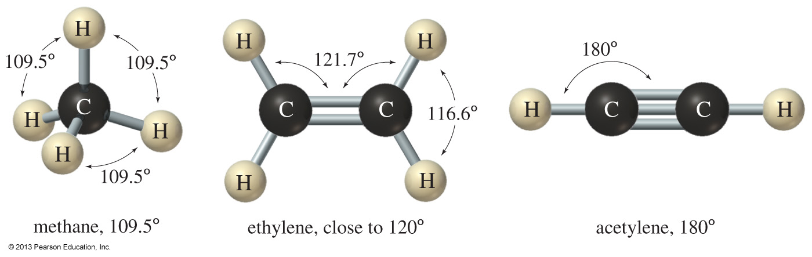
Molecular Shapes
Bond angles cannot be explained with simple s and p orbitals.
Valence-shell electron-pair repulsion theory (VSEPR) is used to explain the molecular shape of molecules.
Hybridized orbitals are lower in energy because electron pairs are farther apart.
Chapter 2
80
Notes:
File Name: AAAKPEQ0
Figure: 02-11.jpg

Slide 81
Summary of Hybridization and Geometry
Hybrid Orbitals (# of σ bonds) | Hybridization | Geometry | Approximate Bond Angle
2 | s + p = sp | linear | 180⁰
3 | s + p + p = sp² | trigonal | 120⁰
4 | s + p + p + p = sp³ | tetrahedral | 109.5⁰
Chapter 2
81
Notes:
File Name: cannot be found in Wade8e_ch02_artms.pdf
Figure: 02_UNT02.jpg

Slide 82


Solved Problem 2
Borane (BH₃) is not stable under normal conditions, but it has been detected at low pressure.
(a) Draw the Lewis structure for borane. (b) Draw a diagram of the bonding in this molecule, and label the hybridization of each orbital. (c) Predict the H–B–H bond angle.
Solution
There are only six valence electrons in borane. Boron has a single bond to each of the three hydrogen atoms.
The best bonding orbitals are those that provide the greatest electron density in the bonding region while keeping the three pairs of bonding electrons as far apart as possible. Hybridization of an s orbital with two p orbitals gives three sp² hybrid orbitals directed 120° apart. Overlap of these orbitals with the hydrogen 1s orbitals gives a planar, trigonal molecule. (Note that the small back lobes of the hybrid orbitals have been omitted.)
Chapter 2
82
Notes:
File Name: AABXRDW0
File Name: AAAKPEU0
Figure: 02-14-02un.jpg

