Slide 1
Acids and Bases Functional Groups
Polarity
Intermolecular Forces
Acids and Bases
Functional Groups

Slide 3
Electronegativity Trends Ability to Attract the Electrons in a Covalent Bond

Slide 4
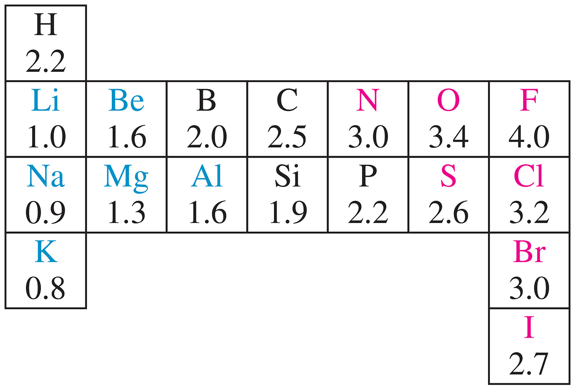
Notes:
Chapter 1, Figure 1.8

Slide 5
Notes:
Chapter 2, Unnumbered Figure, Page 56

Slide 6
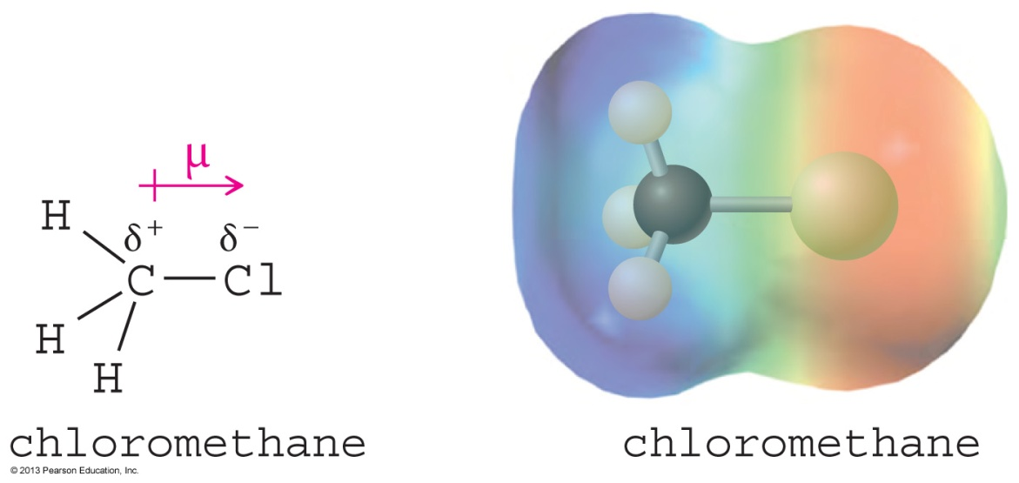
Dipole Moment
Dipole moment is defined to be the amount of charge separation (δ) multiplied by the bond length (μ).
Charge separation is shown by an electrostatic potential map (EPM), where red indicates a partially negative region and blue indicates a partially positive region.
Notes:
Figure: 01-06.jpg
File Name: AACXSBT0

Slide 7
Methanol

Slide 8
Dipole Moment (μ) is sum of the Bond Moments

Slide 9
Molecular Dipole Moment
The molecular dipole moment is the vector sum of the bond dipole moments.
Depends on bond polarity and bond angles.
Lone pairs of electrons contribute significantly to the dipole moment.
Chapter 2
9
Notes:
File Name: AAAKPGH0
Figure: 02-21.jpg

Slide 10
Nonpolar Compounds Bond Moments Cancel Out

Slide 11
A Model of a Saturated Hydrocarbon

Slide 12
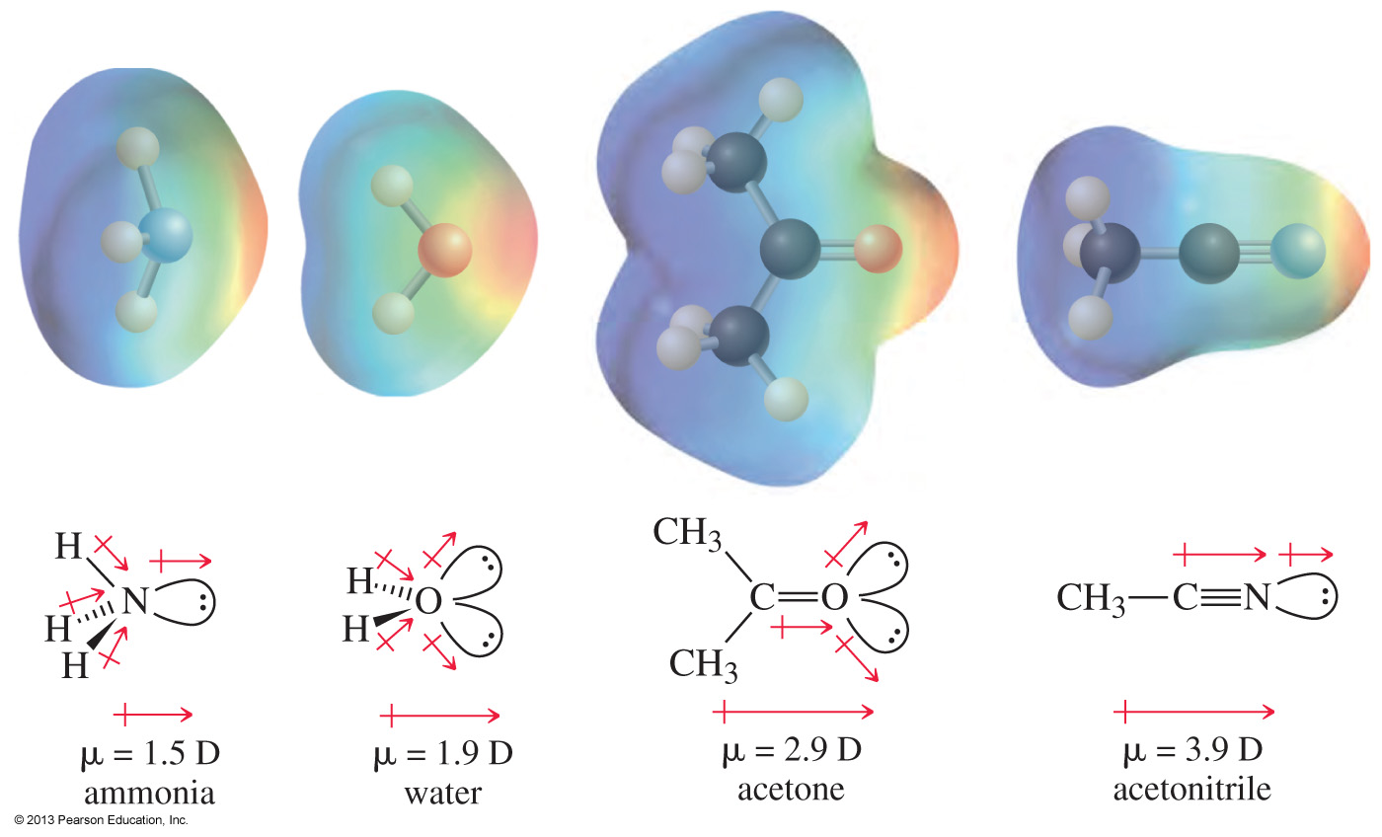
Lone Pairs and Dipole Moments
Chapter 2
12
Notes:
File Name: AACXSEK0
Figure: 02_22.jpg

Slide 13
Nitromethane

Slide 14
Dipole Moment reflects Both Resonance Structures

Slide 15
Intermolecular Forces
Strength of attractions between molecules influences the melting point (m. p.), boiling point (b. p.), and solubility of compounds.
Classification of attractive forces:
Dipole–dipole forces
London dispersions forces
Hydrogen bonding in molecules with —OH or —NH groups
Chapter 2
15

Slide 16
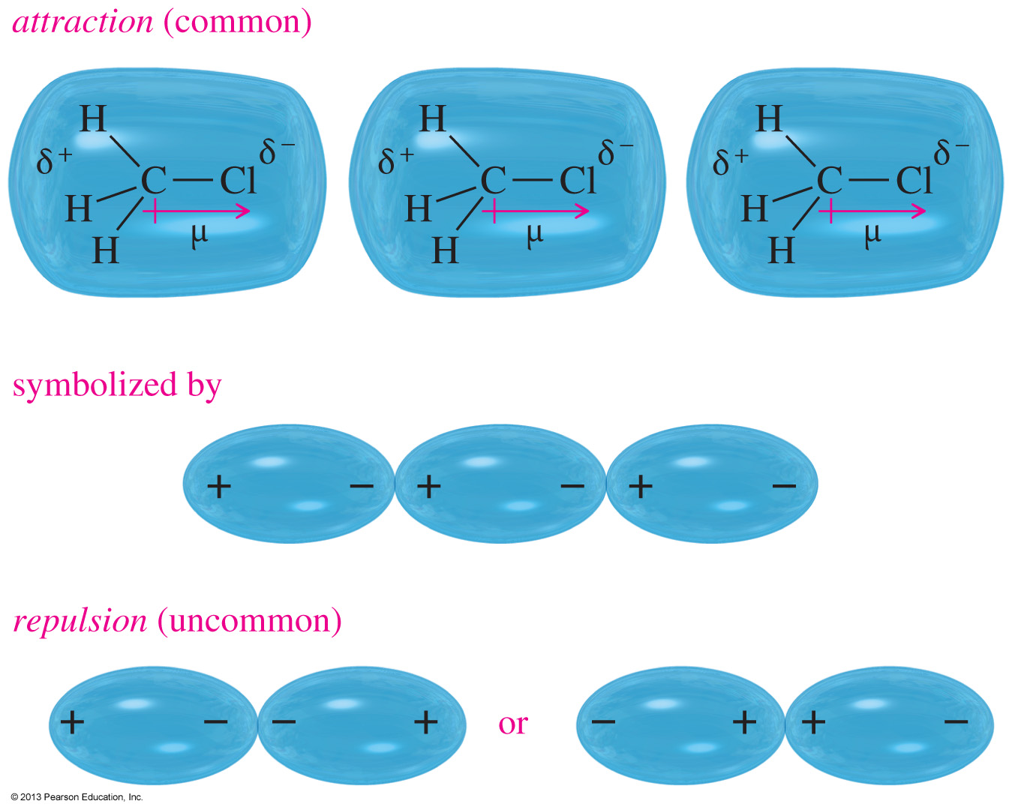
Dipole–Dipole Interaction
Chapter 2
16
Notes:
File Name: AAAKPGJ0
Figure: 02-23.jpg

Slide 17
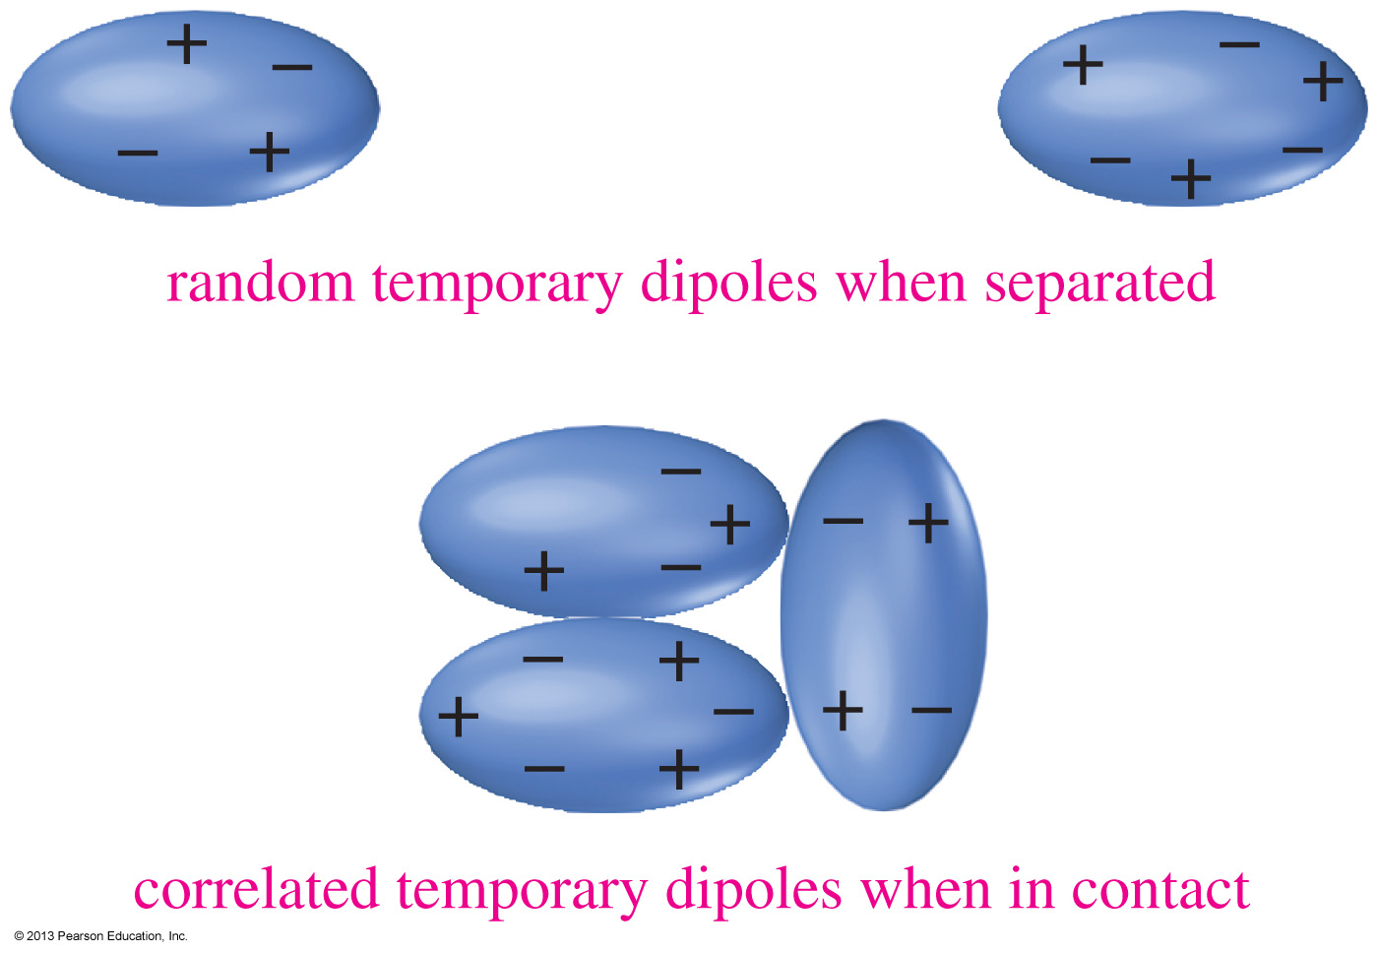
London Dispersions
Chapter 2
17
Notes:
File Name: AAAKPGM0
Figure: 02-24.jpg

Slide 18
Effect of Branching on Boiling Point
The long-chain isomer (n-pentane) has the greatest surface area and therefore the highest boiling point.
As the amount of chain branching increases, the molecule becomes more spherical and its surface area decreases.
The most highly branched isomer (neopentane) has the smallest surface area and the lowest boiling point.
Chapter 2
18
Notes:
File Name: AAAKPGL0
Figure: 02-24-01un.jpg

Slide 19
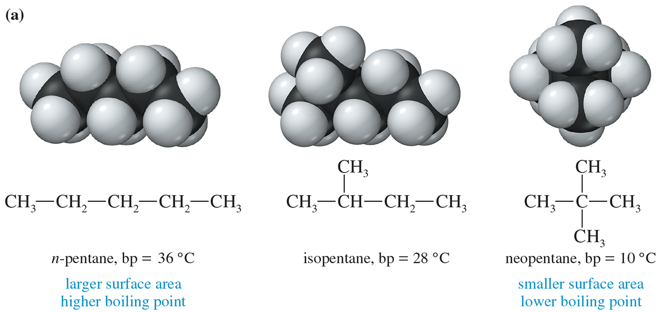
Notes:
Chapter 2, Figure 2.4A

Slide 20
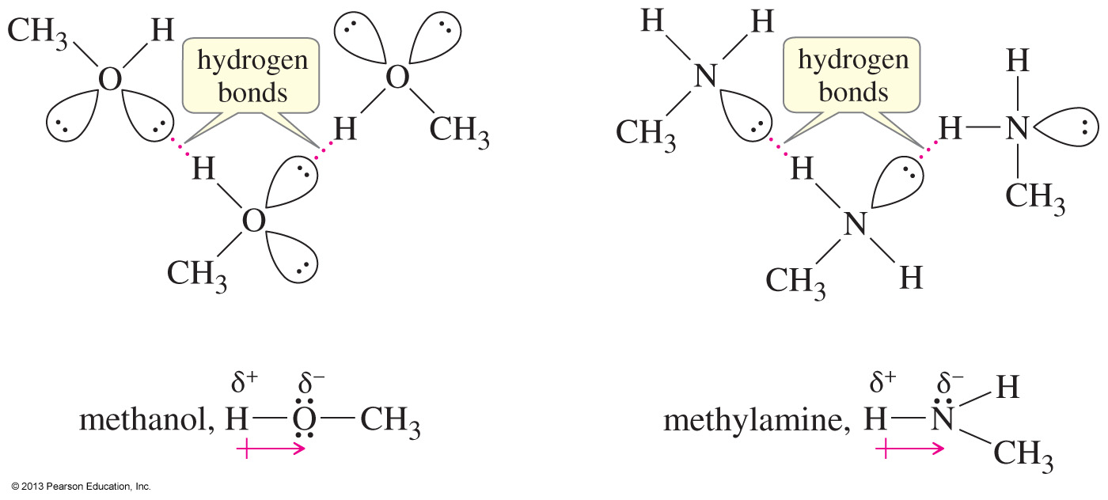
Hydrogen Bonds
Chapter 2
20
Notes:
File Name: AAAKPGO0
Figure: 02-25.jpg

Slide 21
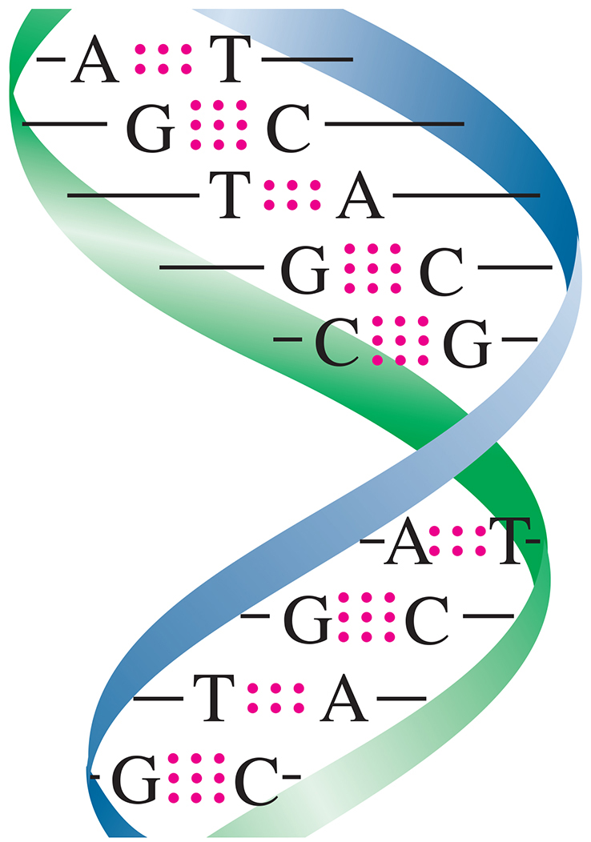
Notes:
Chapter 2, Unnumbered Figure 1, Page 65

Slide 22
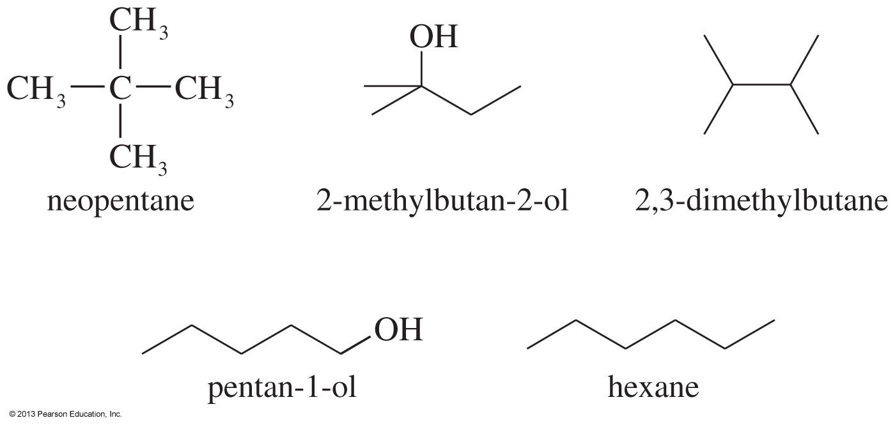
Solved Problem 4
Rank the following compounds in order of increasing boiling points. Explain the reasons for your chosen order.
Chapter 2
22
Notes:
File Name: AAAKPGP0
Figure taken from “Worked Examples” in the IRC
This is Solved problem 2-10, page 65, 8th edition

Slide 23
Solution
To predict relative boiling points, we should look for differences in (1) hydrogen bonding, (2) molecular weight and surface area, and (3) dipole moments. Except for neopentane, these compounds have similar molecular weights. Neopentane is the lightest, and it is a compact spherical structure that minimizes van der Waals attractions. Neopentane is the lowest-boiling compound.
Neither n-hexane nor 2,3-dimethylbutane is hydrogen bonded, so they will be next higher in boiling points. Because 2,3-dimethylbutane is more highly branched (and has a smaller surface area) than n-hexane, 2,3-dimethylbutane will have a lower boiling point than n-hexane.
The two remaining compounds are both hydrogen bonded, and pentan-1-ol has more area for van der Waals forces. Therefore, pentan-1-ol should be the highest-boiling compound. We predict the following order:
neopentane < 2,3-dimethylbutane < n-hexane < 2-methylbutan-2-ol < pentan-1-ol
The actual boiling points are given here to show that our prediction is correct.
10 °C
58 °C
69 °C
102 °C
138 °C
Chapter 2
23
Notes:
Copyright © 2006 Pearson Prentice Hall, Inc.

Slide 24
Polarity Effects on Solubility
Like dissolves like.
Polar solutes dissolve in polar solvents.
Nonpolar solutes dissolve in nonpolar solvents.
Molecules with similar intermolecular forces will mix freely.
Chapter 2
24

Slide 25
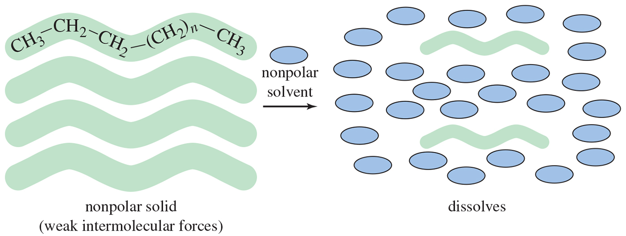
Notes:
Chapter 2, Figure 2.8

Slide 26
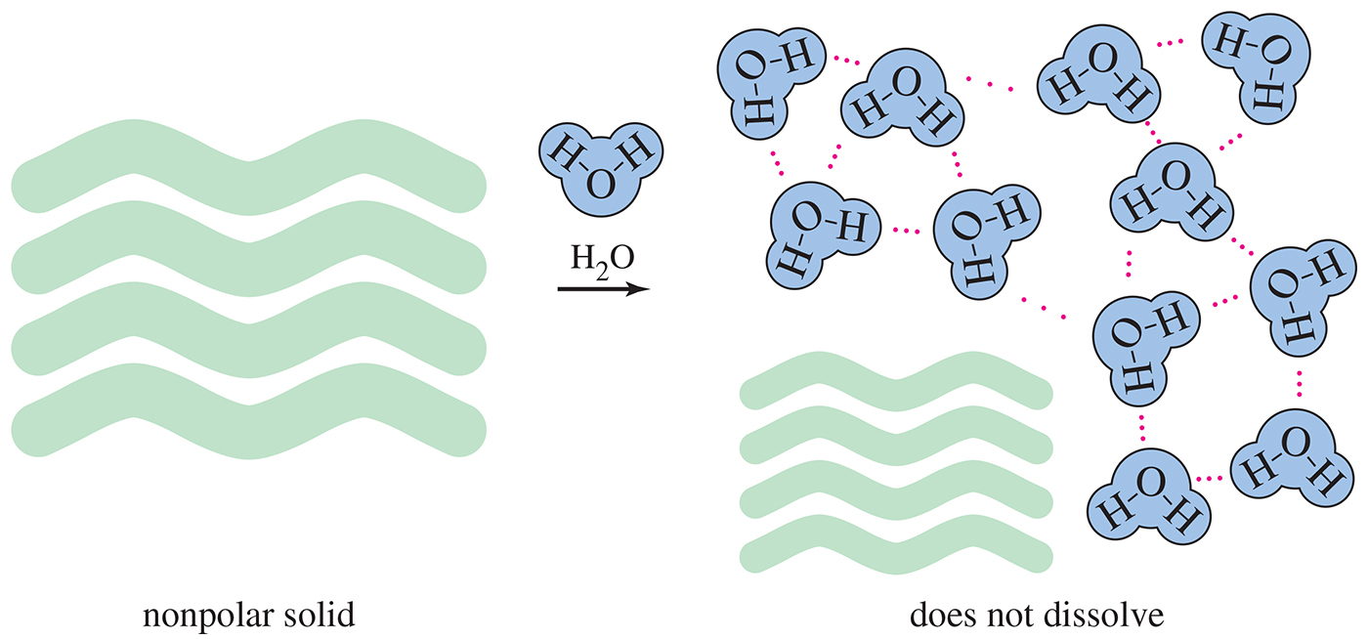
Notes:
Chapter 2, Figure 2.9

Slide 27
Notes:
Chapter 2, Figure 2.10

Slide 28
Definitions of Acids/Bases

Slide 29
Dissociation in H₂O Arrhenius Acid forms H₃O⁺ Bronsted-Lowry Acid donates a H⁺

Slide 30
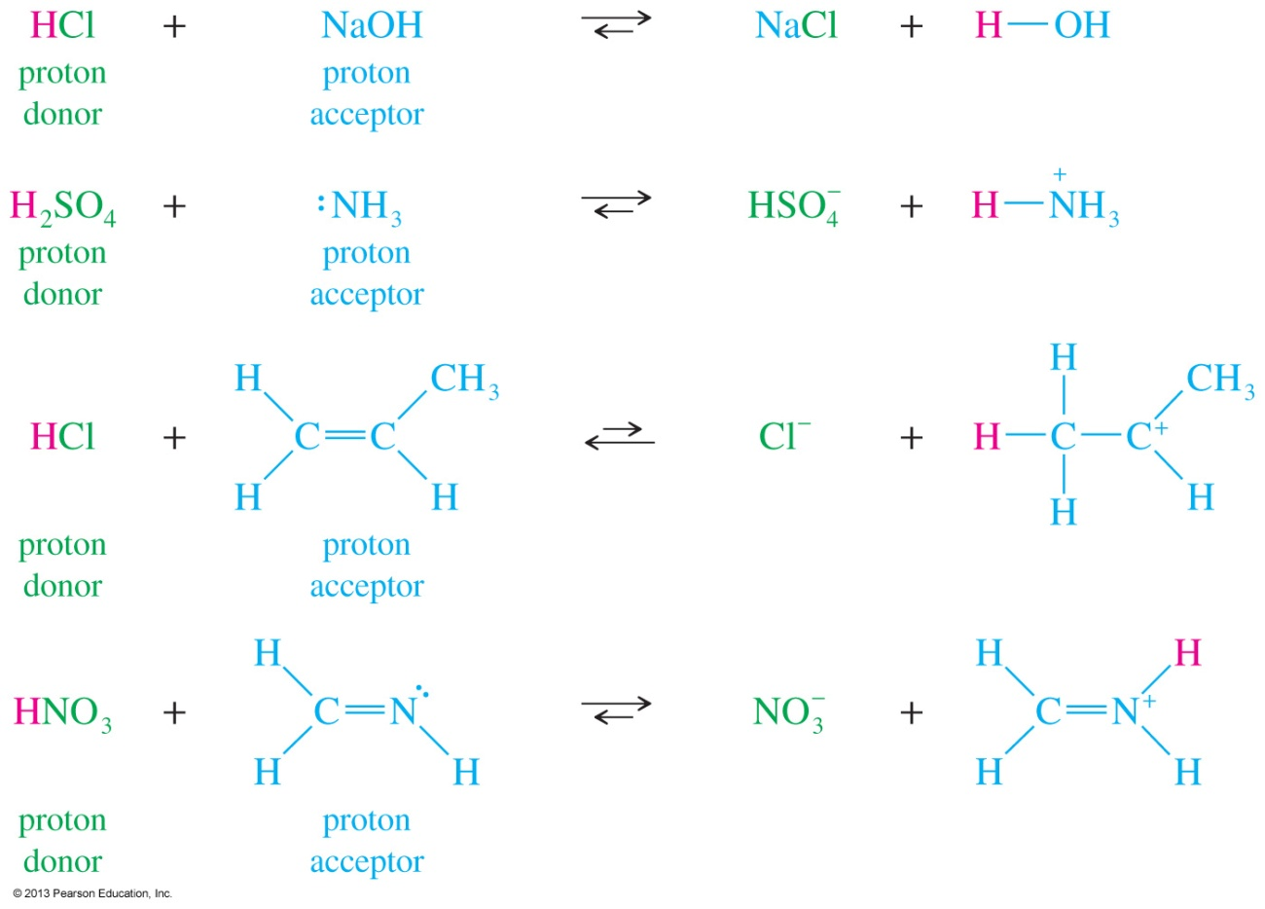
Brønsted-Lowry Acids and Bases
Brønsted-Lowry acids are any species that donate a proton.
Brønsted-Lowry bases are any species that can accept a proton.
Notes:
File Name: AAAKPBJ0
Figure: 01-07-038un.jpg

Slide 31
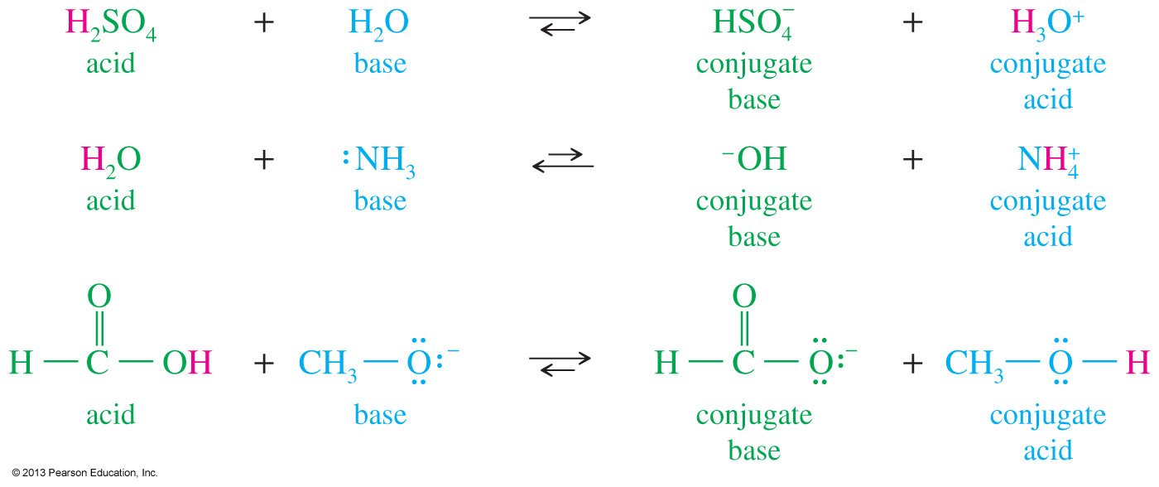
Conjugate Acids and Bases
Conjugate acid: when a base accepts a proton, it becomes an acid capable of returning that proton.
Conjugate base: when an acid donates its proton, it becomes capable of accepting that proton back.
Notes:
File Name: AAAKPBK0
Figure: 01-07-039un.jpg

Slide 32
Acid Strength defined by pK_{a}

Slide 33
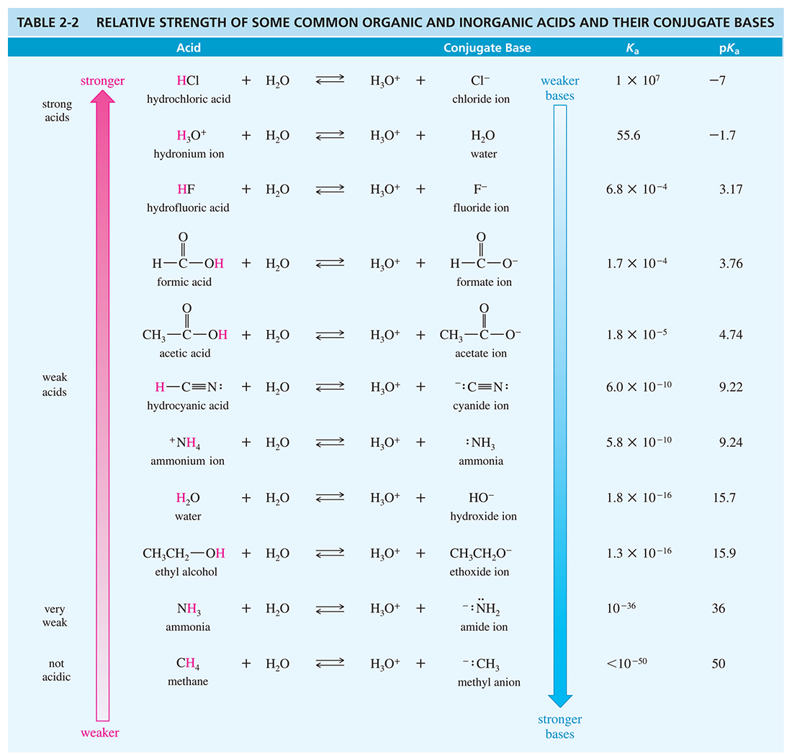
Notes:
Chapter 2, Table 2.2

Slide 34
Stronger Acid Controls Equilibrium

Slide 35
Reaction Described with Arrows

Slide 36
Equilibrium Reactions

Slide 37
Notes:
Chapter 2, Unnumbered Figure 2, Page 73

Slide 38
Notes:
Chapter 2, Unnumbered Figure 2, Page 75

Slide 39
Identify the Acid and Base

Slide 40
Equilibrium Favors Reactants

Slide 41
The Effect of Resonance on pKa

Slide 42
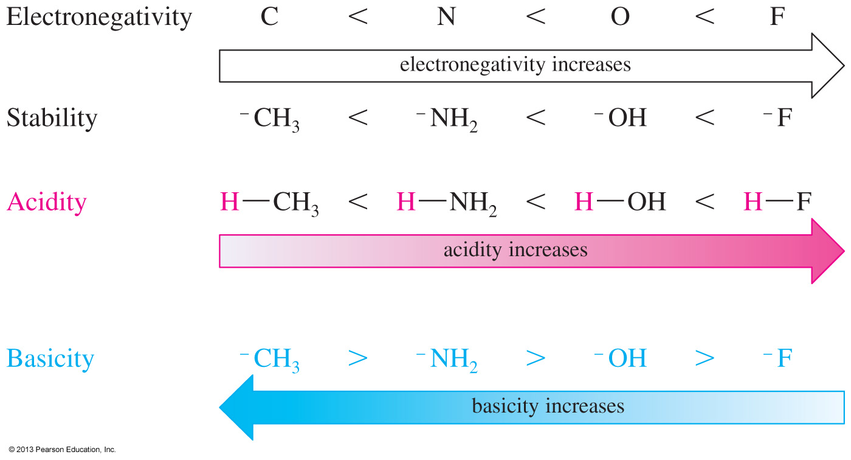
Effect of Electronegativity on pK_{a}
As the bond to H becomes more polarized, H becomes more positive and the bond is easier to break.
Notes:
File Name: AAAKPBV0
Figure: 01-07-052un.jpg

Slide 43
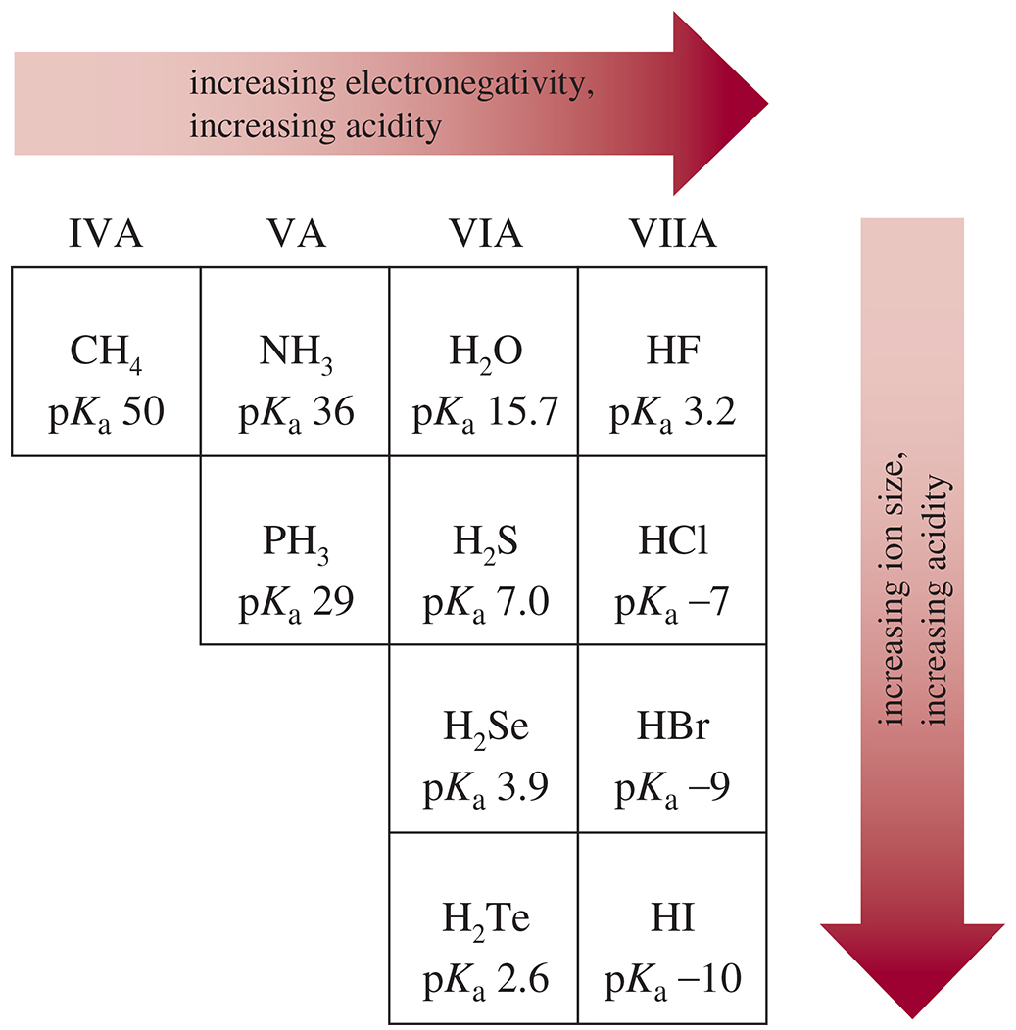
Notes:
Chapter 2, Figure 2.11

Slide 44
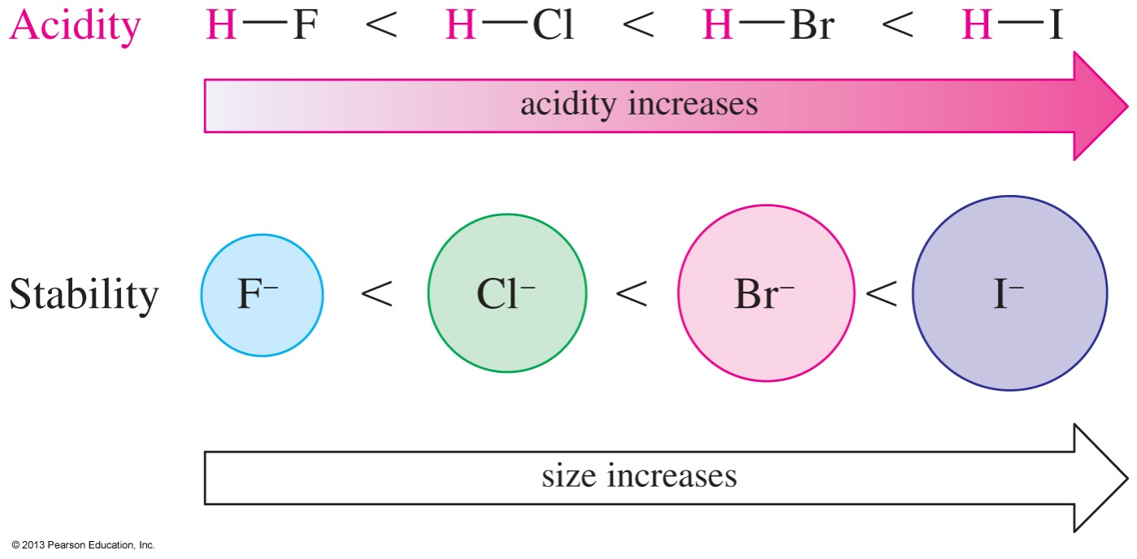
Effect of Size on pK_{a}
As size increases, the H is more loosely held and the bond is easier to break.
A larger size also stabilizes the anion.
Notes:
File Name: AAAKPBV1
Figure: 01-07-052.1UN.jpg

Slide 45
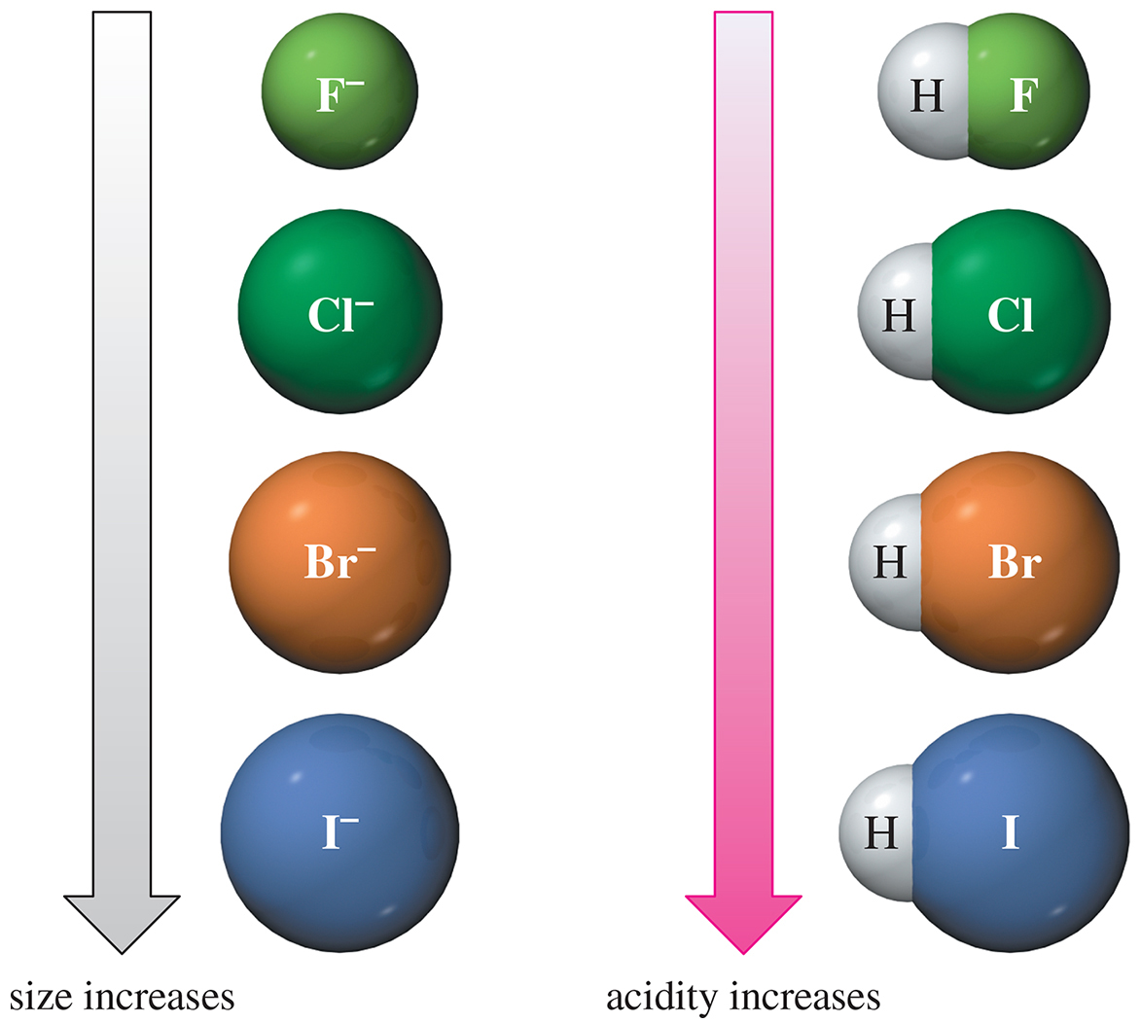
Notes:
Chapter 2, Unnumbered Figure 2, Page 79

Slide 46
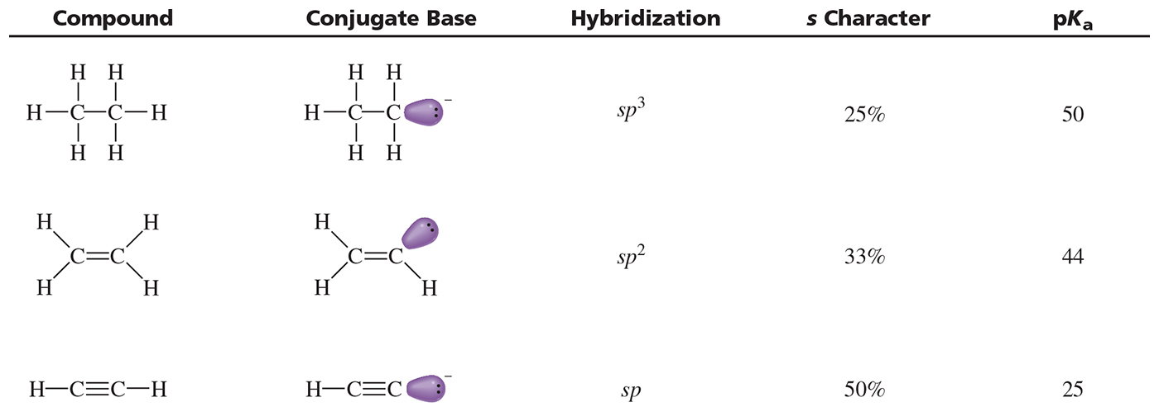
Notes:
Chapter 2, Unnumbered Table, Page 82

Slide 47
Lewis Acids and Lewis Bases
Lewis bases are species with available electrons than can be donated to form a new bond.
Lewis acids are species that can accept these electrons to form new bonds.
Since a Lewis acid accepts a pair of electrons, it is called an electrophile.

Slide 48
Nucleophiles and Electrophiles
Nucleophile: Donates electrons to a nucleus with an empty orbital (same as Lewis Base)
Electrophile: Accepts a pair of electrons (same as Lewis Acid)
When forming a bond, the nucleophile attacks the electrophile, so the arrow goes from negative to positive.
When breaking a bond, the more electronegative atom receives the electrons.

Slide 49
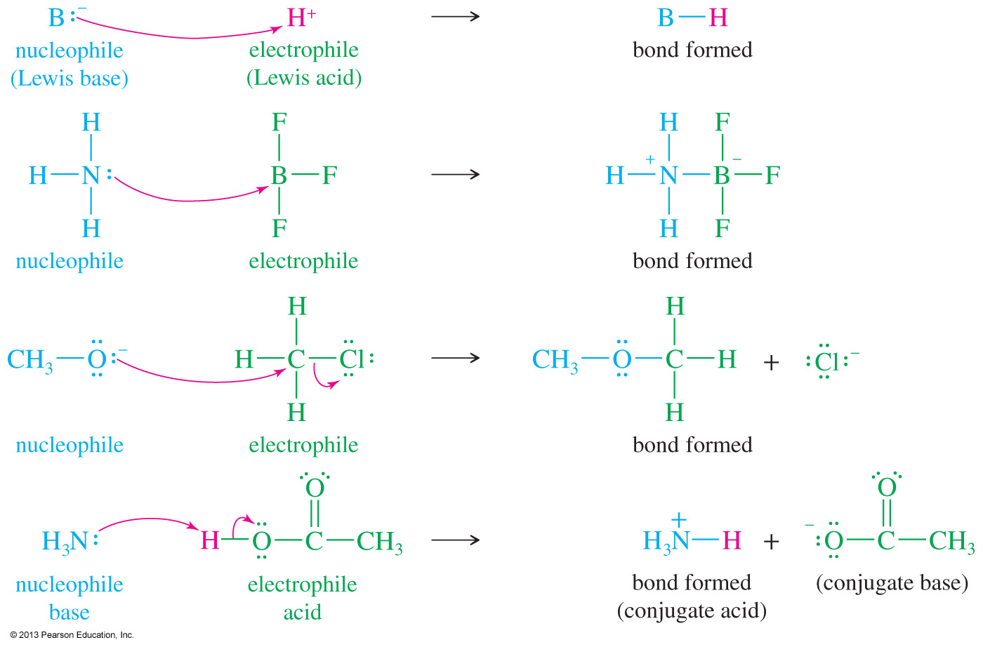
Nucleophiles and Electrophiles
Notes:
File Name: AAAKPBY0
Figure: 01-07-055un.jpg

