Slide 1
Amines
Natural Products and Classification
Nomenclature
Basicity
Preparation
Reactions

Slide 2
Biologically Active Amines
The alkaloids are an important group of biologically active amines, mostly synthesized by plants to protect them from being eaten by insects and other animals.
Many drugs of addiction are classified as alkaloids.

Slide 3
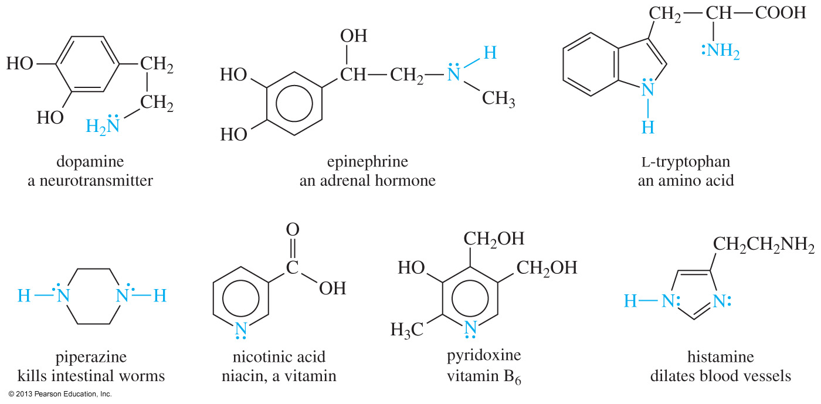
Biological Activity of Amines

Slide 4
Classification of Amines

Slide 5
Quaternary Ammonium Salts
The nitrogen atom has four alkyl groups attached.
The nitrogen is positively charged.

Slide 6
Common Names
Common names of amines are formed from the names of the alkyl groups bonded to nitrogen, followed by the suffix -amine.

Slide 7
Amine as Substituent
On a molecule with a higher-priority functional group, the amine is named as an amino group.

Slide 8
IUPAC Names
Name is based on longest carbon chain containing the amine functional group.
The -e of alkane is replaced with -amine.

Slide 9
Name These Amines

