Slide 1
Your Brain Your Chemistry
Neurotransmitters
(and other Mood Changers)

Slide 2
All Natural – All Organic
Neurotransmitters responsible for: reward pathways, mood, sleep, muscle control, appetite, memory, heart rate, attention span, breathing, fight or flight, general intellectual function, blinking, blood pressure…
Serotonin Epinephrine Dopamine

Slide 3
Nicotine Activates Reward Pathways
Unnatural amounts of Dopamine and Serotonin are released in the brain.
The biochemistry is similar to that created by Cocaine and MDMA (Ecstasy)
Continued ingestion of nicotine creates an attachment to high levels of Dopamine

Slide 4
Happiness at the Molecular Level

Slide 5
The “Bliss” Receptor Anandamide fits; THC fits
Ananda – from the Sanscrit for Bliss
Only discovered 20 years ago, anandamide is a neurotransmitter that is very rarely used, but plays a role in one’s regulation of pain, appetite, anxiety, fertility, depression and memory (studies show that it may induce forgetfulness)
THC fits this receptor perfectly

Slide 6
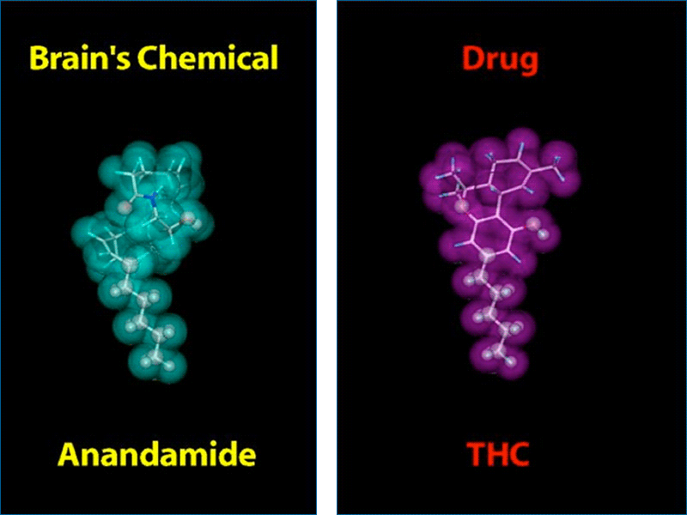
Neurotransmitters and Imposters (i.e. DRUGS)

Slide 7
Designing a Neurotransmitter Oh, My Heart!
Norepinephrine Epinephrine
Methamphetamine Pseudephedrine
(Pseudophed®)
Amphetamine MDMA
(Adderall®) (Ecstasy)

