Slide 1
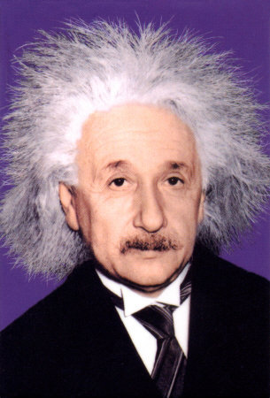
Smart Drugs
“Imagination is more important than knowledge.”
Albert Einstein

Slide 2
Smart Drugs and “Speed”

Slide 3
www.buyprovagilonline.com
Buy Provigil Online 200mg
30 pills $49⁹⁵ Buy Provigil
100 pills $119⁹⁵ Buy Provigil
200 pills $179⁹⁵ Buy Provigil

