Slide 1
Bioinorganic chemistry
Or How “Organic” is Inorganic?

Slide 2
Evolution of life essential elements
Earth solidified ~ 4 billion years ago
81 stable elements
Elements of the living organism:
  Elements with large concentration: 11 elements
  H, C, N, O, Na, Mg, P, S, Cl, K, Ca
  Elements with small concentration : 7 elements
  Mn, Fe, Co, Cu, Zn, I, Mo
  Elements of a few species: 7 elements
  B, F, Si, V, Cr, Se, Sn

Slide 3
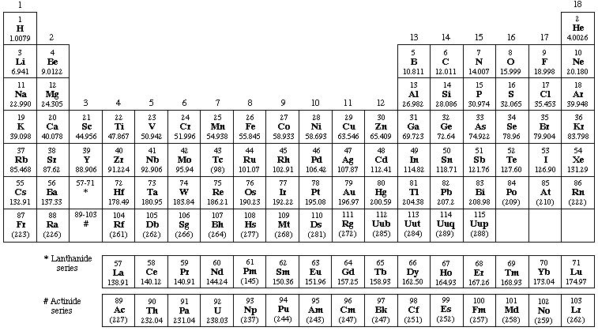
Periodic Table
bulk elements
some species
trace elements

Slide 4
Concentration and physiological effect

Slide 5
Metals

Slide 6
Metals essential for life:
  The role for most is uncertain
  Na, K, Mg, Ca
  V, Cr, Mn, Fe Co, Ni, Cu, Zn
  Mo, W

Slide 7
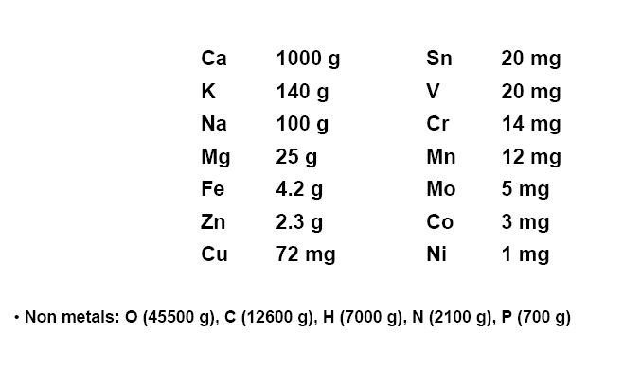
Metal content of a human body (70 kg)

Slide 8
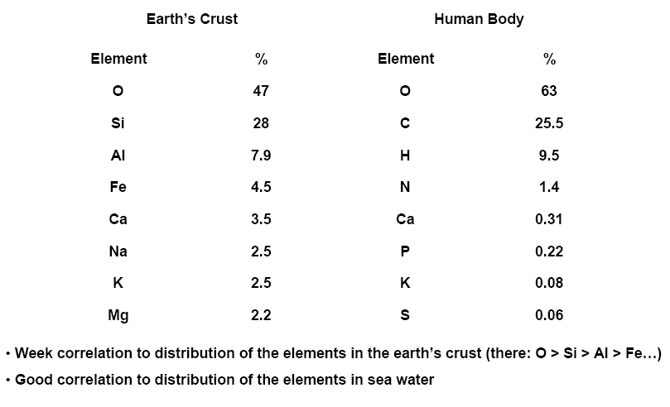
Metal content of a human body (70 kg)

Slide 9
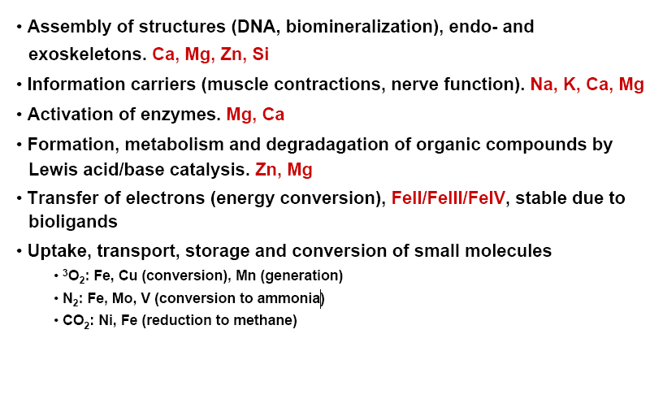
Functions of “inorganic elements”–– summary

Slide 10
General roles of metal ions in biology
Na, K: Charge carriers
        Osmotic and electrochemical gradients
        Nerve function
Mg, Ca: Enzyme activators
        Structure promoters
        Lewis acids
        Mg²⁺: chlorophyll, photosynthesis
        Ca²⁺: insoluble phosphates

Slide 11
Alkali metals
Terrestrial distribution:
Li Na K Rb Cs Fr
0.060 nm 0.133 nm ionic radii
0.095 nm
Distribution in vivo:
(Li) Na K (Rb)

Slide 12
Role: Na⁺
    Extracellular fluid
    Osmotic balance „sodium pump”
    Acid-base balance
    Conformation of proteins
nucleic acids
    Electrical impulse of nerve system
Mg²⁺
3Na⁺_{ic} + 2K⁺_{ec} + ATP⁴⁻ + H₂O 3Na⁺_{ec} + 2K⁺_{ic} + ADP³⁻ + HPO₄²⁻ + H⁺

Slide 13
K⁺
    Enzyme activator
    Conformation of proteins
RNA (replication)
    Secretion of gastric acid
    Transmembrane potentials!
Complexes of alkali metals (Na⁺, K⁺)
Cyclic antibiotics: Valinomycin
Monactin
Nonactin
polyethers
cryptands
synthetic

Slide 14
The valinomycin-potassium complex

Slide 15
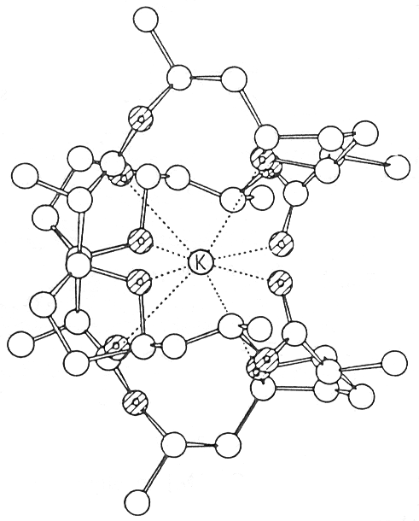
The nonactin-potassium complex

Slide 16
Macrocyclic ligands

Slide 17
Alkaline Earth Metals
Terrestrial distribution:
Be Mg Ca Sr Ba Ra
Distribution in vivo:
Mg Ca
Be, Ba TOXIC!
Sr (not particularly toxic)
⁹⁰Sr accumulates in bones

Slide 18
Alkaline Earth Metals
Mg²⁺
    Plants chlorosis
CHLOROPHYLL
    nervous system (tetany)
    active transport (intracellular)
    enzyme activator (e.g. ATP-ase)
    Ca²⁺ antagonist
Ca²⁺
    Inhibits Mg²⁺⁻activated enzymes
    Extracellular: clotting (10⁻³M)
Ca²⁺
prothrombin thrombin-fibrinogen-fibrin

Slide 19
Chlorophyll
The mechanism of the phosphate hydrolysis

Slide 20
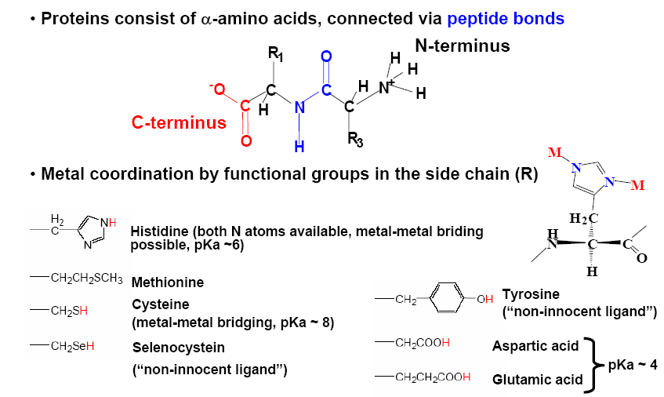
Proteins - Ligands

Slide 21
Transition Metals

Slide 22
Other metal ions: less well defined and more obscure roles
Fe, Cu, Mo: Electron-transfer
        Redox proteins and enzymes
        Oxygen carrying proteins
        Nitrogen fixation
Zn: Metalloenzymes
        Structure promoters
        Lewis acid
        Not a redox catalyst!

Slide 23
Fe(II), Fe(III):
Essential for ALL organisms
In plants: iron deficiency
In human body: 4-5 g
Uptake: ~ 1 mg/day

Slide 24
In human body
75% Hem-iron
Hemoglobin
Myoglobin
Cytochromes
Oxidases, P-450
25% Non-hem-iron
Rubredoxins
Ferredoxins

Slide 25
Cu(I), Cu(II)
Plants Electron transfer
Animals O₂-carrying
Protection of DNA
from O₂⁻
Cu-proteins and enzymes
Cytochrome oxidase O₂ H₂O
Tyrosinase, phenol oxidase ox. of phenols
Ceruloplasmin Fe(II) Fe(III)
Blue proteins Electron transfer
Superoxide dismutase Elimination of O₂⁻
Hemocyanin O₂ transport

Slide 26
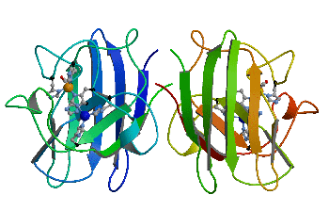
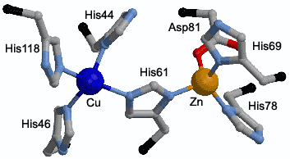
Superoxide Dismutase
SOD-Cu²⁺ + O₂^{.-} ⇒ SOD-Cu¹⁺ + O₂
SOD-Cu¹⁺ + O₂^{.-} + 2H⁺ ⇒ SOD-Cu²⁺ + H₂O₂

Slide 27
Role of Zn²⁺ :
deficiency:
    disturbances of repr. system
    dwarfism
    skin lesions
    skeletal abnormalities

Slide 28
(Cys – X – Cys)₇
x=nonaromatic amino acid
Zn – metalloenzymes: 80!
Zn activated enzymes: 20!
S
(H₂O)₍₁₋₂₎
N
(H₂O)₍₁₋₂₎
O
Zn
Zn
Zn
C
N
S(N)
N
S
S
S(N)
S
O

Slide 29
Function of Zn in metalloenzymes
Structure-promoter
Substrate binder
Lewis acid

Slide 30
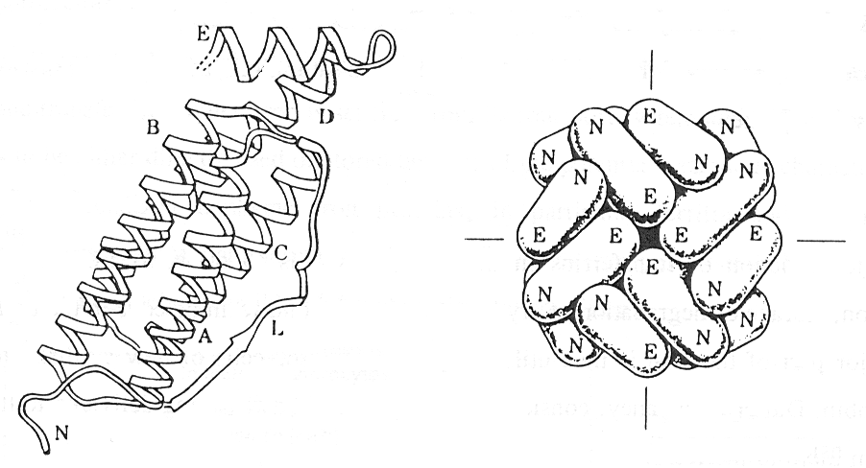
Outlined structure of apoferritin

Slide 31
Iron(II)-protoporfirin IX-complex (HEM)

Slide 32
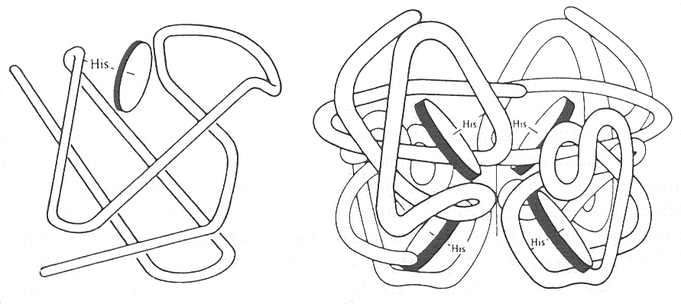
Myoglobin
Hemoglobin

Slide 33
Catalytic cycle of P-450 enzymes
H₂O
ROH
RH
H₂O
H₂O
+ A
e⁻
+ AO
2 H⁺
e⁻
³O₂

Slide 34
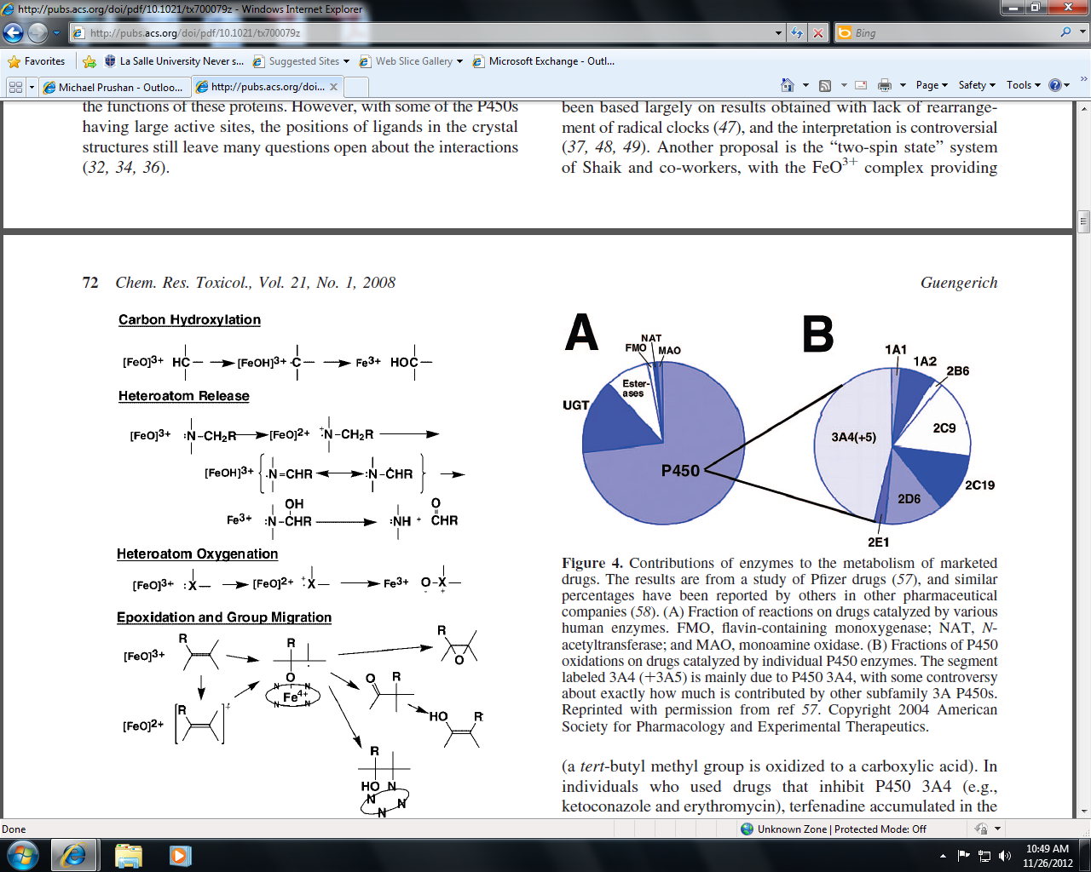

Slide 36
Zink(II) in the active centre of carboxipeptidase-A
The active centre of the alcohol dehydrogenase

Slide 37
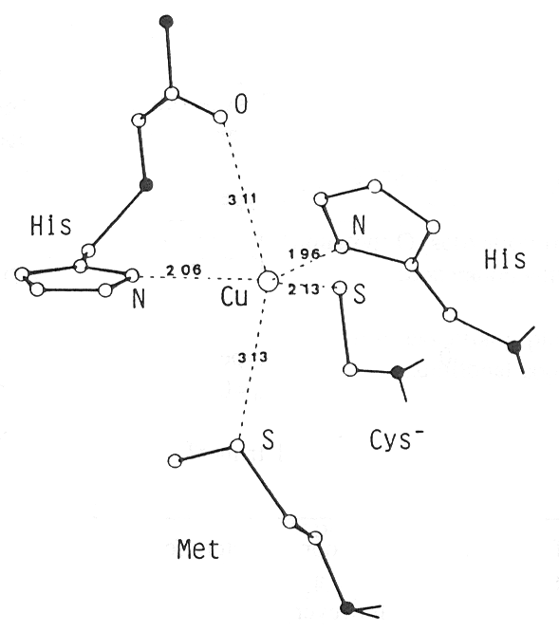
Coordination environment of the copper centre in azurin

Slide 38
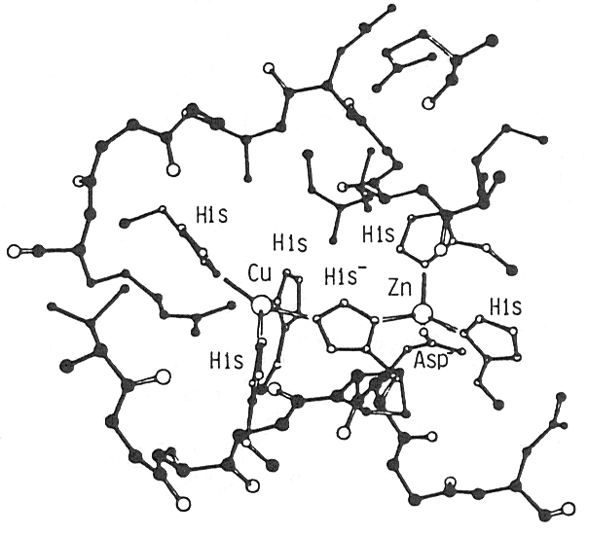
Reversible oxygenation of hemocyanin
A tour of hemocyanin
Structure of dimetal center in Cu-Zn superoxide dismutase

Slide 39
Supposed structure of Fe-S-Mo cofactor of nitrogenase
12 ATP
12 ATP
N₂
3 Ferredoxin
(oxidized)
Fe protein
(reduced)
Fe protein
(reduced)
Fe-Mo protein
(oxidized)
N₂
3 NADH + 3H⁺
Fe-Mo protein
(oxidized)
3 NAD⁺
3 Ferredoxin
(reduced)
12 ATP
Fe protein
(oxidized)
Fe protein
(oxidized)
Fe-Mo protein
(reduced)
2 NH₃
12 ADP + 12 P_{i}
6 H⁺
The supposed reaction mechanism of dinitrogenase

Slide 40
Coordination environment of the Cr³⁺ center in the glucose tolerance factor
Approx. 30 µg
Required daily

