Slide 1
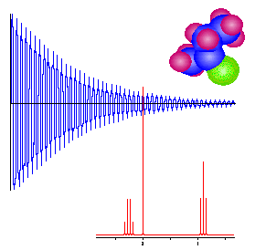
NMR
Nuclear Magnetic Resonance Spectroscopy

Slide 2
Nuclear Magnetic Resonance Spectroscopy
Over the past fifty years nuclear magnetic resonance spectroscopy, commonly referred to as nmr, has become the preeminent technique for determining the structure of organic compounds.
Of all the spectroscopic methods, it is the only one for which a complete analysis and interpretation of the entire spectrum is normally expected.
Although larger amounts of sample are needed than for mass spectroscopy, nmr is non-destructive, and with modern instruments good data may be obtained from samples weighing less than a milligram.
To be successful in using nmr as an analytical tool, it is necessary to understand the physical principles on which the methods are based.

Slide 3
Nuclear Spin
H
Hydrogen Nucleus
has “spin” A.K.A. spin angular momentum
A.K.A. nuclear magnetic dipole moment
The nuclear spin will align with an external magnetic field
Larmor Frequency
ω= γB_{o}
1/2 γB_{o}h
H
γB_{o}h
B_{o} = 2.34 Tesla (100 MHz)
-1/2 γB_{o}h

Slide 4
Apply an external magnetic field
(i.e., put your sample in the magnet)
z
ω
ω = γ B_{o} = ν/2π
ω - resonance frequency
in radians per second,
also called Larmor frequency
ν - resonance frequency
in cycles per second, Hz
γ - gyromagnetic ratio
B_{o} - external magnetic
field (the magnet)
μ
B_{o}
μ
Spin 1/2 nuclei will have two
orientations in a magnetic field
+1/2 and -1/2.
ω

Slide 5
Net magnetic moment
z
ω
μ
+1/2
B_{o}
-1/2
μ
ω

Slide 6
Ensemble of Nuclear Spins
B_{o}
B_{o} = 0
B_{o} > 0
Randomly oriented
Highly oriented
N
S
Each nucleus behaves like
a bar magnet.

Slide 7
Allowed Energy States for a
Spin 1/2 System
ΔE = γ h B_{o} = h ν
-1/2
antiparallel
E
ΔE
+1/2
parallel
B_{o} = 0
B_{o} > 0
Therefore, the nuclei will absorb light with energy ΔE resulting in
a change of the spin states.

Slide 8
Ensemble of Nuclear Spins
Larmor Frequency
ω= γB_{o}
1/2 γB_{o}h
γB_{o}h
-1/2 γB_{o}h
B_{o} = 2.34 Tesla (100 MHz)
magnetic energy
T = 300 K
thermal energy
Boltzmann Factor

Slide 9
Increase spin excess of ground state by lowering the temperature
Larmor Frequency
ω= γB_{o}
Increases the magnetization of the sample
1/2 γB_{o}h
γB_{o}h
-1/2 γB_{o}h
B_{o} = 2.34 Tesla (100 MHz)
magnetic energy
T = 150 K
thermal energy
Boltzmann Factor

Slide 10
Magnetization increase at RT
Larmor Frequency
ω= γB_{o}
1/2 γB_{o}h
γB_{o}h
-1/2 γB_{o}h
B_{o} = 2.34 Tesla (100 MHz)
magnetic energy
T = 300 K
thermal energy
Boltzmann Factor

Slide 11
Magnetization increase at RT
Larmor Frequency
ω= γB_{o}
1/2 γB_{o}h
γB_{o}h
B_{o} = 4.7 Tesla (200 MHz)
-1/2 γB_{o}h
T = 300 K

Slide 12
Magnetization increase at RT
Larmor Frequency
ω= γB_{o}
1/2 γB_{o}h
γB_{o}h
B_{o} = 9.4 Tesla (400 MHz)
-1/2 γB_{o}h
T = 300 K

Slide 13
Larmor Frequency
ω= γB_{o}
1/2 γB_{o}h
γB_{o}h
-1/2 γB_{o}h
B_{o} = 2.34 Tesla (100 MHz)
magnetic energy
T = 300 K
thermal energy
Boltzmann Factor

Slide 14
Larmor Frequency
ω= γB_{o}
Z
y
γ depends on
the nucleus
ω
x
= gyromagnetic (or magnetogyric )
ratio
B_{o}
Magnetization is first vertically aligned
Magnetization is then realigned
Procession freq. is proportional to magnetic field

Slide 15
gyromagnetic ratio table
Nucleus | γ / 10⁶ rad s⁻¹ T⁻¹ | γ/2π / MHz T⁻¹
¹H | 267.513 | 42.576
²H | 41.065 | 6.536
³He | -203.789 | -32.434
⁷Li | 103.962 | 16.546
¹³C | 67.262 | 10.705
¹⁴N | 19.331 | 3.077
¹⁵N | -27.116 | -4.316
¹⁷O | -36.264 | -5.772
¹⁹F | 251.662 | 40.053
²³Na | 70.761 | 11.262
³¹P | 108.291 | 17.235
¹²⁹Xe | -73.997 | -11.777
Largest value and
therefore the most
sensitive nucleus
For NMR.
4 X less
sensitive

Slide 16
Larmor Frequency
ω= γB_{o}
Z
ω
y
γ depends on
the nucleus
x
= gyromagnetic (or magnetogyric )
ratio
B_{o}
Magnetization is first vertically aligned
Magnetization is then realigned
Procession freq. is proportional to magnetic field

Slide 17
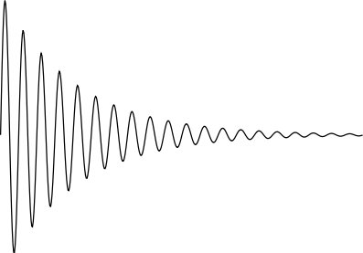
Larmor Frequency
ω= γB_{o}
Z
ω
y
x
Magnetic Coils
FID
B_{o}
Magnetic Coils pick up induced voltage from the processing spins
and produces the FID (Free Induction Decay)

Slide 18
Free Induction Decay
The signals decay away due to interactions with the surroundings.
A free induction decay, FID, is the result.
Fourier transformation, FT, of this time domain signal
produces a frequency domain signal.
FT
Frequency
Time

Slide 20
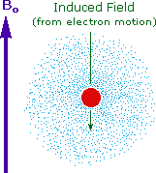
Why should the proton nuclei in different compounds behave differently in the nmr experiment ?
The answer to this question lies with the electron(s) surrounding the proton in covalent compounds and ions. Since electrons are charged particles, they move in response to the external magnetic field (Bo) so as to generate a secondary field that opposes the much stronger applied field.
This secondary field shields the nucleus from the applied field, so Bo must be increased in order to achieve resonance (absorption of rf energy).

Slide 21
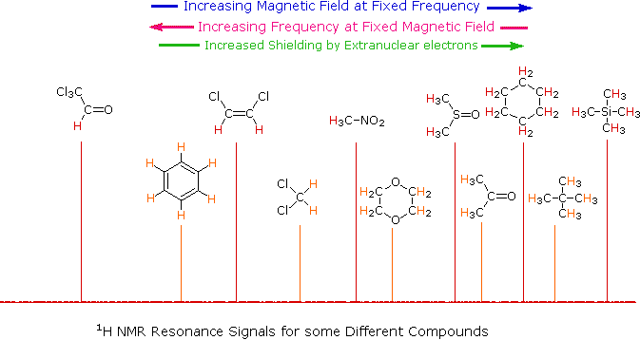

Slide 22
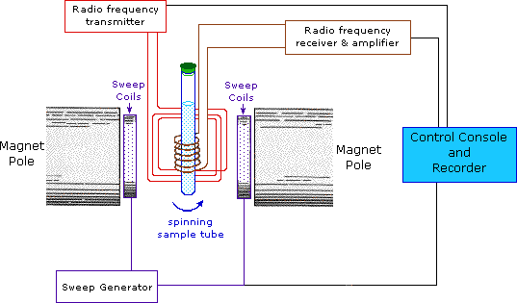

Slide 23
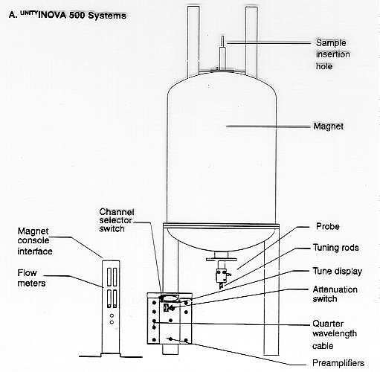

Slide 24
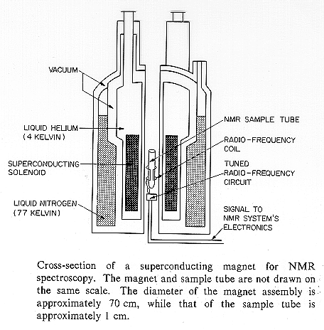

Slide 25
