Slide 1
Applications of Spectrophotometry
(Chapter 19)

Slide 2
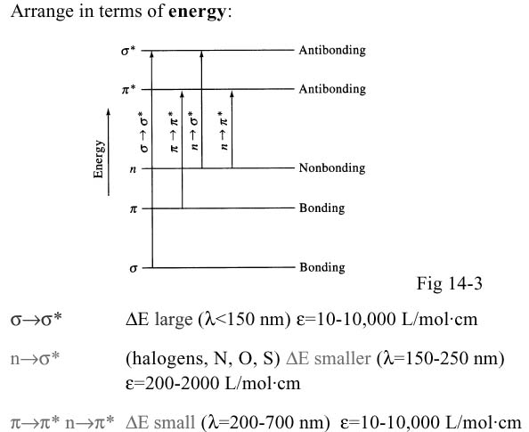

Slide 3
Red shift of λ_{max} with increasing conjugation
CH₂=CHCH₂CH₂CH=CH₂ λ_{max} =185 nm
CH₂=CHCH=CH₂ λ_{max} =217 nm
vs.
Red shift of λ_{max} with # of rings
Benzene λ_{max} =204 nm
Naphthalene λ_{max} =286 nm

Slide 4
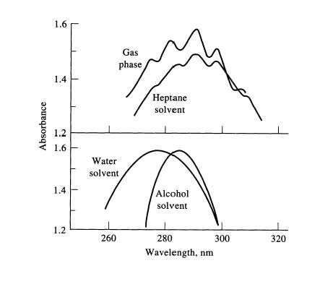
Polar solvents more likely to shift absorption maxima
Shifts of λ_{max} with solvent polarity
n→π* hypsochromic/blue shift
π→π* bathochromic/red shift

Slide 5
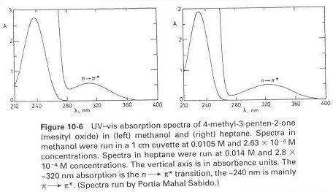
Hypsochromic shift
methanol
heptane

Slide 6
Generally, extending conjugation leads to red shift
“particle in a box” QM theory; bigger box
Substituents attached to a chromophore that cause a red shift are called “auxochromes”
Strain has an effect…
λ_{max} 253 239 256 248

Slide 7
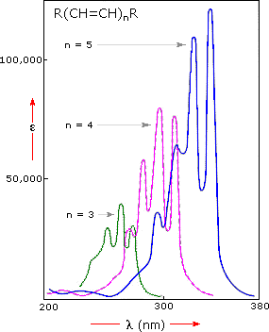
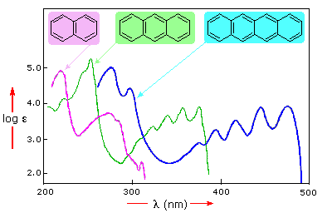
Generally, extending conjugation leads to red shift
“particle in a box” QM theory; bigger box

Slide 8
Determination of Concentration – Multicomponent System
Absorbance
C
B
λ₁
λ₂
Wavelength (nm)
Absorbance
C+B
λ₁
λ₂
Wavelength (nm)

Slide 9
Determination of Concentration – Multicomponent System
Absorbance
C
B
λ₁
λ₂
Wavelength (nm)
(1) Measure ε_{B} and ε_{C} at λ₁ and λ₂ (pure substances)

Slide 10
Determination of Concentration – Multicomponent System
(2) Measure A at λ₁ and λ₂ (mixture)
Absorbance
C+B
λ₁
λ₂
Wavelength (nm)

Slide 11
Determination of Concentration – Multicomponent System
A₁ = xε_{B1} + yε_{C1}
A₂ = xε_{B2} + yε_{C2}
x = molarity B
y = molarity C
Absorbance
C+B
λ₁
λ₂
Wavelength (nm)

Slide 12
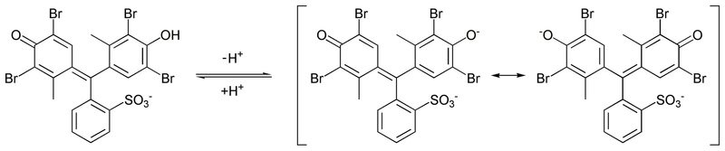
Isobestic Points
HIn (acid form)
In⁻ (base form)
Brocresol green
When one absorbing species is converted to another, it is apparent in the
absorption spectrum.

Slide 13
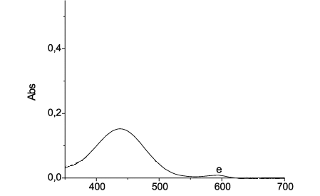
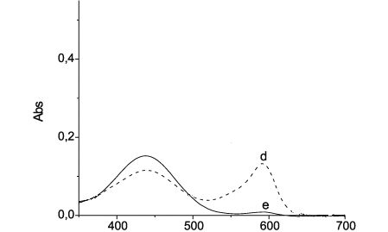
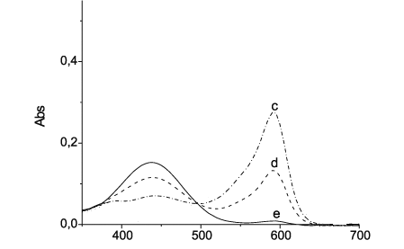
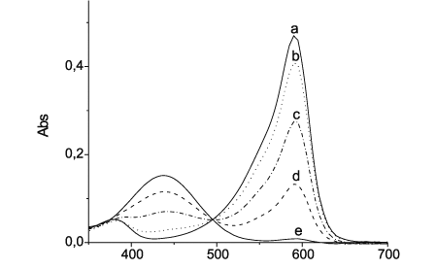
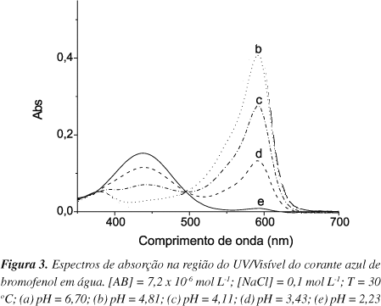

Isobestic Points
pH
[H⁺]
pH
[OH⁻]
I see an isobestic point!!!

Slide 14
Isobestic Points
HIn (acid form)
In⁻ (base form)
The Total concentration of Bromocresol Green is constant throughout the reaction
[Hin] + [In⁻] = F _{bromocresol green}
C_{x} + C_{y} = C
A = b (ε_{x}C_{x} + ε_{y}C_{y})
But at the isosbestic point both molar absorptivities are the same!
ε_{x} + ε_{y} = ε

Slide 15
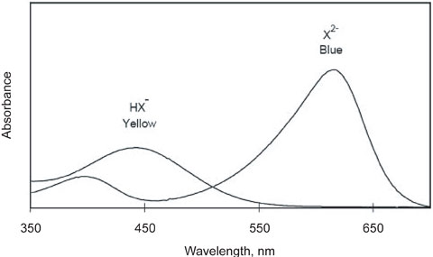
Isobestic Points
HIn (acid form)
In⁻ (base form)
ε_{x} + ε_{y} = ε
Therefore, the absorbance does not depend on the extent of reaction
(i.e. on the particular concentrations of x and y)
A = b (ε_{x}C_{x} + ε_{y}C_{y}) = b ε (C_{x} + C_{y}) = b ε C
An isobestic point is good evidence that only two principal species
are present in a reaction.

Slide 16
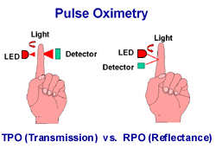
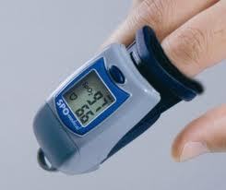
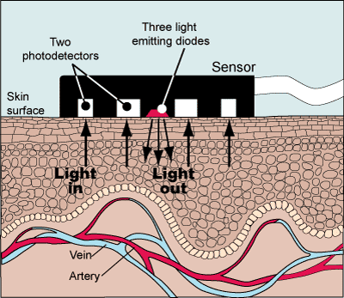
Isobestic Points - Application
Oximetry

Slide 17
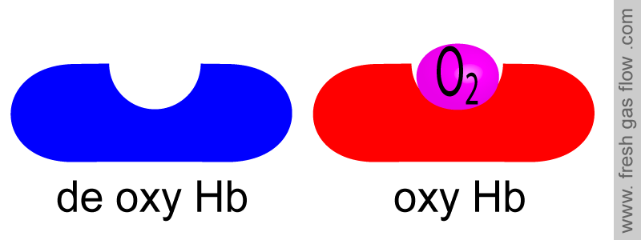
O₂
Hb
HbO₂
deoxyhemoglobin
Oxyhemoglobin
100 % O₂
0 % O₂

Slide 18
Measuring the equilibrium constant
(The Scatchard Plot)
Biochemistry example: The cellular action of a hormone begins when the hormone (L)
Binds to it’s receptor protein (R) in a tight and specific way.
The binding thus gives rise to conformational changes which change the biological activity
of the receptor (an enzyme, an enzyme regulator, an ion channel,
or a regulator of gene expression.
R + L
RL
The binding depends of the concentration of the concentration of the components.
K_{a} is the association constant and K_{d} is the dissociation constant

Slide 19
Measuring the equilibrium constant
(The Scatchard Plot)
When binding has reached equilibrium, the total number of binding sites, B_{max} = [R] + [RL]
whereas, the number of unbound sites would be [R] = B_{max} – [RL].
The equilibrium constant would then be
This expression can then be rearranged to find the ratio of bound to unbound (free) hormone

Slide 20
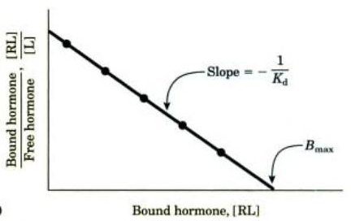
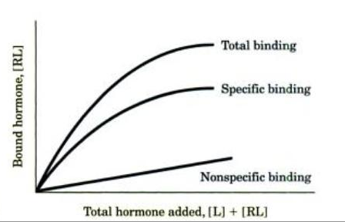
Measuring the equilibrium constant
(The Scatchard Plot)

Slide 21
The method of continuous variation (for isomolar solution)
(Job’s method)
A + n B
AB_{n}
Call this C
Absorbance
Allows for the determination
of the stoichiometry of the
Predominant product.
0
1
Mole fraction (χ = n_{b} / n_{a} + n_{b})

Slide 22
The method of continuous variation (for isomolar solution)
(Job’s method)
Requirements:
The system must conform to Beer's law.
Only single equilibrium
Equimolar solutions M_{A} = M_{B}
Constant volume 1 = V_{T} = V_{A} + V_{B}
K reasonably greater than 1
pH and ionic strength must be maintained constant

Slide 23
The method of continuous variation (for isomolar solution)
(Job’s method)
A + n B
C
Start
M(1-x)
Mx
0
Change
-C
-nC
+C
Equil.
M(1-x)-C
Mx-nC
C
M(1-x) is a concentration

Slide 24
Corrected Absorbance
A₃X
AX
AX₂
0
0.25
0.5
0.66
1
Mole fraction (χ = n_{b} / n_{a})

